Slide 1
Polynomial Optimization over the Unit Sphere
Vijay Bhattiprolu (CMU)
Mrinal Ghosh (TTIC)
Venkat Guruswami (CMU)
Euiwoong Lee (CMU / Simons)
Madhur Tulsiani (TTIC)

Slide 2
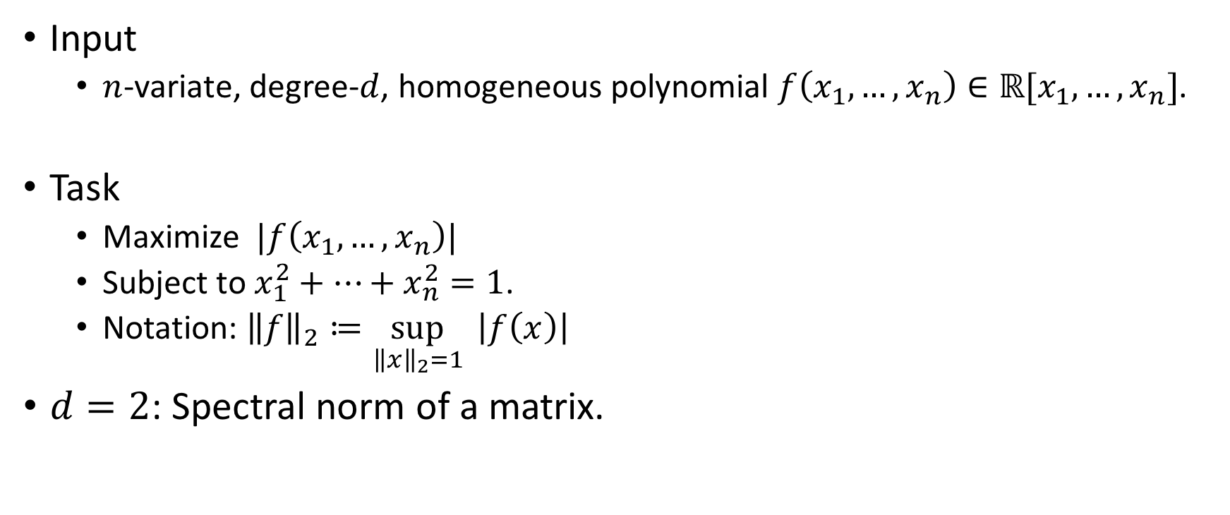
Problem
Input
  $n$-variate, degree-$d$, homogeneous polynomial $f\left(x_{1},…, x_{n}\right)∈ℝ[x_{1},…,x_{n}]$.
Task
  Maximize $|f\left(x_{1},…, x_{n}\right)|$
  Subject to $x_{1}^{2}+…+x_{n}^{2}=1$.
  Notation: ${\left\|f\right\|}_{2}≔\sup_{{\left\|x\right\|}_{2}=1}{ \left|f\left(x\right)\right|}$
$d=2$: Spectral norm of a matrix.

Slide 3
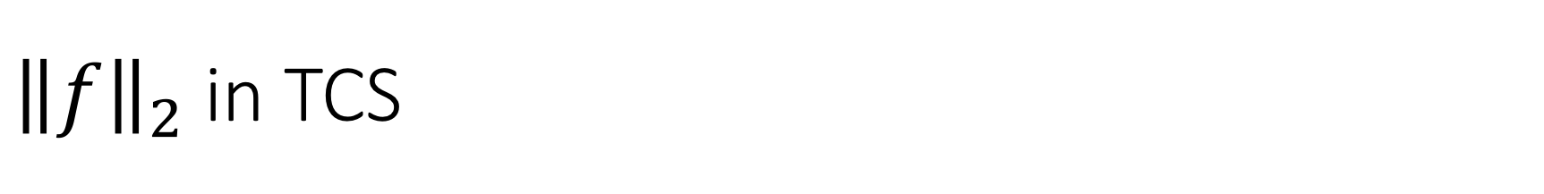
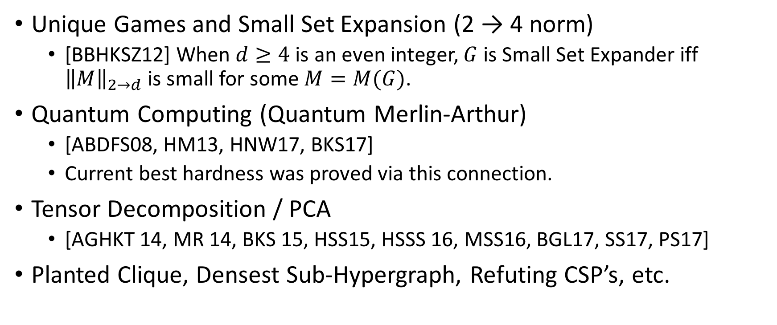
${\left\|f\right\|}_{2}$ in TCS
Unique Games and Small Set Expansion (2 → 4 norm)
  [BBHKSZ12] When $d≥4$ is an even integer, $G$ is Small Set Expander iff ${\left\|M\right\|}_{2→d}$ is small for some $M=M(G)$.
Quantum Computing (Quantum Merlin-Arthur)
  [ABDFS08, HM13, HNW17, BKS17]
  Current best hardness was proved via this connection.
Tensor Decomposition / PCA
  [AGHKT 14, MR 14, BKS 15, HSS15, HSSS 16, MSS16, BGL17, SS17, PS17]
Planted Clique, Densest Sub-Hypergraph, Refuting CSP’s, etc.

Slide 4
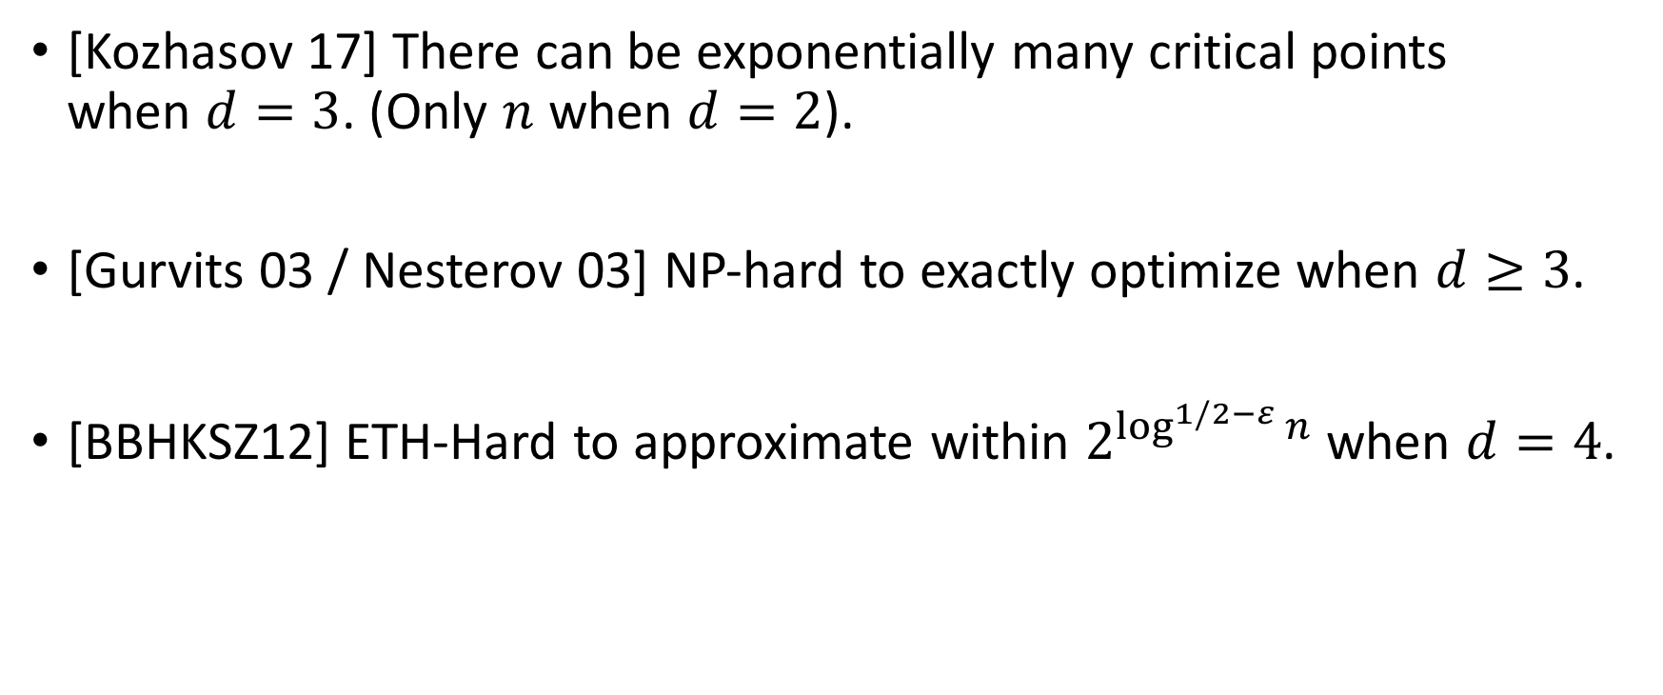
Complexity
[Kozhasov 17] There can be exponentially many critical points
when $d=3$. (Only $n$ when $d=2$).
[Gurvits 03 / Nesterov 03] NP-hard to exactly optimize when $d≥3$.
[BBHKSZ12] ETH-Hard to approximate within $2^{\log^{1/2−ε}{n}}$ when $d=4$.

Slide 5


Approximability $(d=O\left(1\right))$
Approximation Ratio [KN08, HLZ11, So13, …]: $\tilde{O}(n^{d/2−1})$.
$O(n/ε)$-degree SoS Hierarchy gives (1 + $ε$)-approximation [DW13].
  Holds for $Ω(n)$-degree.

Slide 6
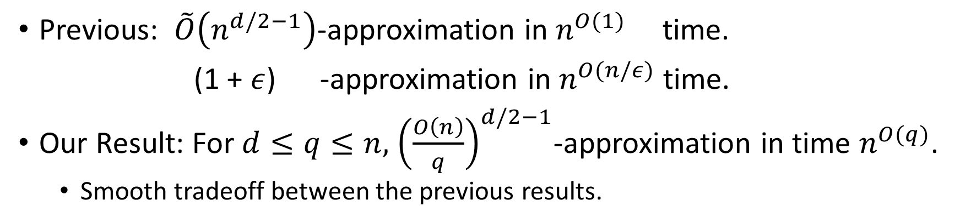







Our Result ($d=O(1)$)
Previous: $\tilde{O}\left(n^{d/2−1}\right)$-approximation in $n^{O(1)}$ time.
(1 + $ε$) -approximation in $n^{O(n/ε)}$ time.
Our Result: For $d≤q≤n,$ ${\left(\frac{O\left(n\right)}{q}\right)}^{d/2−1}$-approximation in time $n^{O(q)}$.
  Smooth tradeoff between the previous results.
$$approx. ratio$$
$$n^{\frac{d}{2}−1}$$
$$1+ε$$
$$runtime$$
$$n^{O(1)}$$
$$n^{O(n/ε)}$$

Slide 7


Our Result ($d=O(1)$)
Previous: $\tilde{O}\left(n^{d/2−1}\right)$-approximation in $n^{O(1)}$ time.
(1 + $ε$) -approximation in $n^{O(n/ε)}$ time.
Our Result: For $d≤q≤n,$ ${\left(\frac{O\left(n\right)}{q}\right)}^{d/2−1}$-approximation in time $n^{O(q)}$.
  Smooth tradeoff between the previous results.
$$approx. ratio$$
$$n^{\frac{d}{2}−1}$$
$$O(1)$$
$$1+ε$$
$$runtime$$
$$n^{O(1)}$$
$$n^{n}$$
$$n^{O(n/ε)}$$

Slide 8
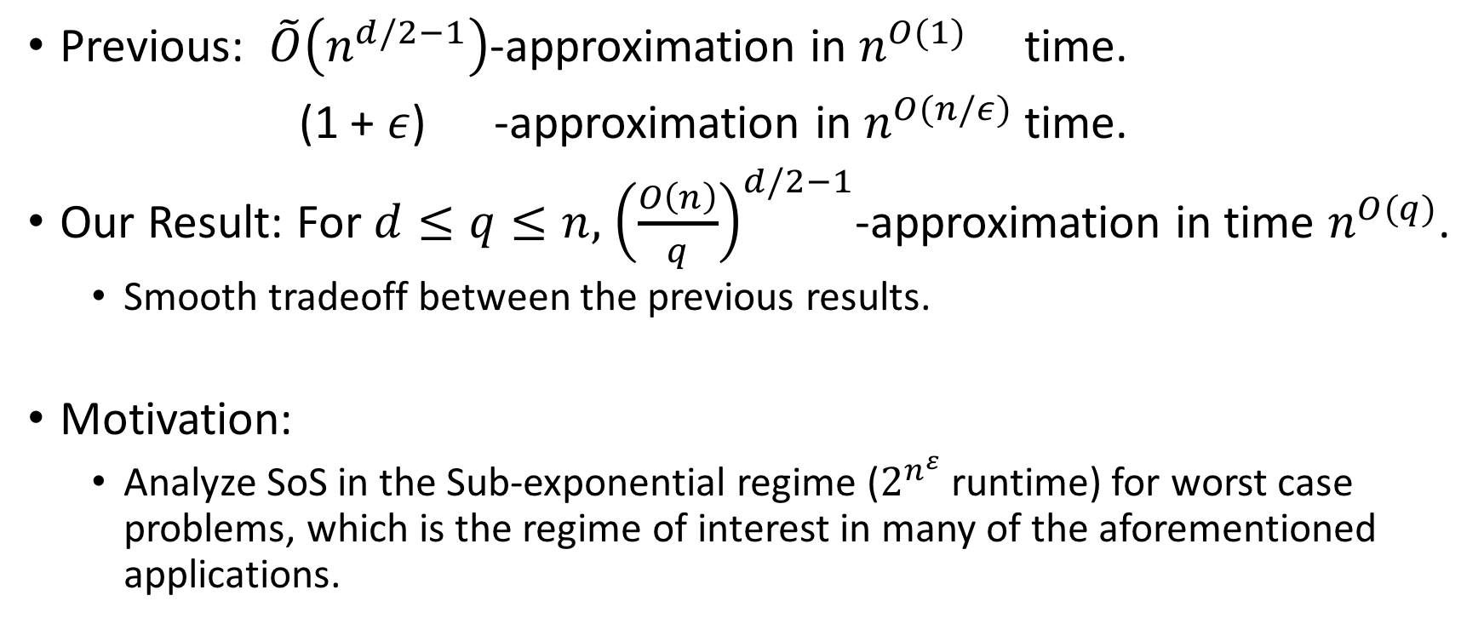
Our Result ($d=O(1)$)
Previous: $\tilde{O}\left(n^{d/2−1}\right)$-approximation in $n^{O(1)}$ time.
(1 + $ε$) -approximation in $n^{O(n/ε)}$ time.
Our Result: For $d≤q≤n,$ ${\left(\frac{O\left(n\right)}{q}\right)}^{d/2−1}$-approximation in time $n^{O(q)}$.
  Smooth tradeoff between the previous results.
Motivation:
  Analyze SoS in the Sub-exponential regime ($2^{n^{ε}}$ runtime) for worst case problems, which is the regime of interest in many of the aforementioned applications.

Slide 9
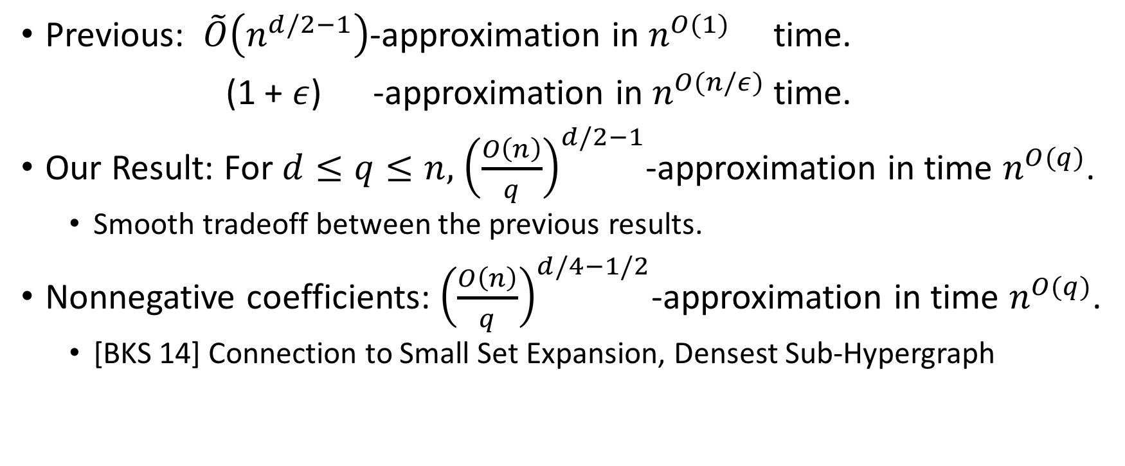
Our Result ($d=O(1)$)
Previous: $\tilde{O}\left(n^{d/2−1}\right)$-approximation in $n^{O(1)}$ time.
(1 + $ε$) -approximation in $n^{O(n/ε)}$ time.
Our Result: For $d≤q≤n,$ ${\left(\frac{O\left(n\right)}{q}\right)}^{d/2−1}$-approximation in time $n^{O(q)}$.
  Smooth tradeoff between the previous results.
Nonnegative coefficients: ${\left(\frac{O\left(n\right)}{q}\right)}^{d/4−1/2}$-approximation in time $n^{O(q)}$.
  [BKS 14] Connection to Small Set Expansion, Densest Sub-Hypergraph

Slide 10
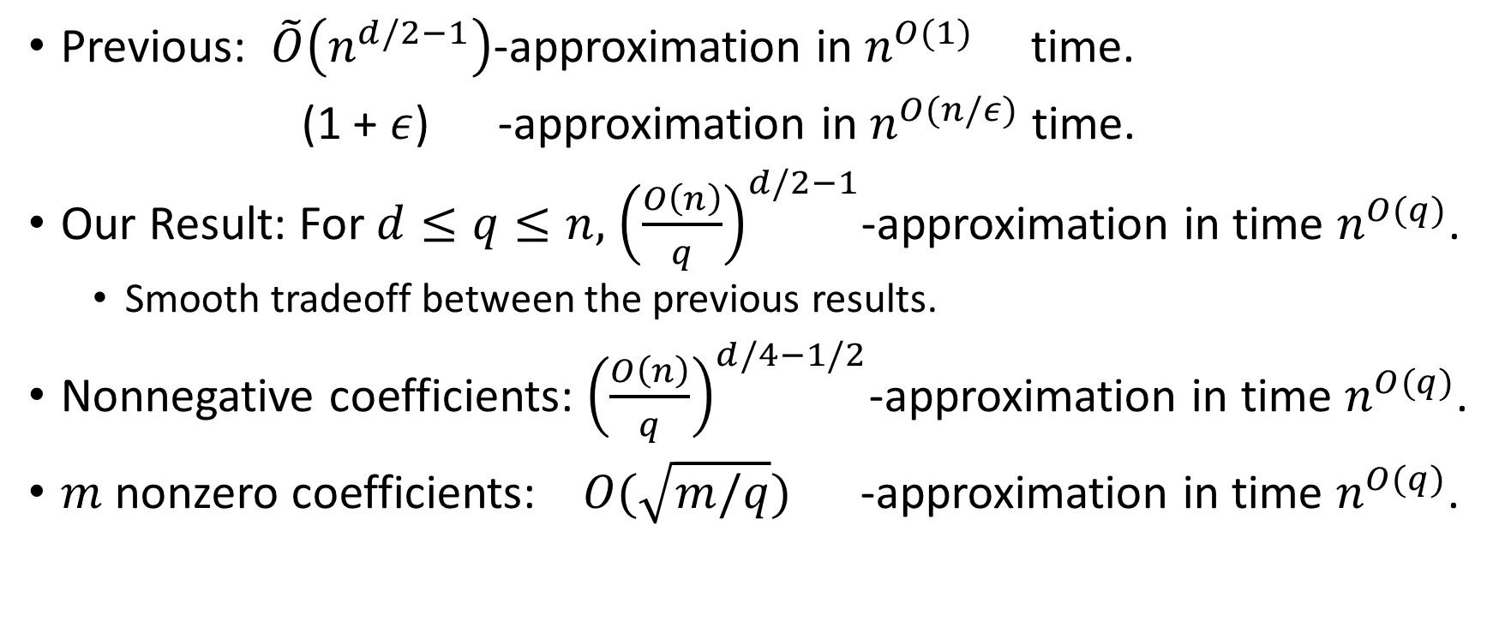
Our Result ($d=O(1)$)
Previous: $\tilde{O}\left(n^{d/2−1}\right)$-approximation in $n^{O(1)}$ time.
(1 + $ε$) -approximation in $n^{O(n/ε)}$ time.
Our Result: For $d≤q≤n,$ ${\left(\frac{O\left(n\right)}{q}\right)}^{d/2−1}$-approximation in time $n^{O(q)}$.
  Smooth tradeoff between the previous results.
Nonnegative coefficients: ${\left(\frac{O\left(n\right)}{q}\right)}^{d/4−1/2}$-approximation in time $n^{O(q)}$.
$m$ nonzero coefficients: $O(\sqrt{m/q})$ -approximation in time $n^{O(q)}$.

Slide 11
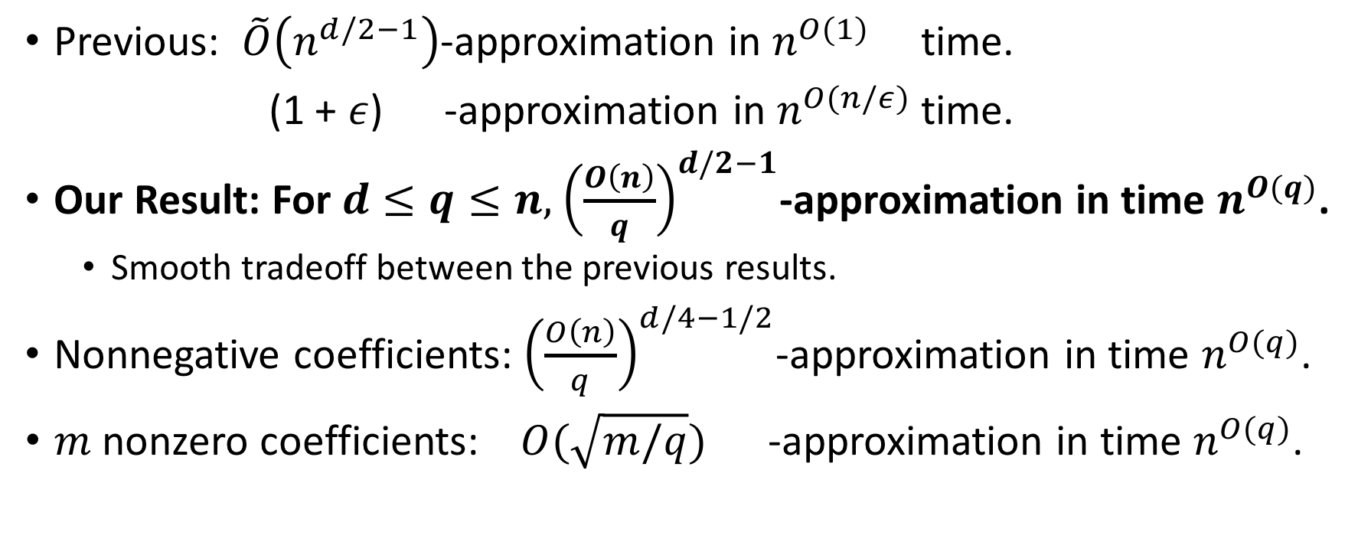
Our Result ($d=O(1)$)
Previous: $\tilde{O}\left(n^{d/2−1}\right)$-approximation in $n^{O(1)}$ time.
(1 + $ε$) -approximation in $n^{O(n/ε)}$ time.
Our Result: For $d≤q≤n,$ ${\left(\frac{O\left(n\right)}{q}\right)}^{d/2−1}$-approximation in time $n^{O(q)}$.
  Smooth tradeoff between the previous results.
Nonnegative coefficients: ${\left(\frac{O\left(n\right)}{q}\right)}^{d/4−1/2}$-approximation in time $n^{O(q)}$.
$m$ nonzero coefficients: $O(\sqrt{m/q})$ -approximation in time $n^{O(q)}$.

Slide 12

What we will prove
Assume $f$ is a $d$-form.
  ${\left(\frac{O\left(n\right)}{q}\right)}^{d/2−1}$-approximation in $n^{O(q)}$-time

Slide 13
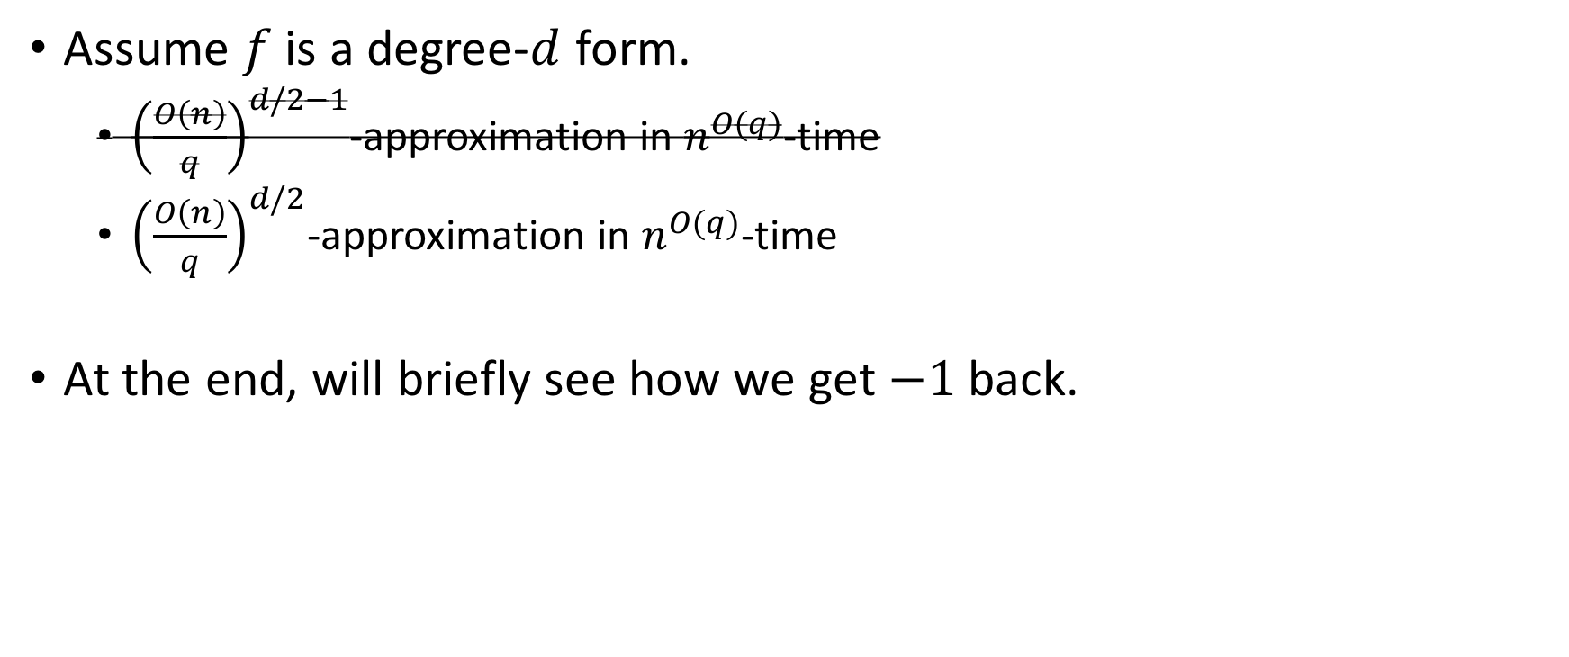
What we will prove
Assume $f$ is a degree-$d$ form.
  ${\left(\frac{O\left(n\right)}{q}\right)}^{d/2−1}$-approximation in $n^{O(q)}$-time
  ${\left(\frac{O\left(n\right)}{q}\right)}^{d/2}$-approximation in $n^{O(q)}$-time
At the end, will briefly see how we get $−1$ back.

Slide 14
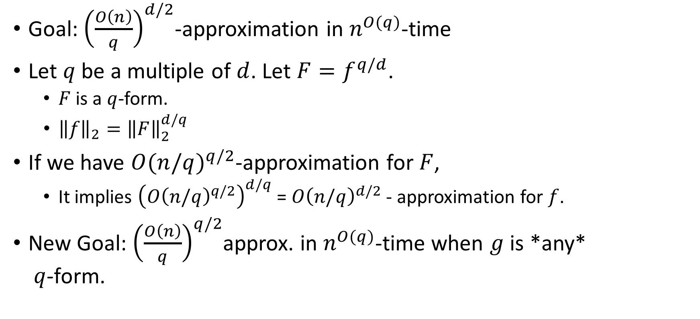
First Step
Goal: ${\left(\frac{O\left(n\right)}{q}\right)}^{d/2}$-approximation in $n^{O(q)}$-time
Let $q$ be a multiple of $d$. Let $F=f^{q/d}$.
  $F$ is a $q$-form.
  ${\left\|f\right\|}_{2}={\left\|F\right\|}_{2}^{d/q}$
If we have ${O(n/q)}^{q/2}$-approximation for $F$,
  It implies ${\left({O\left(n/q\right)}^{q/2}\right)}^{d/q}$ = ${O\left(n/q\right)}^{d/2}$ - approximation for $f$.
New Goal: ${\left(\frac{O\left(n\right)}{q}\right)}^{q/2}$approx. in $n^{O(q)}$-time when $g$ is *any*
$q$-form.

Slide 15
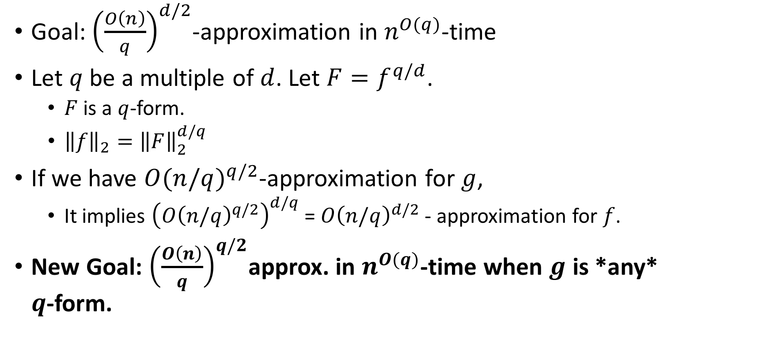
First Step
Goal: ${\left(\frac{O\left(n\right)}{q}\right)}^{d/2}$-approximation in $n^{O(q)}$-time
Let $q$ be a multiple of $d$. Let $F=f^{q/d}$.
  $F$ is a $q$-form.
  ${\left\|f\right\|}_{2}={\left\|F\right\|}_{2}^{d/q}$
If we have ${O(n/q)}^{q/2}$-approximation for $g$,
  It implies ${\left({O\left(n/q\right)}^{q/2}\right)}^{d/q}$ = ${O\left(n/q\right)}^{d/2}$ - approximation for $f$.
New Goal: ${\left(\frac{O\left(n\right)}{q}\right)}^{q/2}$approx. in $n^{O(q)}$-time when $g$ is *any*
$q$-form.

Slide 16
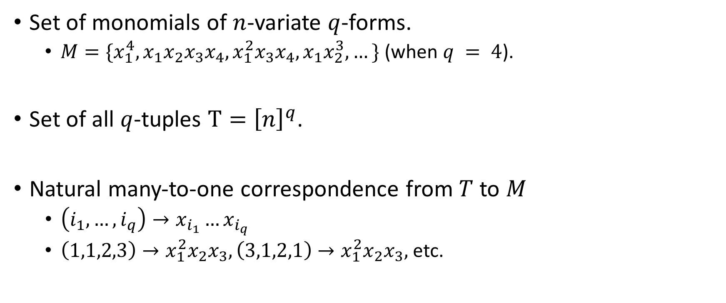
Tuples and Monomials
Set of monomials of $n$-variate $q$-forms.
  $M=\{x_{1}^{4}, x_{1}x_{2}x_{3}x_{4},x_{1}^{2}x_{3}x_{4},x_{1}x_{2}^{3},…\}$ (when $q = 4$).
Set of all $q$-tuples $T={\left[n\right]}^{q}$.
Natural many-to-one correspondence from $T$ to $M$
  $\left(i_{1},…, i_{q}\right)→x_{i_{1}}…x_{i_{q}}$
  $\left(1,1,2,3\right)→x_{1}^{2}x_{2}x_{3}, \left(3,1,2,1\right)→x_{1}^{2}x_{2}x_{3},$ etc.

Slide 17
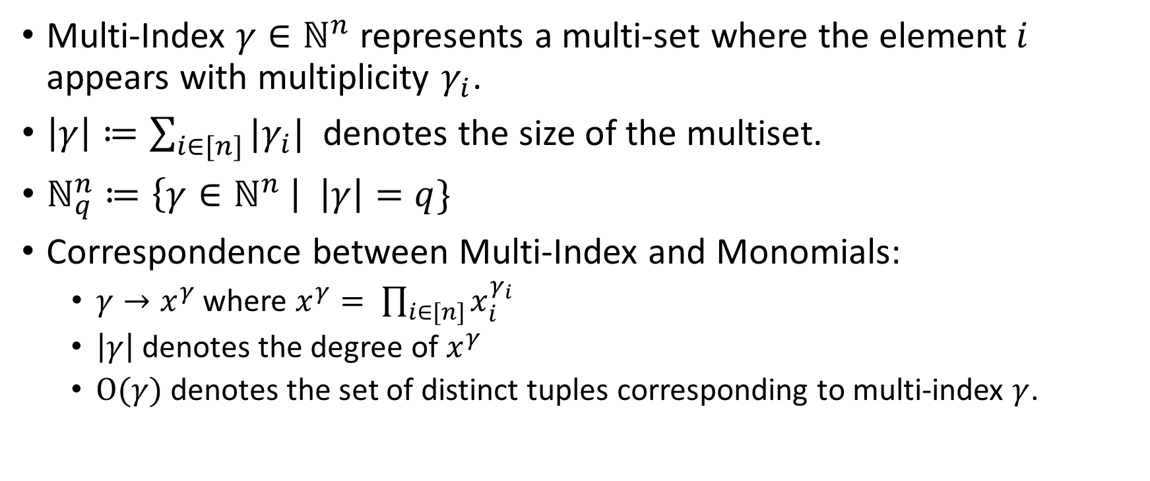
Multi-Indices and Monomials
Multi-Index $γ∈ℕ^{n}$ represents a multi-set where the element$i$ appears with multiplicity $γ_{i}$.
$\left|γ\right|≔\sum_{i∈[n]}{|γ_{i}|}$ denotes the size of the multiset.
$ℕ_{q}^{n}≔\left\{γ∈ℕ^{n} \right| \left|γ\right|=q\}$
Correspondence between Multi-Index and Monomials:
  $γ→x^{γ}$ where $x^{γ}= \prod_{i∈[n]}{x_{i}^{γ_{i}}}$
  $\left|γ\right|$ denotes the degree of $x^{γ}$
  $Ο(γ)$ denotes the set of distinct tuples corresponding to multi-index $γ$.

Slide 18
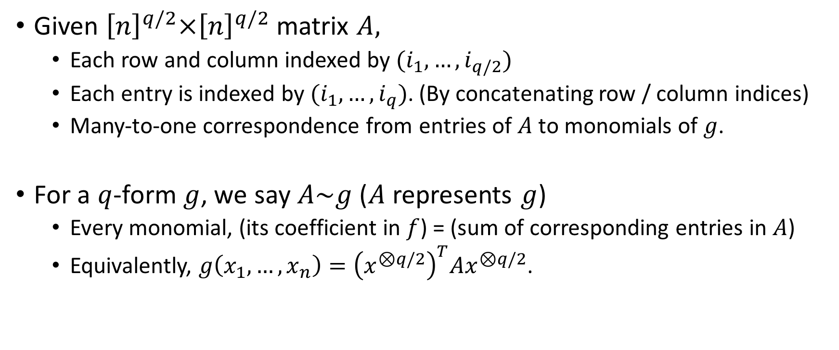
Matrix Representations
Given ${\left[n\right]}^{q/2}×{\left[n\right]}^{q/2}$ matrix $A,$
  Each row and column indexed by $(i_{1},…, i_{q/2})$
  Each entry is indexed by $(i_{1},…, i_{q})$. (By concatenating row / column indices)
  Many-to-one correspondence from entries of $A$ to monomials of $g$.
For a $q$-form $g$, we say $A\sim g$ ($A$ represents $g$)
  Every monomial, (its coefficient in $f$) = (sum of corresponding entries in $A$)
  Equivalently, $g\left(x_{1},…,x_{n}\right)={\left(x^{⊗q/2}\right)}^{T}Ax^{⊗q/2}$.

Slide 19

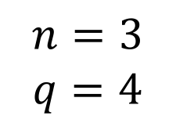

 | 1,1 | 1,2 | 1,3 | 2,1 | 2,2 | 2,3 | 3,1 | 3,2 | 3,3
1,1
1,2
1,3
2,1
2,2
2,3
3,1
3,2
3,3
$$n=3$$
$$q=4$$
$n^{2}$ rows
$n^{2}$ columns

Slide 20
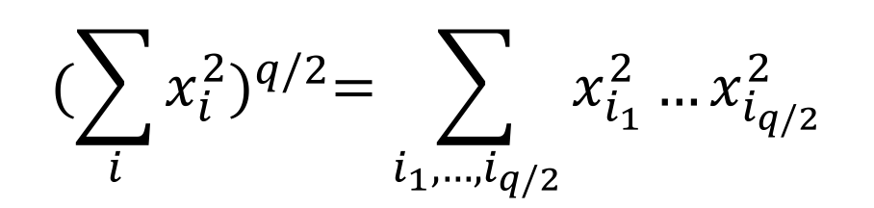
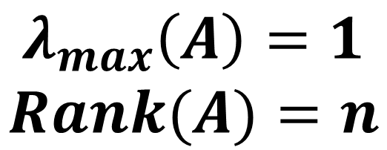
$${(\sum_{i}{x_{i}^{2}})}^{q/2}=\sum_{i_{1},…,i_{q/2}}{x_{i_{1}}^{2}…x_{i_{q/2}}^{2}}$$
 | 1,1 | 1,2 | 1,3 | 2,1 | 2,2 | 2,3 | 3,1 | 3,2 | 3,3
1,1 | 1
1,2 |  | 1
1,3 |  |  | 1
2,1 |  |  |  | 1
2,2 |  |  |  |  | 1
2,3 |  |  |  |  |  | 1
3,1 |  |  |  |  |  |  | 1
3,2 |  |  |  |  |  |  |  | 1
3,3 |  |  |  |  |  |  |  |  | 1
$$n=3$$
$$q=4$$
$n^{2}$ rows
$$λ_{max}\left(A\right)=1$$
$$Rank(A)=n$$
$n^{2}$ columns

Slide 21
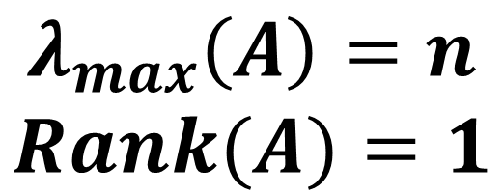

$${(\sum_{i}{x_{i}^{2}})}^{q/2}=\sum_{i_{1},…,i_{q/2}}{x_{i_{1}}^{2}…x_{i_{q/2}}^{2}}$$
 | 1,1 | 1,2 | 1,3 | 2,1 | 2,2 | 2,3 | 3,1 | 3,2 | 3,3
1,1 | 1 |  |  |  | 1 |  |  |  | 1
1,2
1,3
2,1
2,2 | 1 |  |  |  | 1 |  |  |  | 1
2,3
3,1
3,2
3,3 | 1 |  |  |  | 1 |  |  |  | 1
$$n=3$$
$$q=4$$
$n^{2}$ rows
$$λ_{max}\left(A\right)=n$$
$$Rank(A)=1$$
$n^{2}$ columns

Slide 22
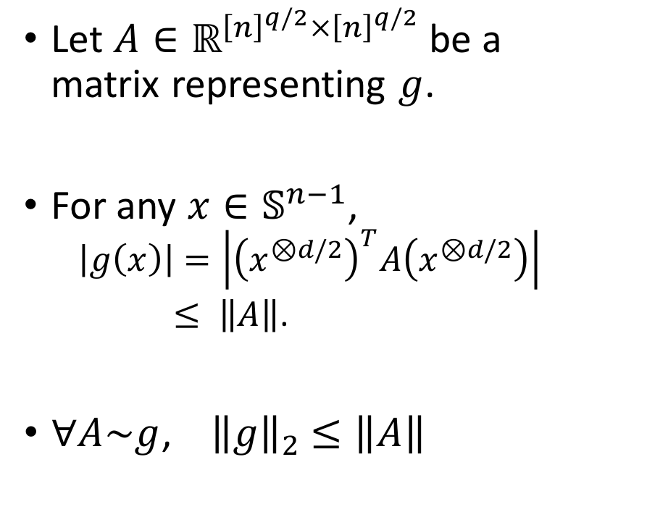
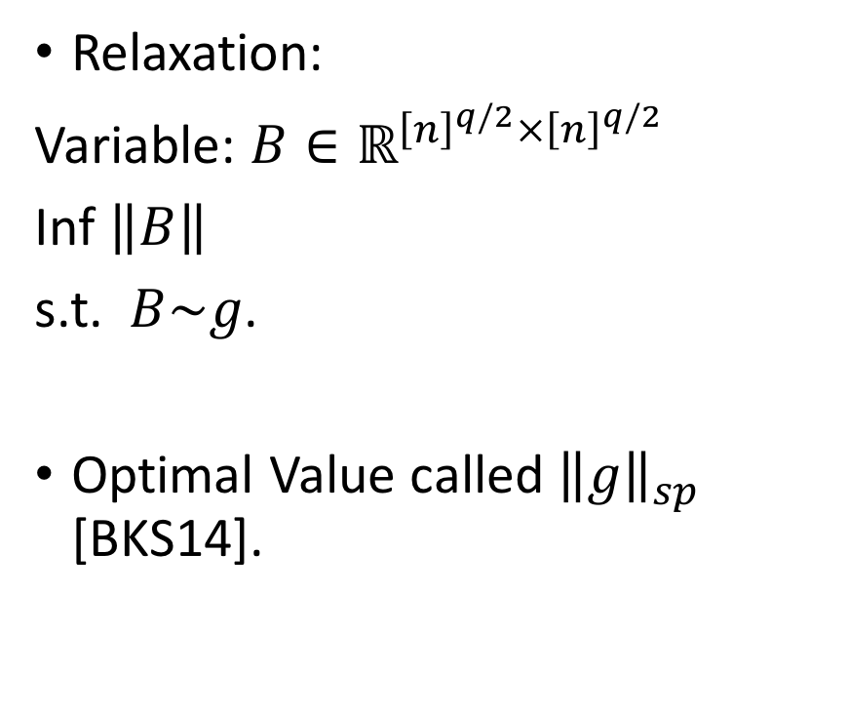
Our “Relaxation”
Let ${A∈ℝ}^{{\left[n\right]}^{q/2}×{\left[n\right]}^{q/2}}$ be a
matrix representing $g$.
For any $x∈𝕊^{n−1}$,
  $$\left|g\left(x\right)\right|=\left|{\left(x^{⊗d/2}\right)}^{T}A\left(x^{⊗d/2}\right)\right|$$
  $≤ \left\|A\right\|$.
$∀A\sim g$, ${ \left\|g\right\|}_{2} ≤\left\|A\right\|$
Relaxation:
Variable: ${B∈ℝ}^{{\left[n\right]}^{q/2}×{\left[n\right]}^{q/2}}$
Inf $\left\|B\right\|$
s.t. $B\sim g$.
Optimal Value called ${\left\|g\right\|}_{sp}$ [BKS14].

Slide 23
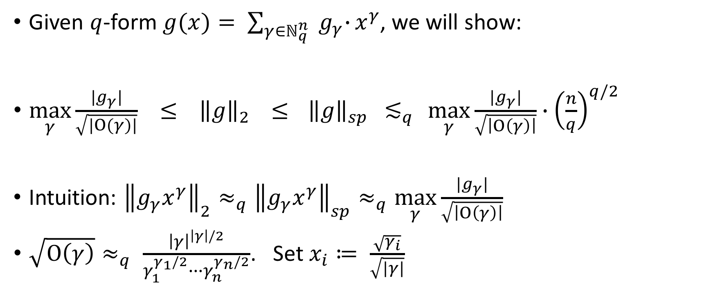
Strategy
Given $q$-form $g(x)= \sum_{γ∈ℕ_{q}^{n}}{{ g}_{γ}∙}x^{γ}$, we will show:
$\max_{γ}{\frac{{|g}_{γ}|}{\sqrt{|Ο(γ)|}}} ≤ { \left\|g\right\|}_{2} ≤{ \left\|g\right\|}_{sp}{ ≲}_{q} \max_{γ}{\frac{{|g}_{γ}|}{\sqrt{\left|Ο\left(γ\right)\right|}}∙{\left(\frac{n}{q}\right)}^{q/2} }$
Intuition: ${\left\|g_{γ}x^{γ}\right\|}_{2}≈_{q}{\left\|g_{γ}x^{γ}\right\|}_{sp}≈_{q}\max_{γ}{\frac{{|g}_{γ}|}{\sqrt{\left|Ο\left(γ\right)\right|}} }$
$\sqrt{Ο\left(γ\right)}≈_{q} \frac{{\left|γ\right|}^{\left|γ\right|/2}}{γ_{1}^{γ_{1}/2}∙∙∙γ_{n}^{γ_{n}/2}}$. Set $x_{i}≔ \frac{\sqrt{γ_{i}}}{\sqrt{|γ|}}$

Slide 24

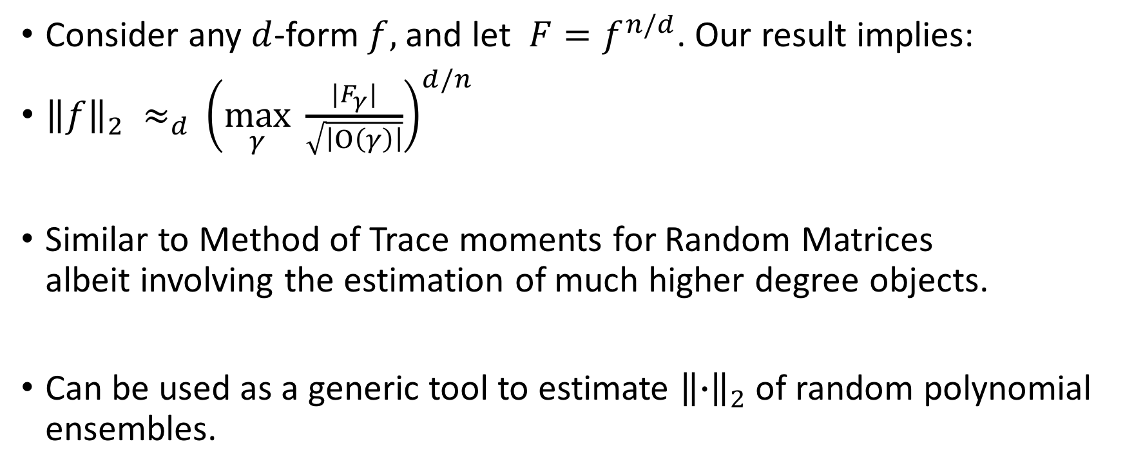
Detour: Method of moments for ${\left\|f\right\|}_{2}$
Consider any $d$-form $f,$ and let $F=f^{n/d}$. Our result implies:
${{\left\|f\right\|}_{2} ≈_{d}\left(\max_{γ}{ \frac{{|F}_{γ}|}{\sqrt{\left|Ο\left(γ\right)\right|}}}\right)}^{d/n}$
Similar to Method of Trace moments for Random Matrices
albeit involving the estimation of much higher degree objects.
Can be used as a generic tool to estimate ${\left\|∙\right\|}_{2}$ of random polynomial ensembles.

Slide 25
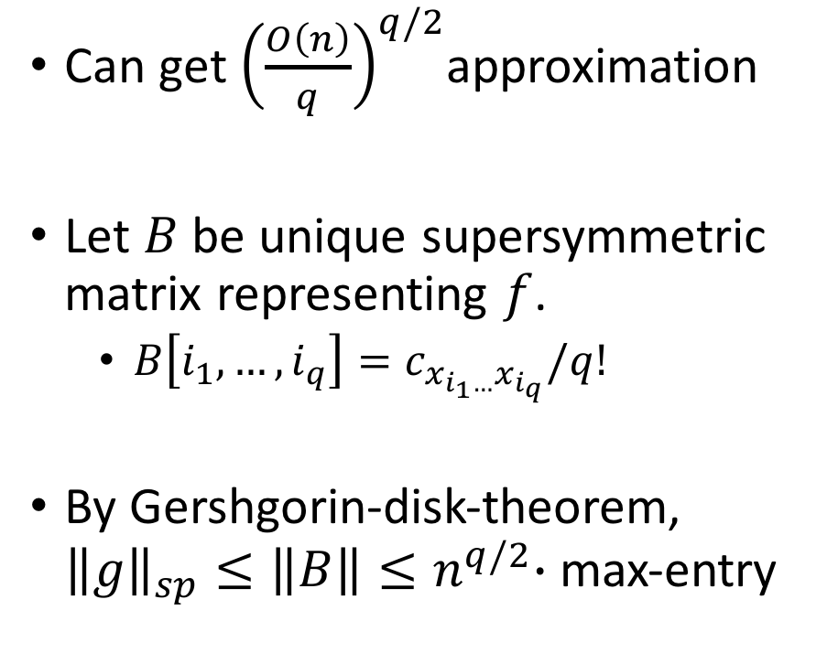



When $g$ is multilinear
Can get ${\left(\frac{O\left(n\right)}{q}\right)}^{q/2}$approximation
Let $B$ be unique supersymmetric matrix representing $f$.
  $B\left[i_{1},…,i_{q}\right]=c_{x_{i_{1}…}x_{i_{q}}}/q!$
By Gershgorin-disk-theorem, ${\left\|g\right\|}_{sp}≤\left\|B\right\|{≤n}^{q/2}∙$ max-entry
$n^{q/2}$ rows
$n^{q/2}$ columns

Slide 26
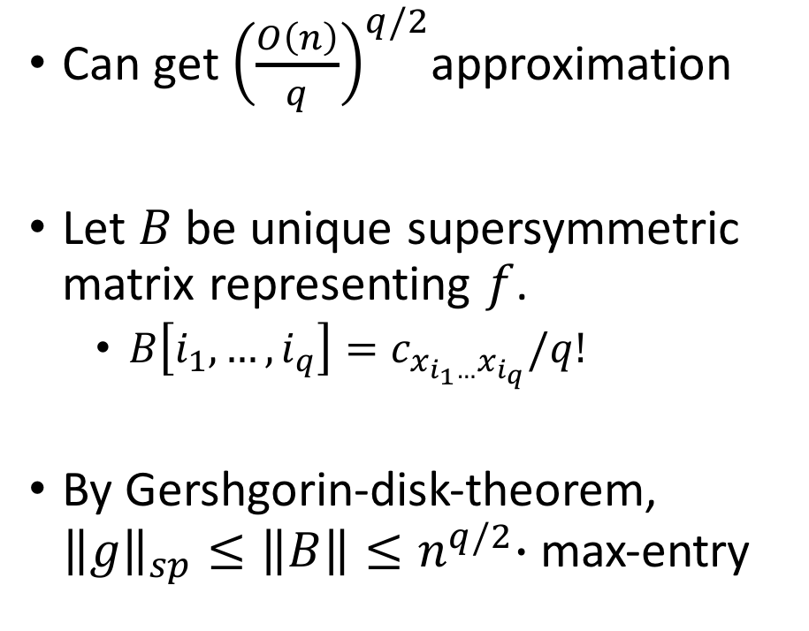
When $g$ is multilinear
Can get ${\left(\frac{O\left(n\right)}{q}\right)}^{q/2}$approximation
Let $B$ be unique supersymmetric matrix representing $f$.
  $B\left[i_{1},…,i_{q}\right]=c_{x_{i_{1}…}x_{i_{q}}}/q!$
By Gershgorin-disk-theorem, ${\left\|g\right\|}_{sp}≤\left\|B\right\|{≤n}^{q/2}∙$ max-entry
$n^{q/2}$ rows
$n^{q/2}$ columns

Slide 27

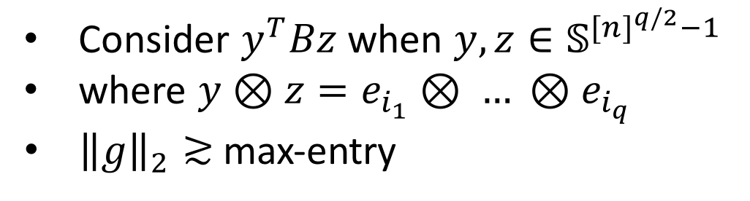
When $g$ is multilinear
Consider $y^{T}Bz$ when $y,z∈𝕊^{{[n]}^{q/2}−1}$
where $y⊗z=e_{i_{1}}⊗ … ⊗e_{i_{q}}$
${\left\|g\right\|}_{2}≳$ max-entry
Can get ${\left(\frac{O\left(n\right)}{q}\right)}^{q/2}$approximation
Let $B$ be unique supersymmetric matrix representing $f$.
  $B\left[i_{1},…,i_{q}\right]=c_{x_{i_{1}…}x_{i_{q}}}/q!$
By Gershgorin-disk-theorem, ${\left\|g\right\|}_{sp}≤\left\|B\right\|{≤n}^{q/2}∙$ max-entry

Slide 28
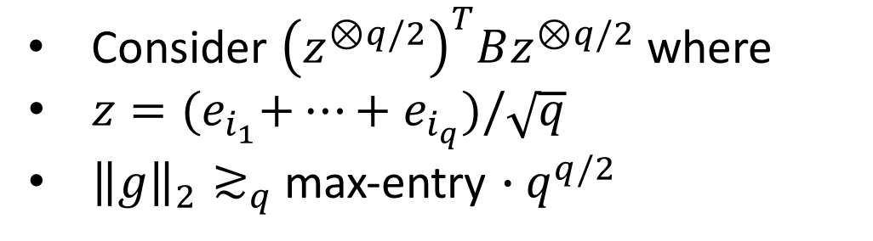
When $g$ is multilinear
Consider ${\left(z^{⊗q/2}\right)}^{T}Bz^{⊗q/2}$ where
$z={(e}_{i_{1}}+…+e_{i_{q}})/\sqrt{q}$
${\left\|g\right\|}_{2}≳_{q}$ max-entry $∙q^{q/2}$
Can get ${\left(\frac{O\left(n\right)}{q}\right)}^{q/2}$approximation
Let $B$ be unique supersymmetric matrix representing $f$.
  $B\left[i_{1},…,i_{q}\right]=c_{x_{i_{1}…}x_{i_{q}}}/q!$
By Gershgorin-disk-theorem, ${\left\|g\right\|}_{sp}≤\left\|B\right\|{≤n}^{q/2}∙$ max-entry

Slide 29

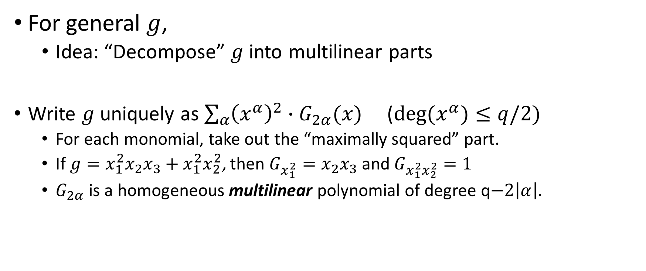
Non-multilinear $g$
For general $g$,
  Idea: “Decompose” $g$ into multilinear parts
Write $g$ uniquely as $\sum_{α}{{\left(x^{α}\right)}^{2}}∙G_{2α}(x)$ ($deg{(x}^{α})≤q/2)$
  For each monomial, take out the “maximally squared” part.
  If $g=x_{1}^{2}x_{2}x_{3}+x_{1}^{2}x_{2}^{2}$, then $G_{x_{1}^{2}}=x_{2}x_{3}$ and $G_{x_{1}^{2}x_{2}^{2}}=1$
  $G_{2α}$ is a homogeneous multilinear polynomial of degree q$−2\left|α\right|$.

Slide 30

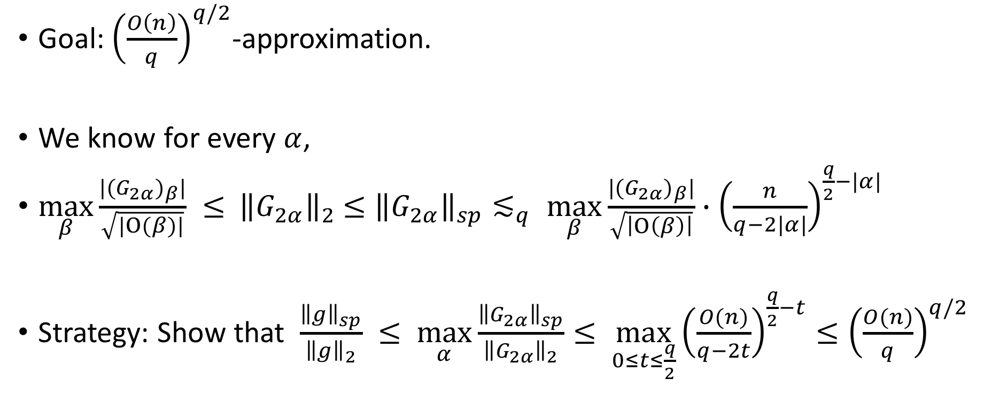
Non-multilinear $g$
Goal: ${\left(\frac{O\left(n\right)}{q}\right)}^{q/2}$-approximation.
We know for every $α$,
$\max_{β}{\frac{{|(G_{2α})}_{β}|}{\sqrt{|Ο(β)|}}} ≤ { \left\|G_{2α}\right\|}_{2} ≤{\left\|G_{2α}\right\|}_{sp}≲_{q} \max_{β}{\frac{{|(G_{2α})}_{β}|}{\sqrt{\left|Ο\left(β\right)\right|}}∙{\left(\frac{n}{q−2|α|}\right)}^{\frac{q}{2}−|α|} }$
Strategy: Show that $\frac{{\left\|g\right\|}_{sp}}{{\left\|g\right\|}_{2}} ≤ \max_{α}{\frac{{\left\|G_{2α}\right\|}_{sp}}{{\left\|G_{2α}\right\|}_{2}}≤ \max_{0≤t≤\frac{q}{2}}{{\left(\frac{O(n)}{q−2t}\right)}^{\frac{q}{2}−t}≤{\left(\frac{O(n)}{q}\right)}^{q/2}}}$

Slide 31
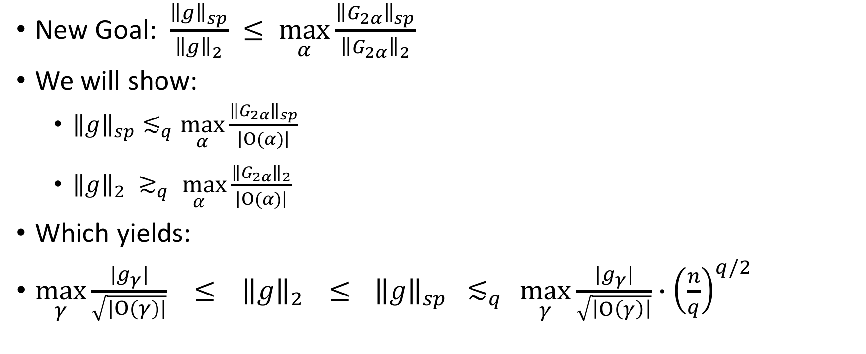
Multilinear Decomposition Inequality
New Goal: $\frac{{\left\|g\right\|}_{sp}}{{\left\|g\right\|}_{2}} ≤ \max_{α}{\frac{{\left\|G_{2α}\right\|}_{sp}}{{\left\|G_{2α}\right\|}_{2}}}$
We will show:
  ${\left\|g\right\|}_{sp}≲_{q}\max_{α}{\frac{{\left\|G_{2α}\right\|}_{sp}}{\left|Ο(α)\right|}}$
  ${\left\|g\right\|}_{2}{ ≳}_{q}\max_{α}{\frac{{\left\|G_{2α}\right\|}_{2}}{\left|Ο(α)\right|}}$
Which yields:
$\max_{γ}{\frac{{|g}_{γ}|}{\sqrt{|Ο(γ)|}}} ≤ { \left\|g\right\|}_{2} ≤{ \left\|g\right\|}_{sp}{ ≲}_{q} \max_{γ}{\frac{{|g}_{γ}|}{\sqrt{\left|Ο\left(γ\right)\right|}}∙{\left(\frac{n}{q}\right)}^{q/2} }$

Slide 32

Multilinear Decomposition Inequality
New Goal: $\frac{{\left\|g\right\|}_{sp}}{{\left\|g\right\|}_{2}} ≤ \max_{α}{\frac{{\left\|G_{2α}\right\|}_{sp}}{{\left\|G_{2α}\right\|}_{2}}}$
We will show:
  ${\left\|g\right\|}_{sp}≲_{q}\max_{α}{\frac{{\left\|G_{2α}\right\|}_{sp}}{\left|Ο(α)\right|}}$
  ${\left\|g\right\|}_{2}{ ≳}_{q}\max_{α}{\frac{{\left\|G_{2α}\right\|}_{2}}{\left|Ο(α)\right|}}$

Slide 33
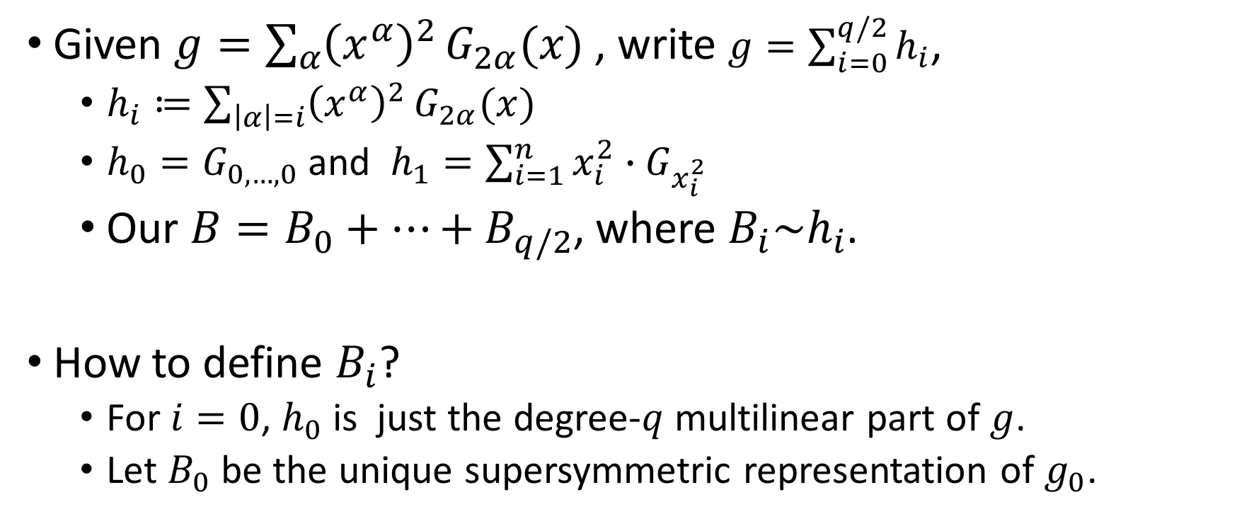
Finding a good Matrix Representation
Given $g=\sum_{α}{{\left(x^{α}\right)}^{2}}G_{2α}(x)$, write $g=\sum_{i=0}^{q/2}{h_{i}}$,
  $h_{i}≔\sum_{\left|α\right|=i}{{\left(x^{α}\right)}^{2}}G_{2α}(x)$
  $h_{0}=G_{0,…,0}$ and $h_{1}=\sum_{i=1}^{n}{x_{i}^{2}{∙G}_{x_{i}^{2}}}$
  Our $B=B_{0}+…+B_{q/2}$, where $B_{i}\sim h_{i}$.
How to define $B_{i}$?
  For $i=0$, $h_{0}$ is just the degree-$q$ multilinear part of $g$.
  Let $B_{0}$ be the unique supersymmetric representation of $g_{0}$.

Slide 34
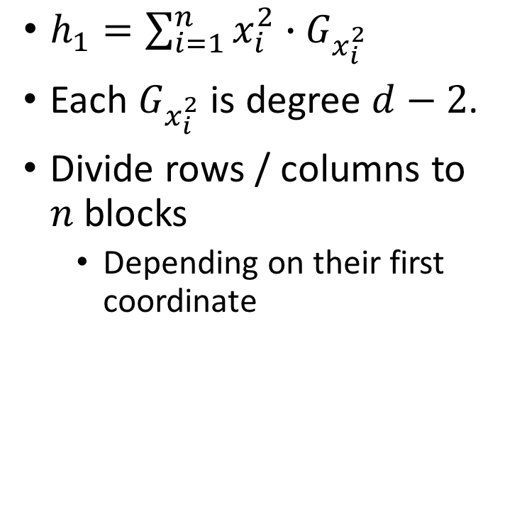


Finding good $B_{1}$
$h_{1}=\sum_{i=1}^{n}{x_{i}^{2}∙G_{x_{i}^{2}}}$
Each $G_{x_{i}^{2}}$ is degree $d−2$.
Divide rows / columns to $n$ blocks
  Depending on their first coordinate
$$n=3, d=4$$
 | 1,1 | 1,2 | 1,3 | 2,1 | 2,2 | 2,3 | 3,1 | 3,2 | 3,3
1,1
1,2
1,3
2,1
2,2
2,3
3,1
3,2
3,3

Slide 35
Finding good $B_{1}$
$h_{1}=\sum_{i=1}^{n}{x_{i}^{2}∙G_{x_{i}^{2}}}$
Each $G_{x_{i}^{2}}$ is degree $d−2$.
Divide rows / columns to $n$ blocks
  Depending on their first coordinate
$$n=3, d=4$$
 | 1,1 | 1,2 | 1,3 | 2,1 | 2,2 | 2,3 | 3,1 | 3,2 | 3,3
1,1
1,2
1,3
2,1
2,2
2,3
3,1
3,2
3,3

Slide 36
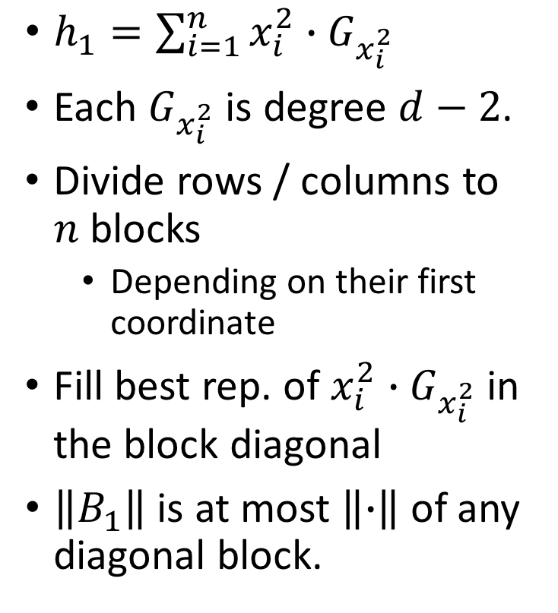
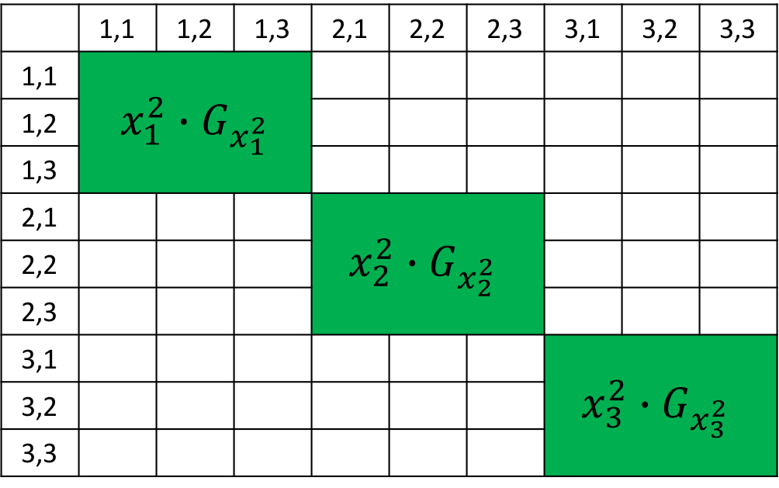
Finding good $B_{1}$
$h_{1}=\sum_{i=1}^{n}{x_{i}^{2}∙G_{x_{i}^{2}}}$
Each $G_{x_{i}^{2}}$ is degree $d−2$.
Divide rows / columns to $n$ blocks
  Depending on their first coordinate
Fill best rep. of $x_{i}^{2}{∙G}_{x_{i}^{2}}$ in the block diagonal
$\left\|B_{1}\right\|$ is at most $\left\|∙\right\|$ of any diagonal block.
$$n=3, d=4$$
 | 1,1 | 1,2 | 1,3 | 2,1 | 2,2 | 2,3 | 3,1 | 3,2 | 3,3
1,1 | $x_{1}^{2}∙G_{x_{1}^{2}}$
1,2
1,3
2,1 |  |  |  | $$x_{2}^{2}{∙G}_{x_{2}^{2}}$$
2,2
2,3
3,1 |  |  |  |  |  |  | $${x_{3}^{2}∙G}_{x_{3}^{2}}$$
3,2
3,3

Slide 37
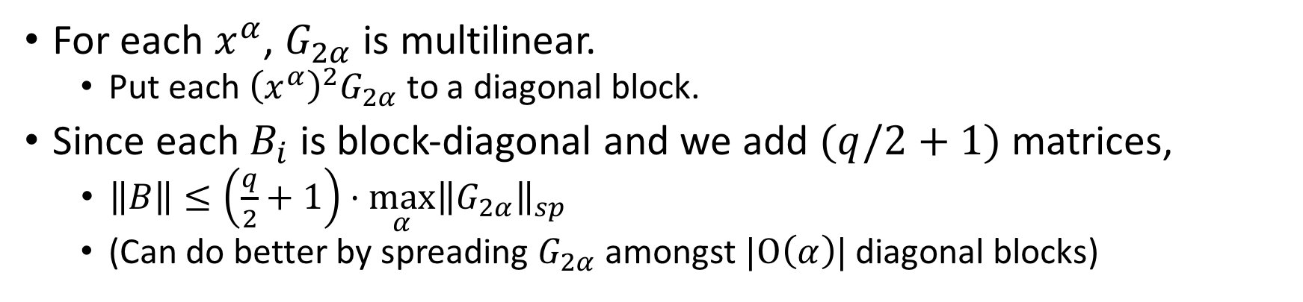
For each $x^{α}$, $G_{2α}$ is multilinear.
  Put each ${\left(x^{α}\right)}^{2}G_{2α}$ to a diagonal block.
Since each $B_{i}$ is block-diagonal and we add $(q/2+1)$ matrices,
  $\left\|B\right\|≤\left(\frac{q}{2}+1\right)⋅\max_{α}{{\left\|G_{2α}\right\|}_{sp}}$
  (Can do better by spreading $G_{2α}$ amongst $|Ο\left(α\right)|$ diagonal blocks)

Slide 38
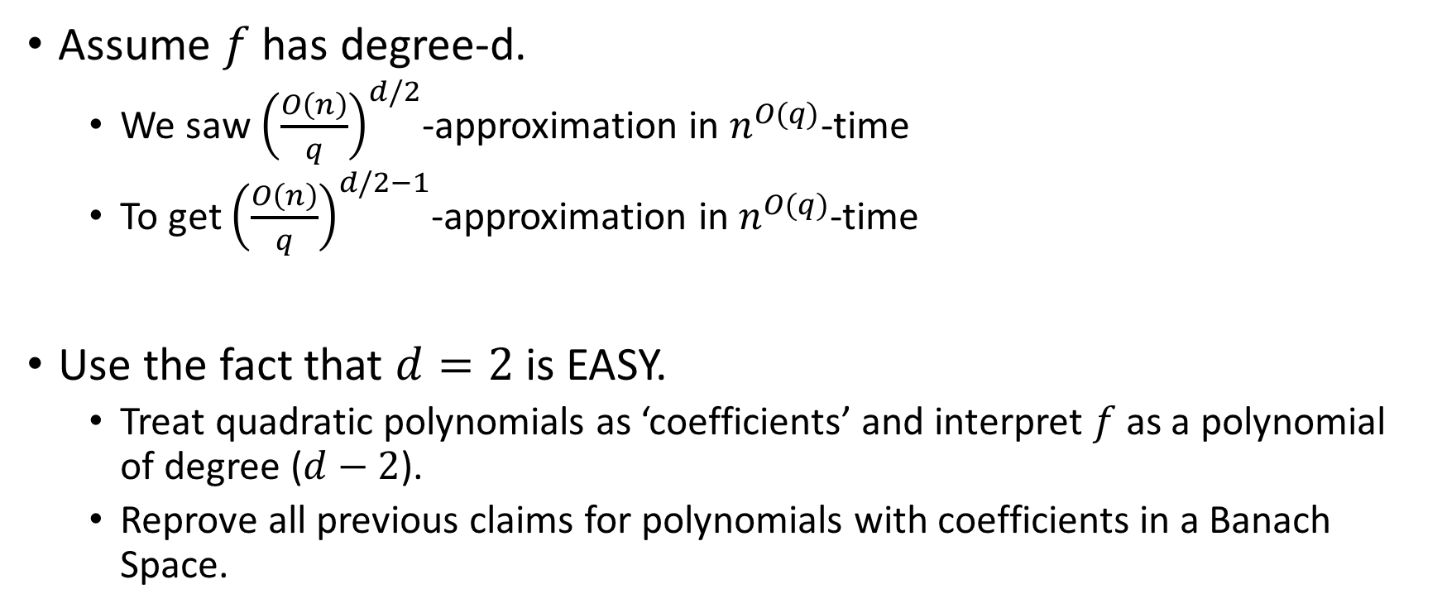
Saving 1 in Exponent
Assume $f$ has degree-d.
  We saw ${\left(\frac{O\left(n\right)}{q}\right)}^{d/2}$-approximation in $n^{O(q)}$-time
  To get ${\left(\frac{O\left(n\right)}{q}\right)}^{d/2−1}$-approximation in $n^{O(q)}$-time
Use the fact that $d=2$ is EASY.
  Treat quadratic polynomials as ‘coefficients’ and interpret $f$ as a polynomial of degree ($d−2$).
  Reprove all previous claims for polynomials with coefficients in a Banach Space.

Slide 39
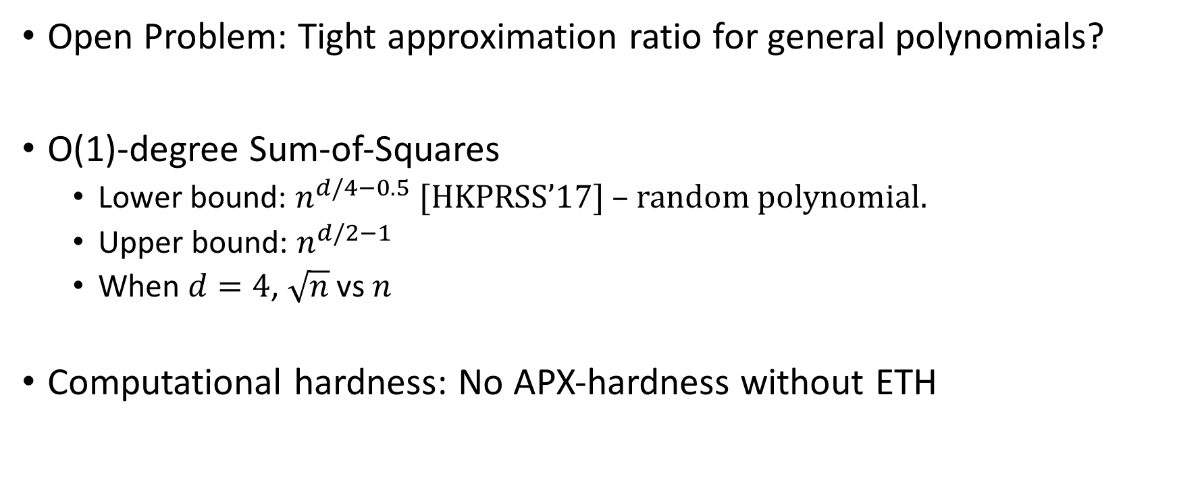
Conclusion
Open Problem: Tight approximation ratio for general polynomials?
O(1)-degree Sum-of-Squares
  Lower bound: $n^{d/4−0.5}$ [HKPRSS’17] – random polynomial.
  Upper bound: $n^{d/2−1}$
  When $d=4$, $\sqrt{n}$ vs $n$
Computational hardness: No APX-hardness without ETH

Slide 40
Thank you!

