Slide 1
Sketching as a tool for Algorithmic Design
Alex Andoni
(Columbia University)

Slide 2
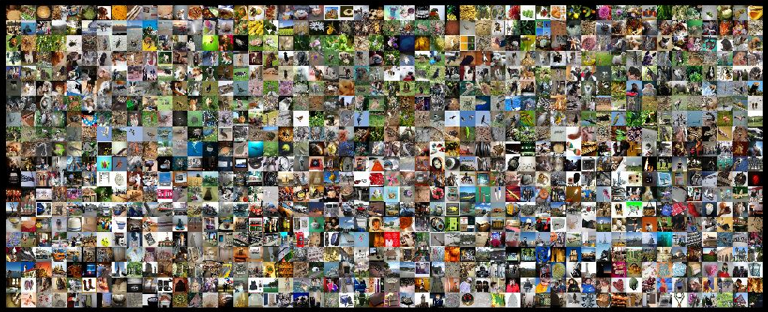
Find similar pairs

Slide 3
Methodology ?
Succinct
data representations
Efficient
Algorithms
000000
011100
010100
000100
010100
011111
000000
011100
010100
000100
010100
011111
dimension
reduction
Sketching (streaming)
Sampling
Metric embeddings
…
$$≈$$
lossy
good for specific task
000000
001100
000100
000100
110100
111111
000000
001100
000100
000100
110100
111111
$$≈$$

Slide 4
Plan
a random sketch of sketching…
Numerical Linear Algebra
Similarity Search
Geometric min-cost matching

Slide 5
Numerical Linear Algebra
Problem: Least Square Regression
$x^{∗}=argmin_{x}||Ax−b||$
where $A$ is $n×d$ matrix
$n≫d$
approximation $1+ε$
Idea: Sketch-And-Solve
solve $x^{′}=argmin_{x}||SAx−Sb||$
Where $S$ is dimension-reduction matrix
reduce to dimension $m≪n$
Hope: $||Ax^{∗}−b||≤\left(1+ε\right)||Ax^{′}−b||$

Slide 6
Sketch-And-Solve
[Sarlos’06, Clarkson-Woodruff’13, …]
Sketch-And-Solve: $O\left(nnz\left(A\right)+{\left(\frac{d}{ε}\right)}^{O\left(1\right)}\right)$
+Preconditioner: $O\left(\left(nnz\left(A\right)+d^{O\left(1\right)}\right)⋅\log{\frac{1}{ε}}\right)$
Oblivious Subspace Embedding:
linear map $S:ℝ^{n}→ℝ^{m}$s.t.
for any linear subspace $P⊂ℜ^{n}$ of dimension $d$: $\underset{S}{Pr}\left[∀p∈P :\frac{||S\left(p\right)||}{||p||}∈\left(1±ε\right)\right]≥1−δ$
$S$: random $±1$, together with CountSketch

Slide 7
$ℓ_{1}$ regression ?
No good dimension reduction in $ℓ_{1}$…
Can get: $O\left(nnz\left(A\right)⋅\log{n}+{\left(\frac{d}{ε}\right)}^{O\left(1\right)}\right)$ [CW’13,…]
More: low-rank approximation & optimization, matrix multiplication,…
see [Woodruff, FnTTCS’14]
Sketch: linear map $S:ℝ^{n}→ℝ^{m}$, estimator $E$, s.t.
for any $p∈ℜ^{n}$ : $\underset{S}{Pr}\left[\frac{E(S\left(p\right))}{||p||_{1}}∈(1±ε)\right]≥1−δ$
$S$: random Cauchy vars
[Indyk’00]
Poor DR: linear map $S:ℝ^{n}→ℝ^{m}$s.t.
for any linear subspace $P⊂ℝ^{n}$of dimension $d$: $\underset{S}{Pr}\left[∀p∈P :1≤\frac{||S\left(p\right)||_{1}}{||p||_{1}}≤d^{O\left(1\right)}\right]≥1−δ$
[Woodruff
Zhang’13]
$S$: random 1/Exp vars, & CountSketch

Slide 8
Plan
Numerical Linear Algebra
Similarity Search
Geometric min-cost matching

Slide 9
Approximate Near Neighbor Search
Preprocess: a set of $n$ point
approximation $c>1$
Query: given a query point $q$, report a point $p^{∗}∈P$ with the smallest distance to $q$
up to factor $c>1$
Near neighbor: threshold $r$
Parameters: space & query time
$$r$$
$$p^{∗}$$
$$cr$$
$$q$$
$$p^{′}$$

Slide 10
Locality-Sensitive Hashing
[Indyk-Motwani’98]
$$q$$
$$p′$$
Random hash function $h$ on $ℝ^{d}$
satisfying:
for close pair (when $\left\|q−p\right\|≤r$)
$Pr⁡[h(q)=h(p)]$ is “high”
for far pair (when $\left\|q−p′\right\|>cr$)
$Pr⁡[h(q)=h(p′)]$ is “small”
Use several hash tables
$$p$$
$$q$$
$$P1=$$
“not-so-small”
$$P2=$$
$$Pr⁡[h(q)=h(p)]$$
$$ρ=\frac{\log{1/P_{1}}}{\log{1/P_{2}}}$$
1
$nρ$, where
$$P1$$
$$P2$$
$$\left\|q−p\right\|$$
$$r$$
$$cr$$

Slide 11
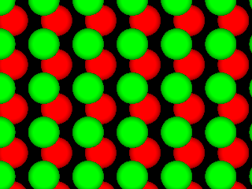
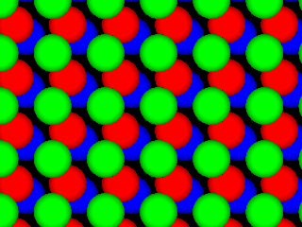
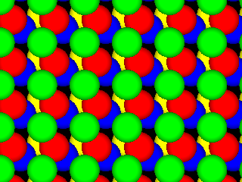
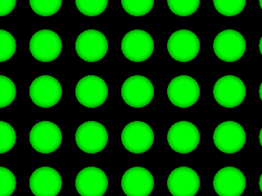
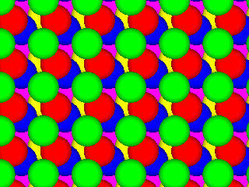
LSH maps
[Datar-Indyk-Immorlica-Mirrokni’04, A.-Indyk’06]
Space | Time | Exponent | $$c=2$$
$$n^{1+ρ}$$ | $$n^{ρ}$$ | $$ρ=1/c$$ | $$ρ=1/2$$
 |  | $$ρ≈1/c^{2}$$ | $$ρ=1/4$$
 |  | $$ρ≈\frac{1}{2c^{2}}−1$$ | $$ρ=1/7$$
$$q$$
$$p$$
$$p′$$
Even better LSH maps?
NO: example of isoperimetry
[Motwani-Naor-Panigrahy’06, O’Donell-Wu-Zhou’11]
Can get better maps, if allowed to depend on the dataset
[A-Indyk-Nguyen-Razenshteyn’14, A-Razenshteyn’15]
Applications to: Max/Min inner product (MIPS), greedy coordinate descent, kernel approximation & estimation,…

Slide 12
Plan
Numerical Linear Algebra
Similarity Search
Geometric min-cost matching
Can exploit sketches for:
input
internal state / partial computations
Computation
input
output

Slide 13
LP for Geometric Matching
Problem:
Given two sets $A,B$ of points in $ℝ^{d}$,
Find min-cost matching
a.k.a., Earth-Mover Distance, optimal transport, Wasserstein metric, etc
Classically: LP with $n^{2}$ variables
Best: $\tilde{O}(n^{2}/ε^{4})$ time*
[Altschuler-Weed-Rigolet’17]
But can hope for $≪n^{2}$ runtime!
$$\min_{π∈ℝ_{+}^{n^{2}}}\sum_{ij}{||p_{i}−q_{j}||⋅π_{ij}}$$
s.t. $π1=\frac{1}{n}1$ and $π^{t}1=\frac{1}{n}1$
Solve-And-Sketch [A.-Nikolov-Onak-Yaroslavtsev’14]:
For fixed $d, ε$, can solve in $n^{1+o(1)}$ time
Notes:
pictures of problems!

Slide 14
Solve-And-Sketch (=Divide & Conquer)
Partition the space hierarchically in a “nice way”
In each part
Compute a “solution” for the local view
Sketch the solution using small space
Combine local sketches into (more) global solution

Slide 15
Solve-And-Sketch for Geo Matching
Partition the space hierarchically in a “nice way”
In each part
Compute a “solution” for the local view
Sketch the solution using small space
Combine local sketches into (more) global solution
all potential local solutions
quad-tree
cannot precompute
any “local solution”
after committing to a wrong alternation,
cannot get <2 approximation!

Slide 16
Sketching ALL local solutions
Let $k=$ size of $ε$-net (“portal” points)
Define “solution” function $F:ℝ^{k}→ℝ_{+}$
input $x∈ℝ^{k}$ defines the flow (matching) at the portals
(“interface” to the rest)
$F(x)$ is the min-cost matching assuming flow $x$ at portals
Sketch of $F$:
size ${O\left(\frac{\log{n}}{ε}\right)}^{k}$
for any $x$, can estimate $F(x)$ up to $1+ε$ factor

Slide 17
Overall algorithm
Recomposing sketches into global solution:
can formulate as a (small) LP
Reinterpretation: decompose the LP into many small ones
small ones have size $≤n^{o\left(1\right)}$
ok to use any poly-time LP solver
recompose hierarchically (divide and conquer)

Slide 18
Finale
Succinct
data representations
Efficient
Algorithms
Numerical Linear Algebra
Similarity Search
Geometric min-cost matching
Just a small selection…
Dimension reduction
Sketching (streaming)
Sampling
Metric embeddings
…

