Slide 1


Understanding Generalization
in Adaptive Data Analysis
Vitaly (the West Coast) Feldman

Slide 2
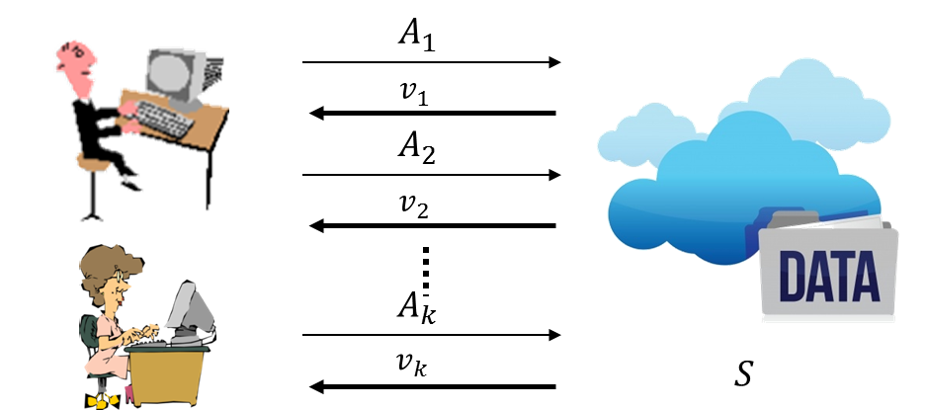
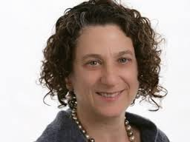
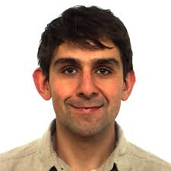
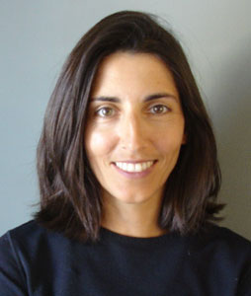
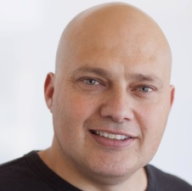
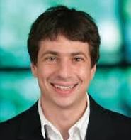
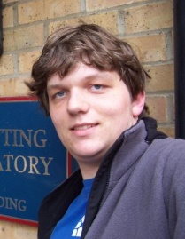
Overview
Adaptive data analysis
  Motivation
  Framework
  Basic results
  With Dwork, Hardt, Pitassi, Reingold, Roth [DFHPRR 14,15]
New results (with Thomas Steinke)
Open problems

Slide 3

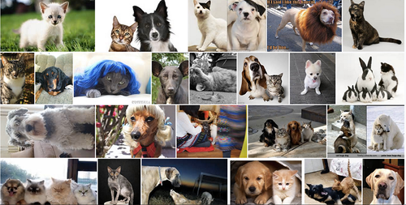
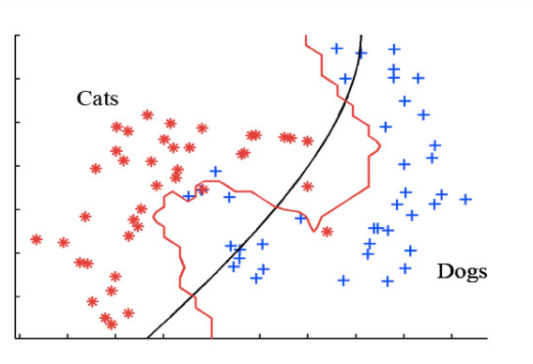
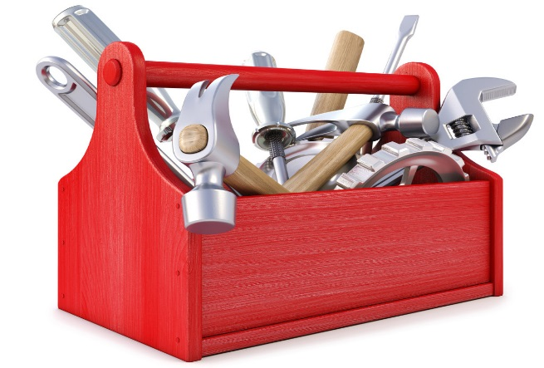

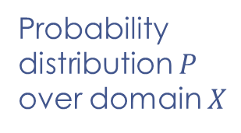



$E_{x∼P}[Loss(f,x)]$=?
Probability
distribution $P$
over domain $X$
Data
Results
$$S=\left(x_{1},…,x_{n}\right)∼P^{n}$$
$$f=A(S)$$
Analysis
$$A$$

Slide 4
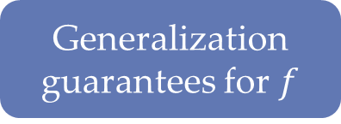


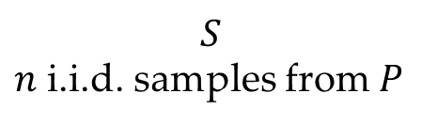
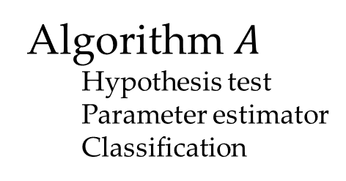
Statistical inference
Data
Data
Data
$$S$$
$n$ i.i.d. samples from $P$
Theory
  Concentration/CLT
  Model complexity
  Rademacher compl.
  Stability
  Online-to-batch
Algorithm$A$
  Hypothesis test
  Parameter estimator
  Classification
Generalization
guarantees for $f$
$$f=A(S)$$
0
$$\hat{Loss_{P}(f)}$$

Slide 5










Data analysis is adaptive
Steps depend on previous analyses of the same dataset
$$A_{1}$$
Data pre-processing
Exploratory data analysis
Feature selection
Model stacking
Hyper-parameter tuning
Shared datasets
…
$$v_{1}$$
$$A_{2}$$
$$v_{2}$$
$$A_{k}$$
$$v_{k}$$
$$S$$
Data analyst(s)
Notes:
Mention non-adaptive reuse

Slide 6

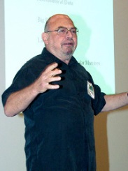
Thou shalt not test
hypotheses suggested
by data
“Quiet scandal of statistics”
[Leo Breiman, 1992]

Slide 7
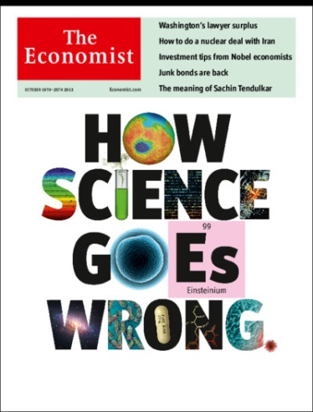
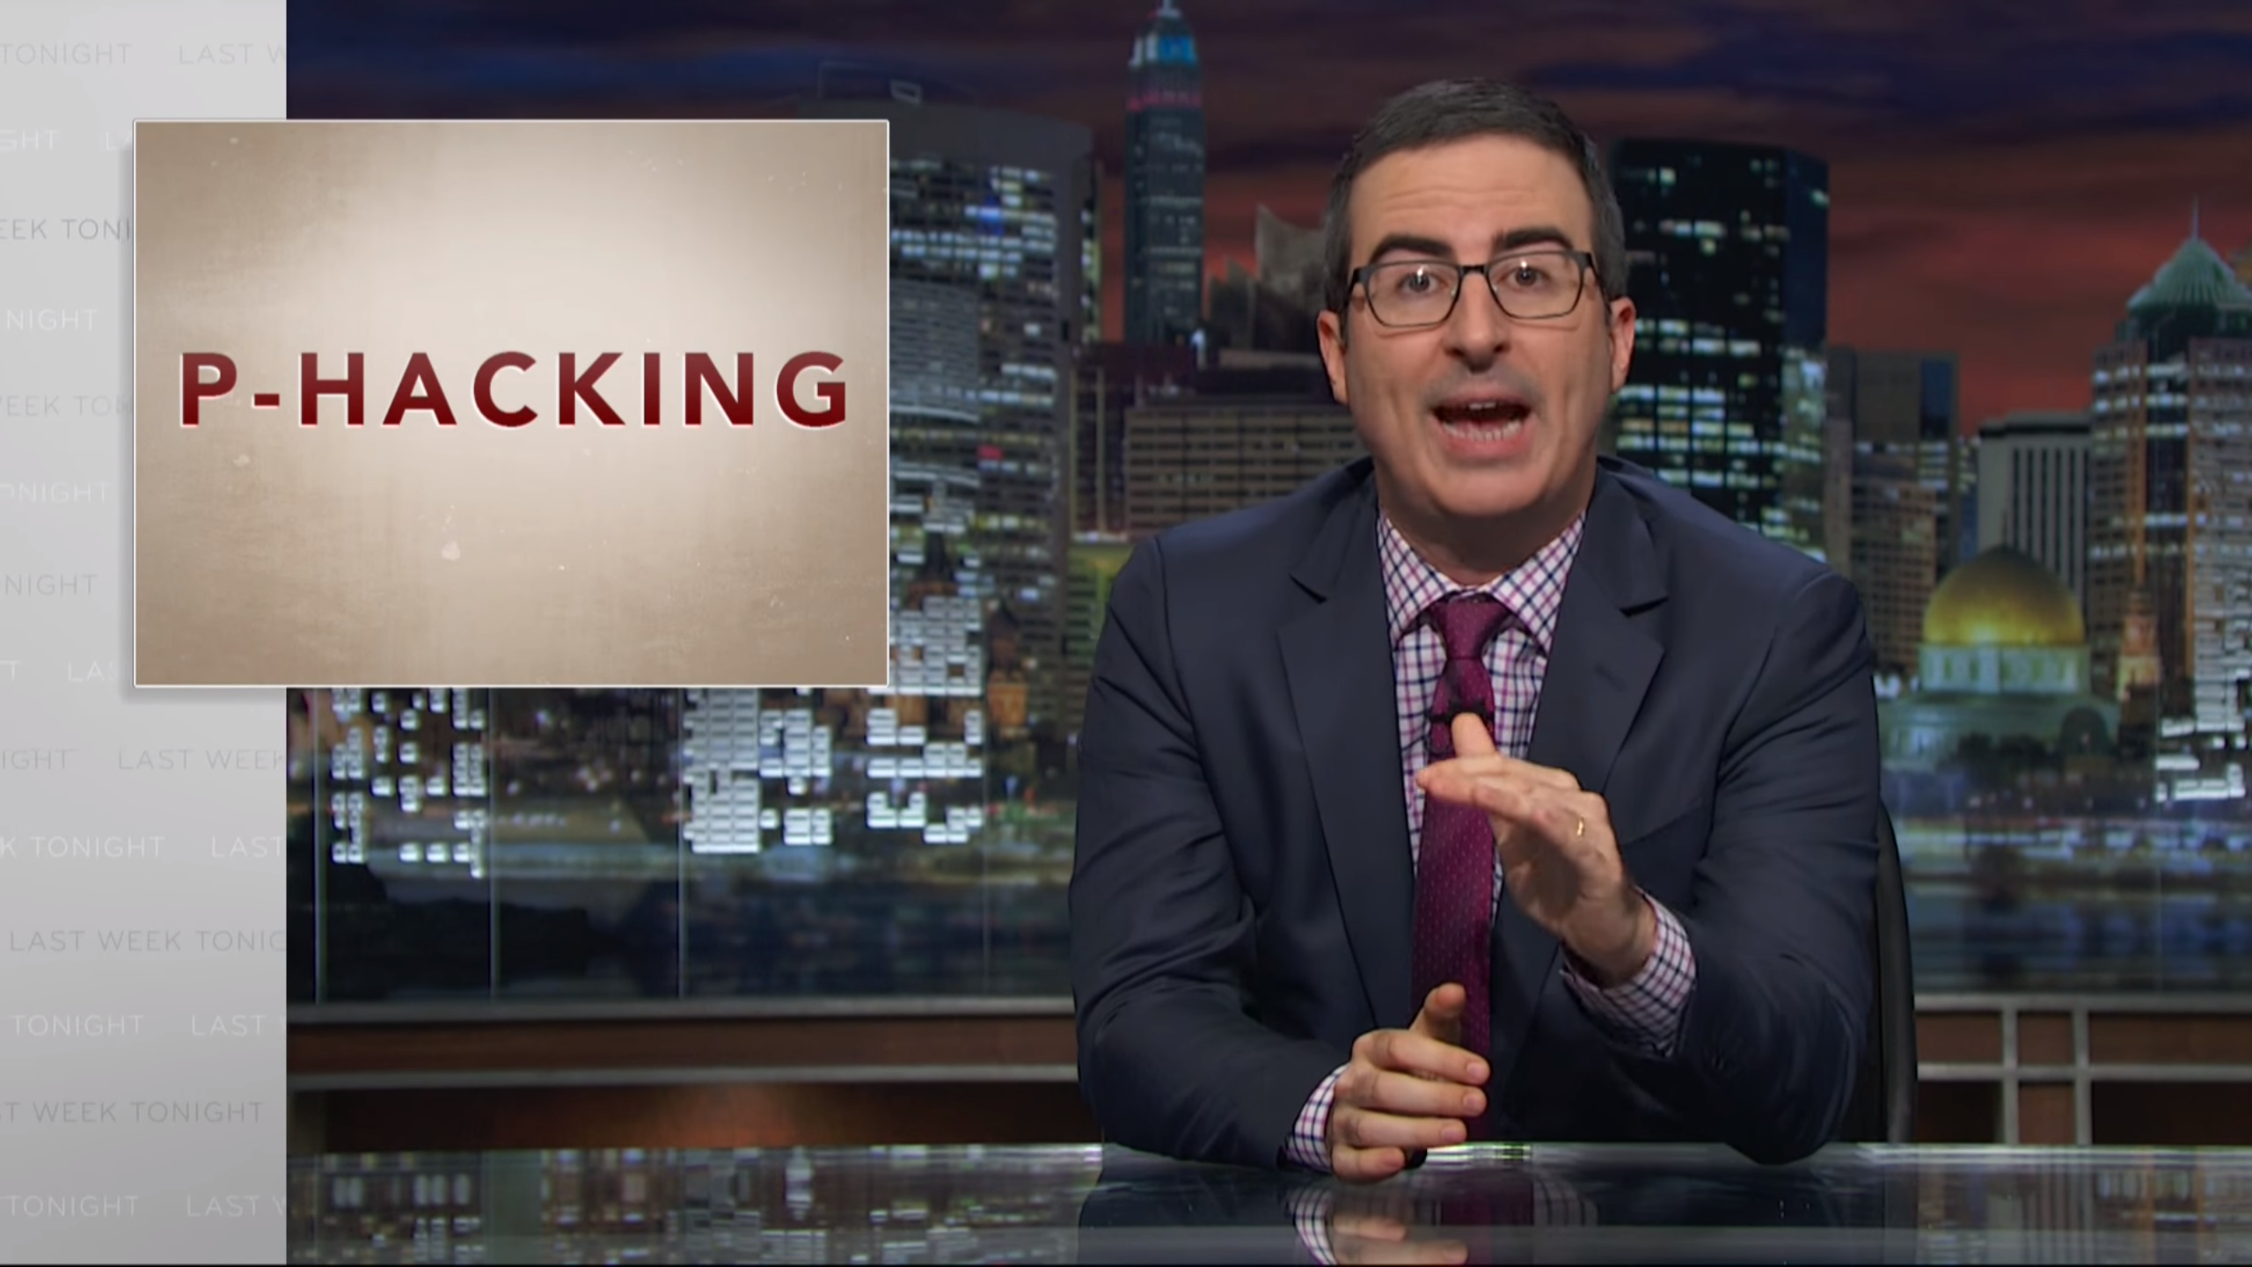
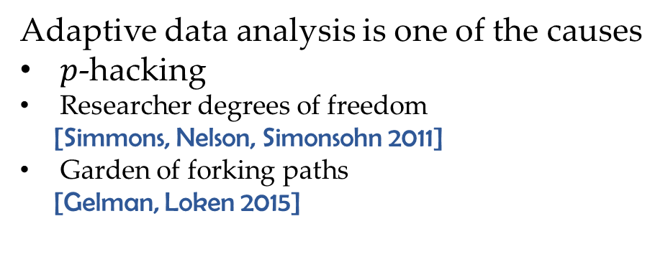
Reproducibility crisis?
Why Most Published Research Findings Are False [Ioannidis 2005]
“Irreproducible preclinical research exceeds 50%,
resulting in approximately US$28B/year loss”
[Freedman,Cockburn,Simcoe 2015]
Adaptive data analysis is one of the causes
$p$-hacking
Researcher degrees of freedom
[Simmons, Nelson, Simonsohn 2011]
Garden of forking paths
[Gelman, Loken 2015]

Slide 8
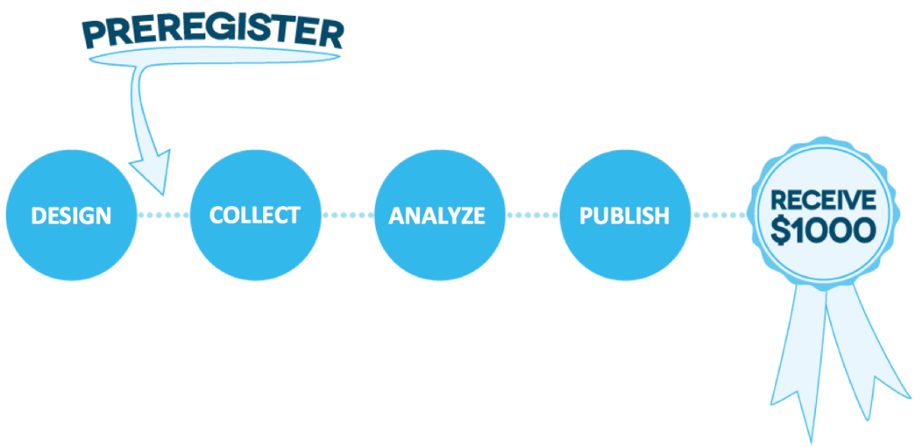
Existing approaches
Sample splitting
Selective inference
  Model selection + parameter estimation
  Variable selection + regression
Pre-registration
© Center for Open Science

Slide 9


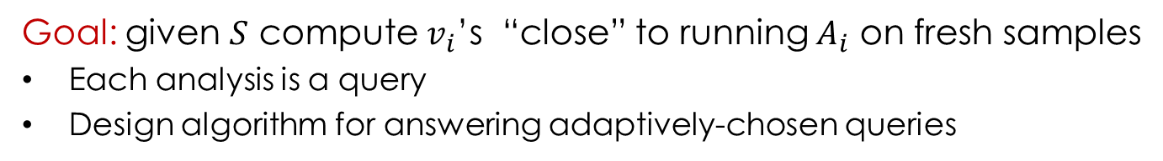


Adaptive data analysis [DFHPRR 14]
$$A_{1}$$
Algorithm
$$v_{1}$$
$$A_{2}$$
$$v_{2}$$
$$A_{k}$$
$$v_{k}$$
$$S=\left(x_{1},…,x_{n}\right)∼P^{n}$$
Data analyst(s)
Goal: given $S$ compute $v_{i}$’s “close” to running $A_{i}$ on fresh samples
Each analysis is a query
Design algorithm for answering adaptively-chosen queries
Notes:
Need both tools for analysis and ways to make algorithms that compose better.

Slide 10

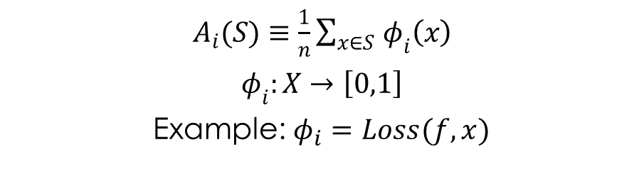



Adaptive statistical queries
$$A_{1}$$
$$v_{1}$$
$$A_{2}$$
$$v_{2}$$
$$S$$
$$A_{k}$$
$$v_{k}$$
Statistical query oracle
[Kearns 93]
Data analyst(s)
$$S=\left(x_{1},…,x_{n}\right)∼P^{n}$$
$A_{i}(S)≡$ $\frac{1}{n}\sum_{x∈S }{φ_{i}\left(x\right)}$
$φ_{i}:X→\left[0,1\right]$
Example: $φ_{i}=Loss(f,x)$
$\left|v_{i}−E_{x∼P}\left[φ_{i}\left(x\right)\right]\right|≤τ$ with prob. $1−β$
Can measure correlations, moments, accuracy/loss
Run any statistical query algorithm

Slide 11
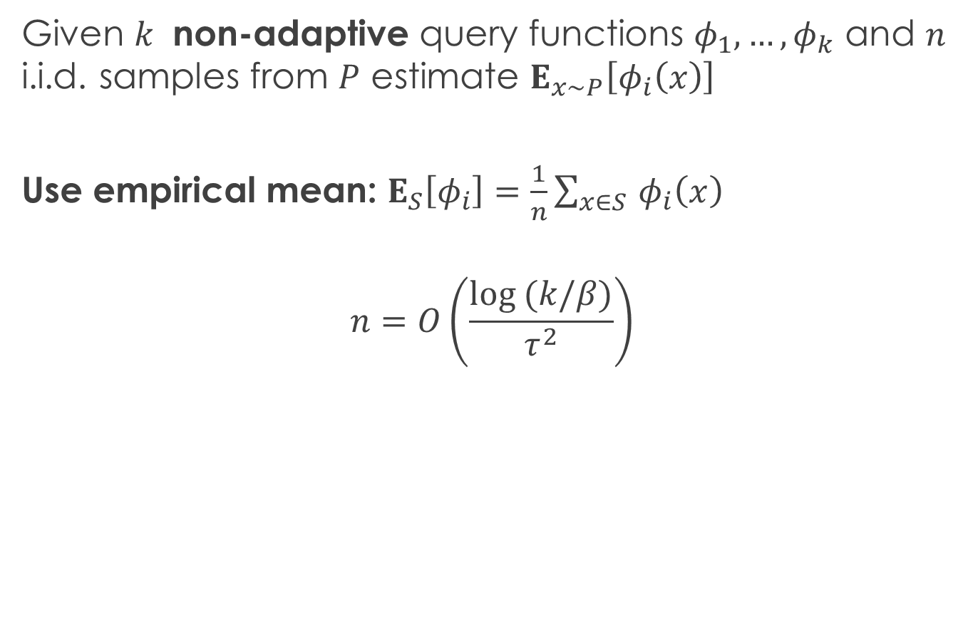
Answering non-adaptive SQs
Given $k$ non-adaptive query functions $φ_{1},…{,φ}_{k}$ and $n$ i.i.d. samples from $P$ estimate $E_{x∼P}\left[φ_{i}\left(x\right)\right]$
Use empirical mean: $E_{S}\left[φ_{i}\right]=\frac{1}{n}\sum_{x∈S }{φ_{i}\left(x\right)}$
$$n=O\left(\frac{log (k/β)}{τ^{2}}\right)$$

Slide 12

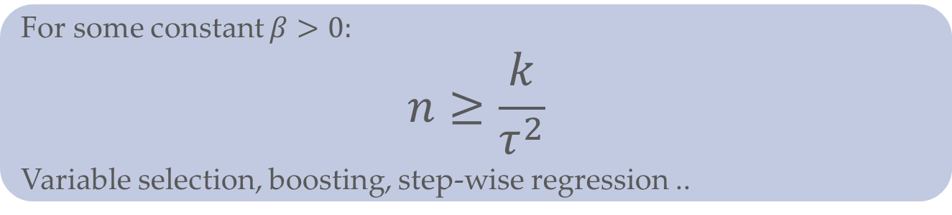
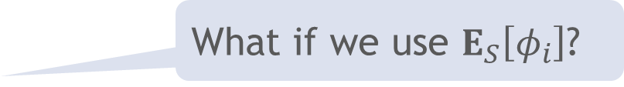
Answering adaptively-chosen SQs
What if we use $E_{S}\left[φ_{i}\right]$?
For some constant $β>0:$
$$n≥\frac{k}{τ^{2}}$$
Variable selection, boosting, step-wise regression ..
Sample splitting: $n=O\left(\frac{k⋅log k}{τ^{2}}\right)$

Slide 13
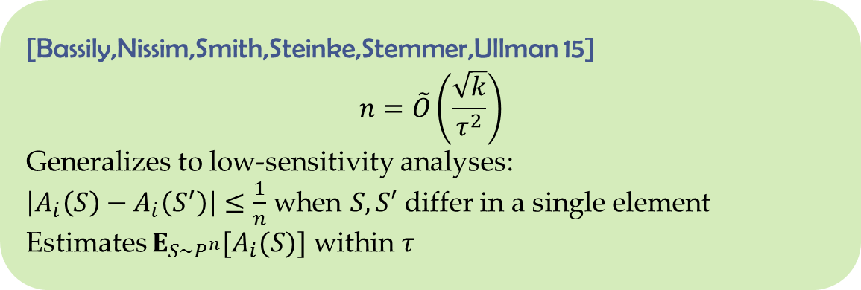
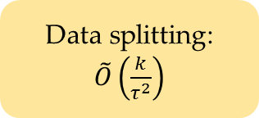
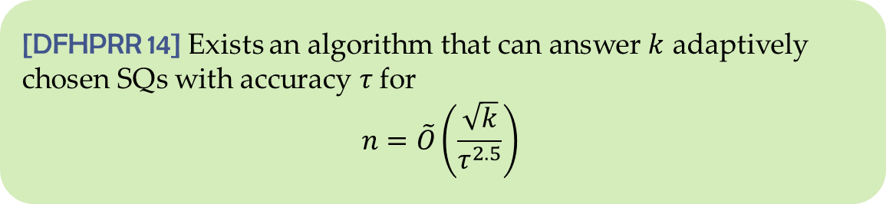
Answering adaptive SQs
[DFHPRR 14] Exists an algorithm that can answer $k$ adaptively chosen SQs with accuracy $τ$ for
$$n=\tilde{O}\left(\frac{\sqrt{k}}{τ^{2.5}}\right)$$
Data splitting:
$\tilde{O}\left(\frac{k}{τ^{2}}\right)$
[Bassily,Nissim,Smith,Steinke,Stemmer,Ullman 15]
$$n=\tilde{O}\left(\frac{\sqrt{k}}{τ^{2}}\right)$$
Generalizes to low-sensitivity analyses:
$\left|A_{i}\left(S\right)−A_{i}\left(S^{′}\right)\right|≤\frac{1}{n}$ when $S,S′$ differ in a single element
Estimates $E_{S∼P^{n}}[A_{i}(S)]$ within $τ$

Slide 14

Value perturbation
Answer low-sensitivity query $A$ with $A\left(S\right)+ζ$
Laplace/Gaussian

Slide 15

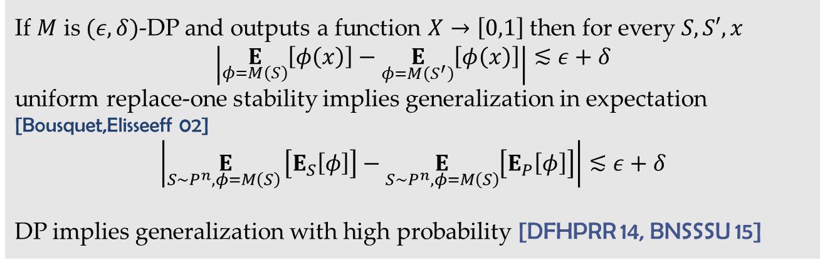
Differential privacy [Dwork,McSherry,Nissim,Smith 06]
DP implies generalization
Differential privacy is stability
If $M$ is $(ε,δ)$-DP and outputs a function $X→\left[0,1\right]$ then for every $S,S′,x$
$$\left|\underset{φ=M\left(S\right)}{E}\left[φ\left(x\right)\right]−\underset{φ=M\left(S^{′}\right)}{E}\left[φ\left(x\right)\right]\right|≲ε+δ$$
uniform replace-one stability implies generalization in expectation [Bousquet,Elisseeff 02]
$$\left|\underset{S∼P^{n}, φ=M\left(S\right) }{E}\left[E_{S}\left[φ\right]\right]−\underset{S∼P^{n}, φ=M\left(S\right)}{E}\left[E_{P}\left[φ\right]\right]\right|≲ε+δ$$
DP implies generalization with high probability [DFHPRR 14, BNSSSU 15]

Slide 16
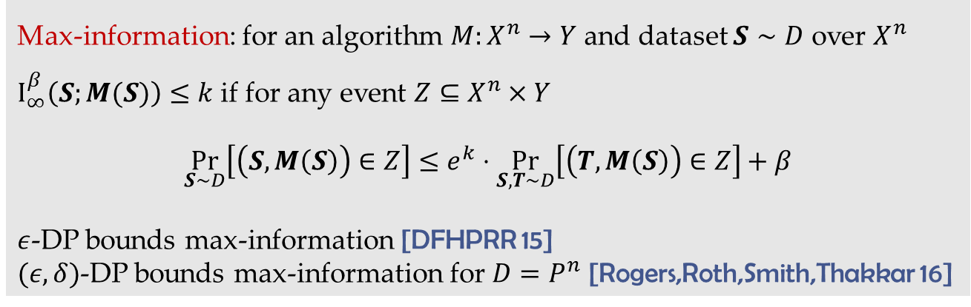
Differential privacy [DMNS 06]
DP implies generalization
Differential privacy limits information learned about the dataset
Max-information: for an algorithm $M:X^{n}→Y$ and dataset $S∼D$ over $X^{n}$
$I_{∞}^{β}\left(S;M(S)\right)≤k$ if for any event $Z⊆X^{n}×Y$
$$\underset{S∼D}{Pr}\left[\left(S,M\left(S\right)\right)∈Z\right]≤e^{k}⋅\underset{S,T∼D}{Pr}\left[\left(T,M\left(S\right)\right)∈Z\right]+β$$
$ε$-DP bounds max-information [DFHPRR 15]
$(ε,δ)$-DP bounds max-information for $D=P^{n}$ [Rogers,Roth,Smith,Thakkar 16]

Slide 17

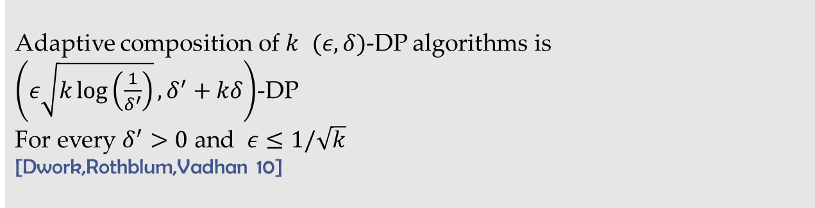
Differential privacy [DMNS 06]
DP implies generalization
DP composes adaptively
Adaptive composition of $k$ $(ε,δ)$-DP algorithms is
$\left(ε\sqrt{k\log\left(\frac{1}{δ^{′}}\right)},δ^{′}+kδ\right)$-DP
For every $δ^{′}>0$ and $ε≤1/\sqrt{k}$
[Dwork,Rothblum,Vadhan 10]

Slide 18
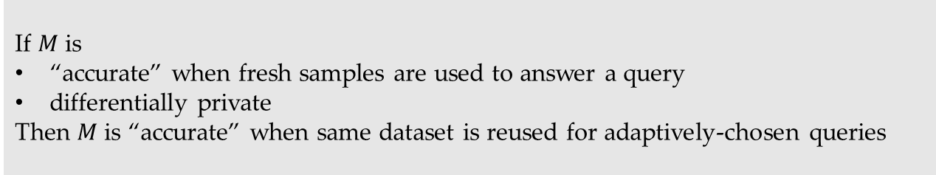
Differential privacy [DMNS 06]
DP implies generalization
DP composes adaptively
If $M$ is
“accurate” when fresh samples are used to answer a query
differentially private
Then $M$ is “accurate” when same dataset is reused for adaptively-chosen queries

Slide 19
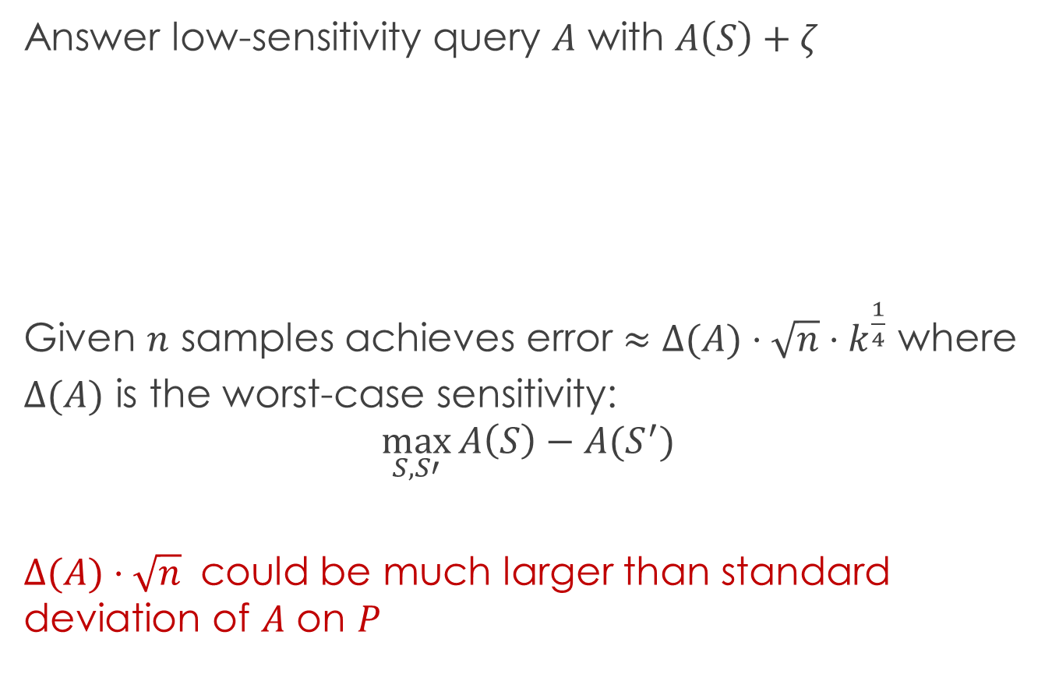
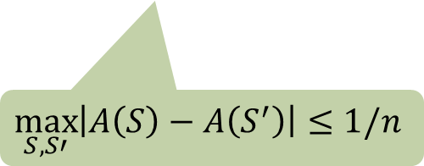
Value perturbation [DMNS 06]
Answer low-sensitivity query $A$ with $A\left(S\right)+ζ$
Given $n$ samples achieves error $≈Δ(A)⋅\sqrt{n}⋅k^{\frac{1}{4}}$ where
$Δ(A)$ is the worst-case sensitivity:
$$\max_{S,S′}{A\left(S\right)−A(S^{′})}$$
$Δ(A)⋅\sqrt{n}$ could be much larger than standard deviation of $A$ on $P$
$$\max_{S,S′}\left|A\left(S\right)−A\left(S^{′}\right)\right|≤1/n$$

Slide 20
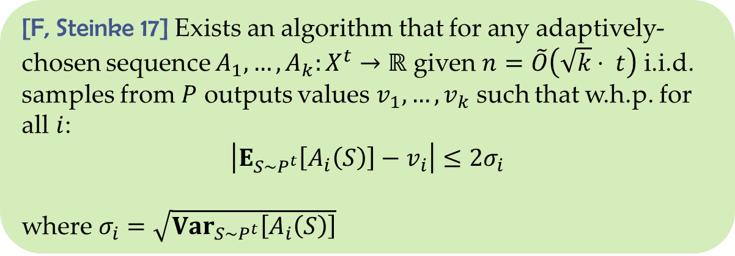
Beyond low-sensitivity
[F, Steinke 17] Exists an algorithm that for any adaptively-chosen sequence $A_{1},…,A_{k}:X^{t}→ℝ$ given $n=\tilde{O}\left(\sqrt{k}⋅ t\right)$ i.i.d. samples from $P$ outputs values $v_{1},…,v_{k}$ such that w.h.p. for all $i$:
$$\left|E_{S∼P^{t}}\left[A_{i}\left(S\right)\right]−v_{i}\right|≤2σ_{i}$$
where $σ_{i}=\sqrt{{Var}_{S∼P^{t}}\left[A_{i}\left(S\right)\right]}$

Slide 21



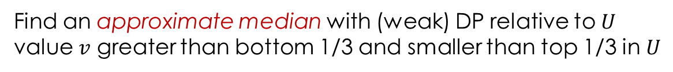















Stable Median
$$S$$
$$S^{1}$$ | $S^{2}$ | $$S^{3}$$ | $⋯$ | $$⋯$$ | $$⋯$$ | $$S^{m}$$
$$n=tm$$
$⋯$
$$A_{i}$$
$$A_{i}$$
$$A_{i}$$
$⋯$
$$A_{i}$$
$$A_{i}$$
$$A_{i}$$
$$y_{1}$$
$$y_{2}$$
$$y_{3}$$
$$y_{m−2}$$
$$y_{m−1}$$
$$y_{m}$$
$$U$$
$$v$$
Find an approximate median with (weak) DP relative to $U$
value $v$ greater than bottom 1/3 and smaller than top 1/3 in $U$

Slide 22
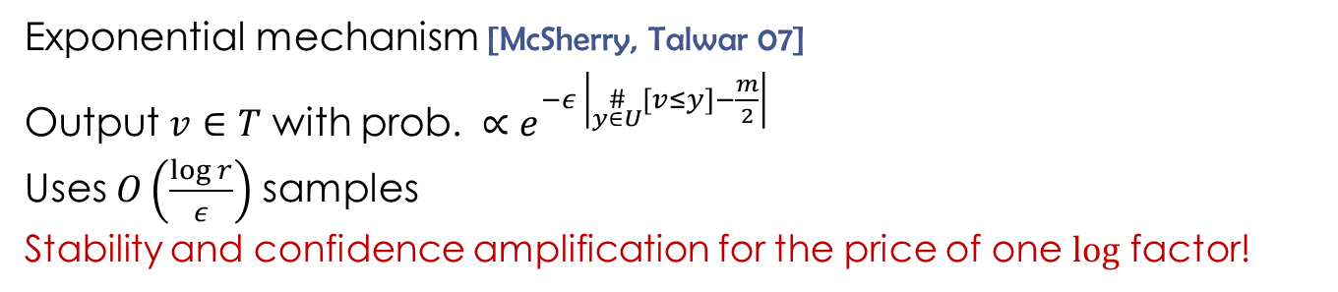
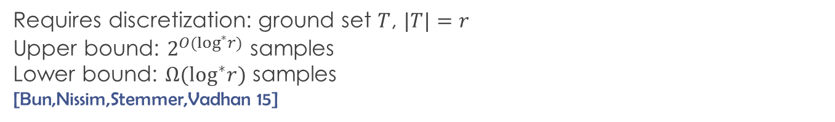


Median algorithms
Requires discretization: ground set $T$, $|T|=r$
Upper bound: $2^{O(\log^{∗}r)}$ samples
Lower bound: $Ω(\log^{∗}r)$ samples
[Bun,Nissim,Stemmer,Vadhan 15]
$$U$$
$$T$$
Exponential mechanism [McSherry, Talwar 07]
Output $v∈T$ with prob. $∝e^{−ε \left|\underset{y∈U}{\#}\left[v≤y\right]−\frac{m}{2}\right|}$
Uses $O\left(\frac{log r}{ε}\right)$ samples
Stability and confidence amplification for the price of one $log$ factor!

Slide 23
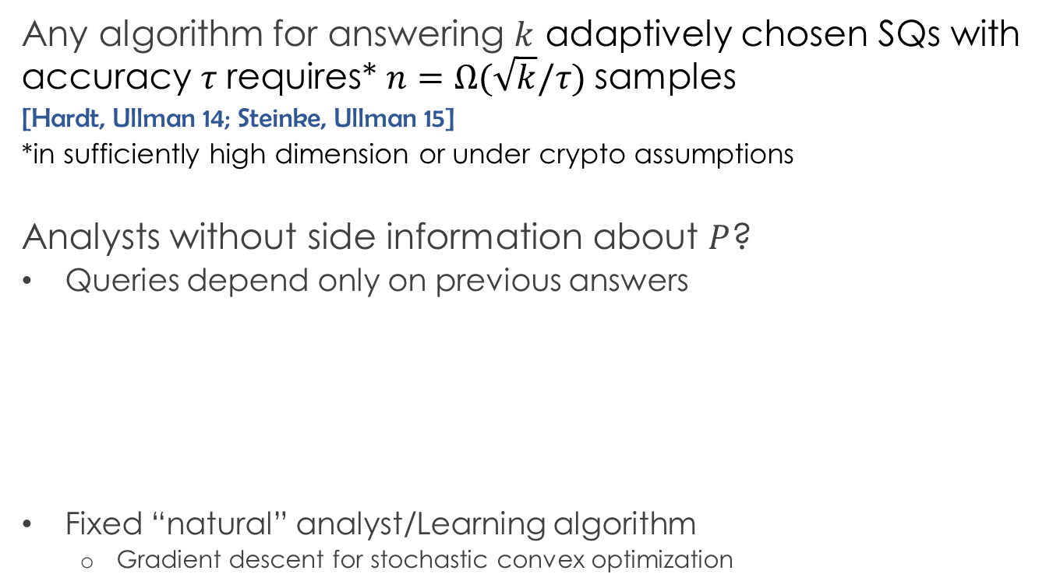
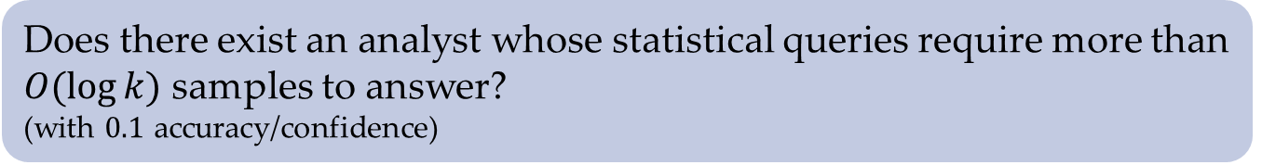
Limits
Any algorithm for answering $k$ adaptively chosen SQs with accuracy $τ$ requires* $n=Ω(\sqrt{k}/τ)$ samples
[Hardt, Ullman 14; Steinke, Ullman 15]
*in sufficiently high dimension or under crypto assumptions
Analysts without side information about $P$?
Queries depend only on previous answers
Fixed “natural” analyst/Learning algorithm
  Gradient descent for stochastic convex optimization
Does there exist an analyst whose statistical queries require more than $O(\log{k)}$ samples to answer?
(with $0.1$ accuracy/confidence)

Slide 24
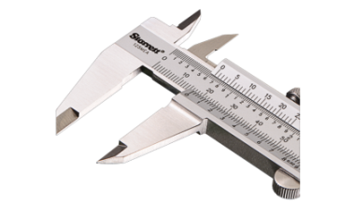

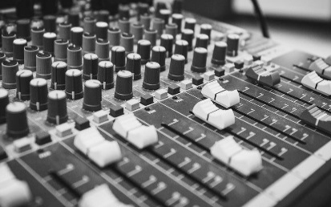

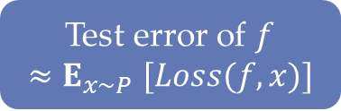


ML practice
Data
Data
Data
Data
Data
Data
Data
Training
Validation
Testing
$$θ$$
XGBoost SVRG Tensorflow
$$f$$
$$f_{θ}$$
Test error of $f$
$${≈E}_{x∼P}[Loss(f,x)]$$

Slide 25




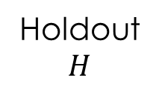


Reusable holdout [DFHPRR 15]
Data
Data
Data
Training
$$T$$
Data
Data
Data
Holdout
$$H$$
$$f_{1}$$
$$\hat{Loss}(f_{1})$$
Reusable holdout
algorithm
$$f_{2}$$
$$\hat{Loss}(f_{2})$$
AI guru
$$f_{k}$$
$$\hat{Loss}(f_{k})$$

Slide 26
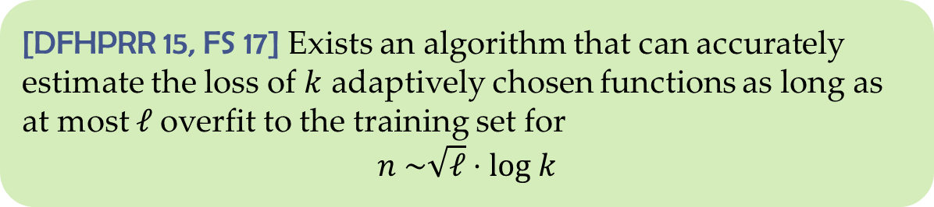
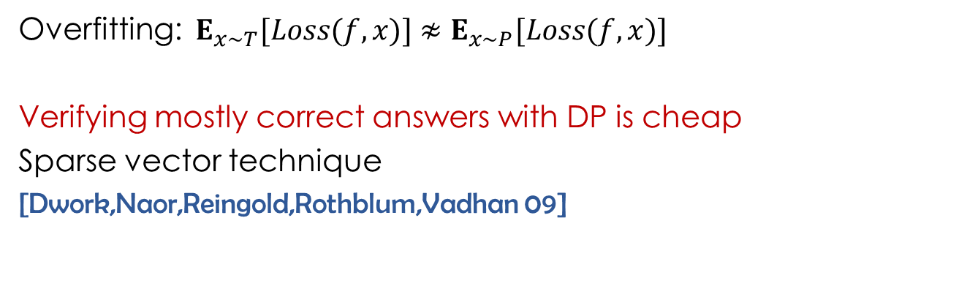
Reusable holdout
[DFHPRR 15, FS 17] Exists an algorithm that can accurately estimate the loss of $k$ adaptively chosen functions as long as at most $ℓ$overfit to the training set for
$$n \sim \sqrt{ℓ}⋅log k$$
Overfitting: $E_{x∼T}[Loss(f,x)]{ ≉E}_{x∼P}[Loss(f,x)]$
Verifying mostly correct answers with DP is cheap
Sparse vector technique
[Dwork,Naor,Reingold,Rothblum,Vadhan 09]

Slide 27
Conclusions
Datasets are reused adaptively
New conceptual framework
Deep connections to DP
  Privacy and generalization are aligned
  Data “freshness” is a limited resource
Real-valued analyses (without any assumptions)
Going beyond adversarial adaptivity
  Connections to stability and selective inference
Using these techniques in practice

