Slide 1
Diffusion-Based Metrics for Biological Network Analysis
Lenore Cowen
Tufts University

Slide 2
PPI network: issue with defining local neighborhoods: “small-world” network where everything is nearby!
Notes:
CDK-dependent phosphorylation pathway

Slide 3
Classical function label prediction
???
Secretion
Cell differentiation
SEC9
SSO2
Vesicular transport
Secretion
MSO1
UB14
SSO1
Ubiquination
Protein degradation
SNX4
Vesicular transport
Secretion
Proteolytic processing
Protein transport
Homeostasis
SNC1
???
BTN2
RCY1
Cell differentiation
Vesicular transport

Slide 4
Shortest path distances in yeast

Slide 5
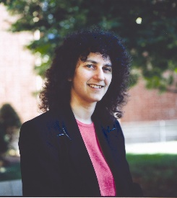
Our insight: Not all short paths are equally strong indications of similarity
Short paths through low degree nodes mean more!
Notes:
Xavi Hernandez

Slide 6
Same in biological networks
HHT2 is a core histone involved in chromatin assembly, global genome nucleotide excision repair, and heterochromatin-mediated telomeric and HM silencing.
HHT2
RAD53
HXT7
PCT1
COG4

Slide 7
Wanted: More fine-grained measure of pairwise similarity
Need a new Distance Metric:
Shortest path has lots of ties:
Recall: A metric d satisfies the following three properites:
d(X,Y)=0 iff X=Y
d(X,Y) = d(Y,X)
d(X,Y) + d (Y,Z) ≥ d(X,Z)
 | 0 | 1 | 1 | 2 | 1 | 2 | 3 | 2 | 1 | 2 | 2
 | 1 | 0 | 1 | 1 | 2 | 2 | 1 | 3 | 1 | 1 | 2
 | 1 | 1 | 0 | 1 | 2 | 1 | 2 | 3 | 1 | 2 | 1
 | 2 | 1 | 1 | 0 | 1 | 2 | 3 | 2 | 2 | 1 | 2
 | 1 | 2 | 2 | 1 | 0 | 2 | 2 | 2 | 2 | 1 | 1
 | 2 | 2 | 1 | 2 | 2 | 0 | 2 | 2 | 2 | 2 | 1
 | 3 | 1 | 2 | 3 | 2 | 2 | 0 | 2 | 1 | 1 | 2
 | 2 | 3 | 3 | 2 | 2 | 2 | 2 | 0 | 2 | 1 | 1
 | 1 | 1 | 1 | 2 | 2 | 2 | 1 | 2 | 0 | 2 | 1
 | 2 | 1 | 2 | 1 | 1 | 2 | 1 | 1 | 2 | 0 | 2
 | 2 | 2 | 1 | 2 | 1 | 1 | 2 | 1 | 1 | 2 | 0

Slide 8
Diffusion State Distance: first piece
Define Heᵏ (a,b) = the expected number of times the k-step random walk starting at a reaches b.
Note: not yet a metric
a
b
b
a

Slide 9
Diffusion State Distance (Full definition)
Define Heᵏ (a,b) = the expected number of times the k-step random walk starting at a reaches b.
Heᵏ (a) = (Heᵏ (a, v₁), Heᵏ (a,v₂), … Heᵏ (a,vn) )
DSDᵏ (u,v) = | Heᵏ (u) - Heᵏ (v) |₁
We prove DSD is a metric + converges as k→∞

Slide 10
Complexity of computing the DSD matrix
We can compute the converged DSD matrix as follows:
DSD (u,v)= $\left\|(\right.1_{u}$– $1_{v}$) (I${\left. −D^{−1} A+W )^{−1}\right\|}_{1}$
where D is the diagnol degree matrix, A is the adjacency matrix of the network, and W is the constant matrix where each row is a copy of $π^{}$ the degree of each of the vertices normalized by the sum of all the vertex degrees.
Complexity dominated by inverting matrix: ${ O(n}^{3})$

Slide 11
Connection to the Graph Laplacian
Boehnlein et al. showed: (for a lazy random walk version of DSD and for $L_{q}$ norms):
${DSD}_{q}$(u,v)= $\left\|(\right.1_{u}$– $1_{v}$) G ${\left. \right\|}_{q}$
where G is the so-called Green’s function
uniquely defined as the matrix satisfying
G∆ = I - 1$π^{T}$
G1 = 0.
where ∆ = I - $D^{−1}$A, where A is the adjacency matrix and D is the diagnol matrix of degrees.

Slide 12
Connection to the Graph Laplacian
Recently, Andrew Beveridge proved that this means that DSD can be shown to measure the difference between random walks starting from u and v to a randomly chosen target node D
Many other diffusion kernels have been proposed for PPI networks: see [Lee, Tu, Deng, Sun and Chen, 2006; Qi, Suhail, Lin, Boeke and Bader, 2008; also see survey by Fengzhu Sun et al., 2013.]

Slide 13
Connection to the Graph Laplacian
Many other diffusion kernels have been proposed for PPI networks: see [Lee, Tu, Deng, Sun and Chen, 2006; Qi, Suhail, Lin, Boeke and Bader, 2008; also see survey by Fengzhu Sun et al., 2013.]
DSD is worthy of study: mathematically natural, connected to the graph Laplacian, convergent independent of the length of the random walk, downweights paths through hubs.

Slide 14
DSD spreads out distances
Notes:
fff

Slide 15
Classical function label prediction: have k closest DSD neighbors vote
???
Secretion
Cell differentiation
SEC9
SSO2
Vesicular transport
Secretion
MSO1
UB14
SSO1
Ubiquination
Protein degradation
SNX4
Vesicular transport
Secretion
Proteolytic processing
Protein transport
Homeostasis
SNC1
???
BTN2
RCY1
Cell differentiation
Vesicular transport

Slide 16
Four classical function prediction methods
Based on shortest paths
Based on DSD
Majority vote
Neighborhood
Multi-way cut
Functional Flow
Majority vote
Neighborhood
Multi-way cut
Functional Flow

Slide 17
Classical Function Prediction Methods
Majority vote; neighborhood methods [Schwikowski et al 2000, Hishigaki et al, 2001]
Clustering methods [Arnau et al 2005, Bader et al 2003, Song&Singh 2009]
Multiway cut [Vasquez et al 2003]
Functional Flow [Nabieva et al 2005]
Other methods [see, e.g. Sharan et al 2007]

Slide 18
Cross-Validation on the Yeast PPI Network
Largest connected component of the PPI network of S. cerevisiae, downloaded from BioGRID: 4990 nodes; 74,310 edges: did 10 runs of 2-fold cross validation and reported mean and standard deviation for:
Accuracy: assign each protein its highest scoring label; mark as correct it its one of its assigned labels.
F1 score: top 3 scoring labels: compute 2*p*r/(p+r) (p=precision; r=recall)
Notes:
Precision = TP/(TP+FP) = proportion of correct real positives
Recall = sensitivity= TP/P = TP / (TP+FN)

Slide 19
Where do the labels come from?
10 cell cycle and DNA
10.01 DNA processing
10.01.05 DNA repair & recombination
17
MIPS
Funcat
74
154
Or GO, the gene ontology

Slide 20
DSD function prediction example

Slide 21
Classical Function Prediction Methods
Majority vote; [Schwikowski et al 2000]
Ordinary majority vote: all neighbors vote on functional label.
. DSD Majority vote
DSD version: k closest neighbors
Weighted DSD: k closest neighbors weighted by DSD distance.

Slide 22
Notes:
MV, 10 runs, 2 fold

Slide 23
Classical Function Prediction Methods
Neighborhood method [Hishigaki et al, 2001]
Assign functional labels values based on number of times they appear in neighborhood compared to in entire PPI network
DSD Neighborhood
Instead of taking nodes to shortest path distance n, take k closest nodes in DSD distance as a node’s local neighborhood

Slide 24
Notes:
Neighborhood with error bar

Slide 25
Classical Function Prediction Methods
Multiway Cut [Vasquez et al, 2003]
ILP formulation that seeks to minimize the number of times annotations associated with neighboring proteins receive different labels.
DSD Multiway Cut
Add additional edges between nodes whose DSD distance falls below a given threshold (based on mean and std dev)

Slide 26
Notes:
Gmc, with error bars

Slide 27
Classical Function Prediction Methods
Fuctional Flow [Nabieva et al, 2005]
Assign functional labels by pushing flow through the DSD network; each known annotation creates a reservoir of that function.
DSD Functional Flow
For nodes whose DSD distance is below a threshold, add edges with weights inversely proportional to the DSD (threshold set by mean/std dev of DSD values)

Slide 28
Notes:
FF 10 runs, 2-fold CV

Slide 29
 | MIPS First Level |  | MIPS Second Level |  | MIPS Third Level
 | Accuracy | F1 Score | Accuracy | F1 Score | Accuracy | F1 Score
Majority Vote | 50.0±0.5 | 41.6±0.2 | 40.7±0.5 | 30.7±0.4 | 38.4±0.4 | 29.5±0.4
MV with DSD | 63.7±0.4 | 47.2±0.2 | 49.3±0.5 | 35.6±0.2 | 43.8±0.4 | 32.3±0.3
MV (weighted DSD) | 63.2±0.5 | 48.1±0.3 | 50.6±0.4 | 36.6±0.2 | 45.3±0.3 | 33.6±0.2
Neighborhood | 43.3±0.3 | 34.5±0.2 | 32.4±0.6 | 26.1±0.3 | 31.3±0.5 | 24.8±0.3
NH with DSD | 51.5±0.4 | 40.6±0.3 | 34.8±0.5 | 27.7±0.2 | 32.6±0.6 | 25.1±0.3
Multi-cut | 55.2±0.4 | 42.1±0.2 | 42.0±0.6 | 28.1±0.2 | 36.6±0.4 | 24.8±0.3
Multi-cut with DSD | 58.3±0.3 | 42.2±0.2 | 44.6±0.4 | 29.6±0.1 | 38.2±0.3 | 25.3±0.2
Functional Flow | 50.5±0.6 | 37.0±0.3 | 32.1±0.4 | 22.6±0.3 | 25.4±0.6 | 18.3±0.3
FF with DSD | 54.0±0.4 | 40.8±0.2 | 38.3±0.3 | 27.1±0.3 | 31.5±0.3 | 22.8±0.2

Slide 30
Notes:
GO exact match

Slide 32
Notes:
Pombe, GO

Slide 33
Notes:
Pombe, GO

Slide 34
Notes:
Pombe, GO

Slide 35
Notes:
Pombe, GO

Slide 36
So far....
A diffusion based metric was defined for function prediction on biological networks
The right metric for this problem involved downweighting paths through hubs; how to design the right metric for other biological network problems?
See http://dsd.cs.tufts.edu for code and our paper in PLOS One… (joint with Ben Hescott)

Slide 37
Beyond function prediction: disease gene prioritization
Disease gene prioritization problem: given a set of seed genes known to be implicated in some complex disease, rank a set of other genes as most related to the seed set based on the PPI network.
This is also a very well studied problem; diffusion-based methods perform best (Kohler’s RWR, GeneWanderer, many more)

Slide 38
DSD for Disease Gene Prioritization
DSD is a gene-gene distance.
Several natural ways to generalize DSD to a gene-geneset distance (minimum, average, new artificial node connected to all the disease genes)
Prioritize genes in order of their DSD distance to the known disease gene set.

Slide 39
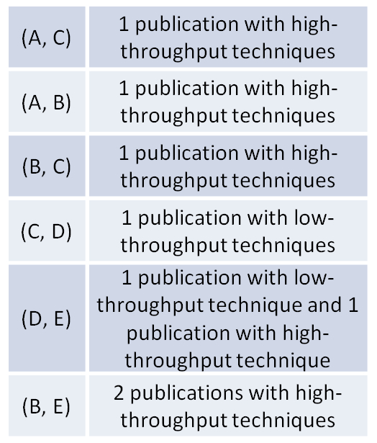
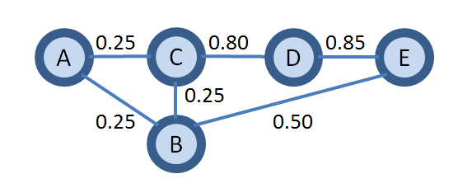
cDSD: let’s have some confidence
Data Quality Issue: false positives and false negatives
BioGRID: Assign confidence score based on the experiment counts & types
$cDSD\left(X, Y\right)={\left|{He}^{k}\left(X\right)−{He}^{k}\left(Y\right)\right|}_{1}$, for any protein X and Y
Notes:
First let’s have some confidence; due to the data quality issue, there are false positive and false negatives as well as missing PPIs;
Therefore we assign confidence score based on the experiment evidence, which is not done by our previous work.
As shown in the example, we have the PPI network, and then for each edge, we look at its evidence, if it is veified by somoe low-throughput experiment,
We tend to assign high confidence score; if there are multiple evidence, we also give bonus evidence~

Slide 40
cDSD: confidence scores can be incorporated in the natural way!
Data Quality Issue: false positive and false negative
BioGRID: Assign confidence score based on the experiment counts & types
0.50
0.19
0.62
0.48
0.52
0.63
0.25
0.50
0.19 0.25
0.50
0.37
$cDSD\left(X, Y\right)={\left|{He}^{k}\left(X\right)−{He}^{k}\left(Y\right)\right|}_{1}$, for any protein X and Y
Notes:
Add transition probabilities

Slide 41
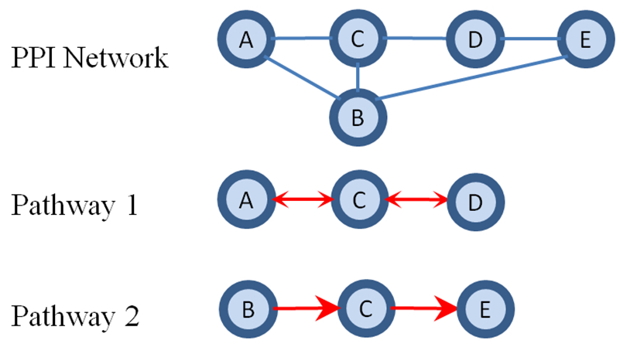
Incorporating known biological knowledge: “important” nodes or pathways
Notes:
We also test the method where we incorporate pathway PPIs as independent PPIs and define caDSD
To compare with
We will allow directed edges but in the paper we don’t have enough directed edges to affect the performance but we can still handle it

Slide 42
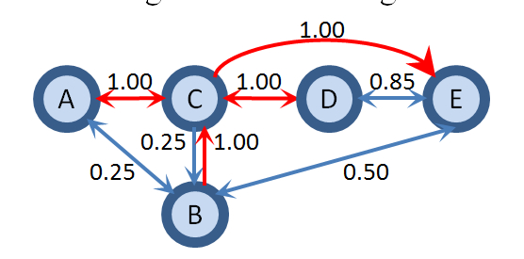
caDSD: just takes edges from pathways naively
Normalize and calculate transition probabilities;
$caDSD\left(X, Y\right)={\left|{He}^{k}\left(X\right)−{He}^{k}\left(Y\right)\right|}_{1}$, for any protein X and Y
Notes:
We also test the method where we incorporate pathway PPIs as independent PPIs and define caDSD
To compare with
We will allow directed edges but in the paper we don’t have enough directed edges to affect the performance but we can still handle it

Slide 43
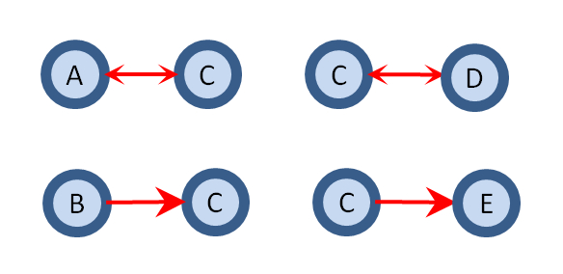
capDSD: adds Highway Paths
By simply augmenting the graph from KEGG PPIs, we lost the dependence information between protein pairs that function together.
Notes:
Again, by simply using independent pathway PPIs, we lost a lot of information;
We add KEGG pathways as highway paths
Incorporate functional pathway into PPI network explicitly, capture temporal information

Slide 44
capDSD: adds Highway Paths

Slide 45
capDSD: adds Highway Paths

Slide 46
capDSD: adds Highway Paths
1 1 1
2 2 2

Slide 47
capDSD: adds Highway Paths
r
1 1 1
m
m
2 2 2
r

Slide 48
capDSD: adds Highway Paths
1 1 1
2 2 2

Slide 49
capDSD: adds Highway Paths
1 1 1
2 2 2

Slide 50
capDSD: adds Highway Paths
1 1 1
2 2 2

Slide 51
capDSD: adds Highway Paths
1 1 1
2 2 2
$He\left(X, Y\right)=\sum_{i}{TIMES(X, Y_{i})},$ for any protein X and Y
where TIMES(x,y) is the expected visiting times from x to y in the augmented graph for k steps.
$He\left(X\right)=[He\left(X,U_{1}\right), He\left(X,U_{2}\right),…,He\left(X,U_{n}\right)]$, for each protein X
$capDSD\left(X, Y\right)={\left|{He}^{k}\left(X\right)−{He}^{k}\left(Y\right)\right|}_{1}$, for any protein X and Y

Slide 52
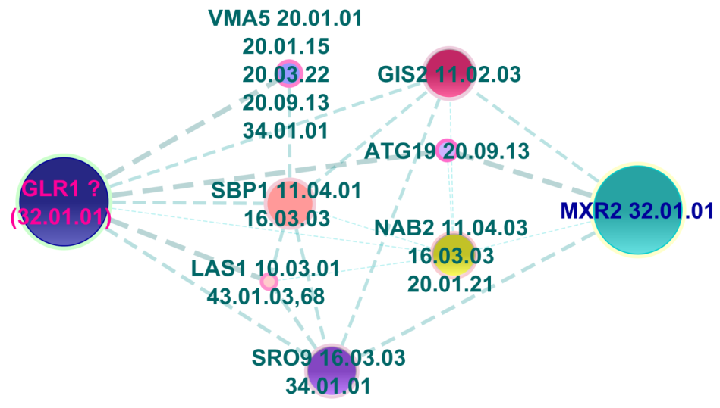
Experimental Validation
We conduct 10 runs of 2-fold cross validation for protein function prediction for
majority vote/weighted majority vote, [Schwikowski et al 2000]
functional flow, [Nabieva et al 2005]
multi-way cut; [Vasquez et al 2003]
We compare the original method against the version where we replace the shortest-path distance with DSDs (DSD, cDSD, caDSD, capDSD)
Majority vote/Weighted majority vote
We test two types of networks:
Physical PPIs from BioGRID
Integrative Protein Association Network from STRING: physical/genetic PPIs, co-expression data verified by experiments
Performance Measurement
Accuracy: see the highest scoring label is correct
F1 score: for top 3 scoring labels, compute 2*p*r/(p+r),
where p=precision, r=recall
Notes:
We test MV, WMV, FF, GMC;
Two sets of data: physical from BioGRID and STRING, integrative network
10 runs of 2-fold cross validation
Annotations are from MIPS and GO
For the purpose of the talk, we will focus the first one method because it is the simplest to explain, the original majority vote,, the DSD majority vote will…
For example, this is the subgraph of the ppi network; we have proteins and their functional labels from MIPS,
We want to predict functions for this one, the original mv will

Slide 53
Experimental Validation
We test two types of networks:
Physical PPIs from BioGRID
Integrative Protein Association Network from STRING: experimental physical/genetic PPIs, co-expression data, pathway relations
MIPS Functional Catalogue: First/Second/Third levels (GO, see paper)
Performance Measurement
Accuracy: percentage of proteins where the highest scoring label is correct
F1 score: for top 3 scoring labels, compute 2*p*r/(p+r),
where p=precision, r=recall
Notes:
We test MV, WMV, FF, GMC;
Two sets of data: physical from BioGRID and STRING, integrative network
10 runs of 2-fold cross validation
Annotations are from MIPS and GO

Slide 54
Our Results on BioGRID Physical PPI Network (MIPS)
(%)
Notes:
Define accuracy and FI score, say what majority vote is, and maybe a little about multiway cut and functional flow

Slide 55
Our Results on BioGRID Physical PPI Network (MIPS)
(%)
Notes:
Define accuracy and FI score, say what majority vote is, and maybe a little about multiway cut and functional flow

Slide 56
Our Results on BioGRID Physical PPI Network (MIPS)
(%)
Adding confidence (cDSD) always helps
Adding pathway edges (caDSD/capDSD) always helps: should we add highways?
Adding pathways as highways (capDSD) hurts GMC and FF sometimes
Best performing on BioGRID is weighted majority vote with capDSD
Notes:
Define accuracy and FI score, say what majority vote is, and maybe a little about multiway cut and functional flow

Slide 57
Our Results on STRING Network (MIPS)
 | Accuracy |  |  | F1 score
 | First Level | Second Level | Third Level | First Level | Second Level | Third Level
Majority Vote (MV) | 65.71% | 53.95% | 46.17% | 49.50% | 37.96% | 33.75%
Weighted MV with original DSD | 65.25% | 52.19% | 45.64% | 49.15% | 37.10% | 33.00%
WMV with caDSD | 69.67% | 59.41% | 53.21% | 52.20% | 41.62% | 38.29%
WMV with capDSD | 71.30% | 62.88% | 57.84% | 52.97% | 43.98% | 41.07%
Highway paths are even more important in the noisy network
FF improves across the board but again not for Multi-way Cut (see paper)
Best performing for STRING is also weighted majority vote with capDSD
Notes:
As for the string database where the pathway information is already incorporated in the simple fashion, namely cDSD already has pathway edges;
so we only have cDSD and capDSD
But we achieve even better improvement
The best performaning method is weighted majority vote with capDSD,

Slide 58
We have shown--
New metrics helped!
Incorporating confidence (always) and pathways (in most cases) helped even more!
Our networks are naturally directed, we could add unique directional edges. Does this help? (we tried adding edges known to be directed, but they are too few to make a difference). Predicted directions?
How to design the right metric for other network problems?
Supporting Website (includes code): http://dsd.cs.tufts.edu/capdsd
Notes:
There is code for this project and welcome to use it if you have a biological network and a set of pathways or confidence

Slide 59
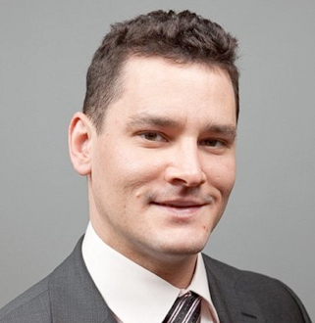
Thanks to NIH; collaborators

Slide 60
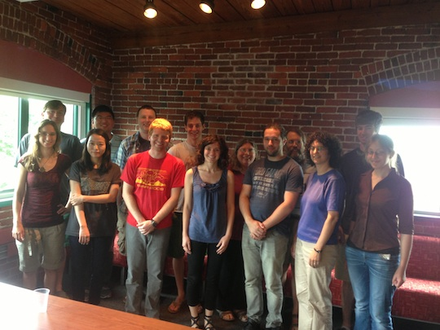
Acknowledgment
Tufts Bioinformatics and Computational Biology Research Group;

