Slide 1
Genome-wide Prediction of Enhancers and Their Target Genes using ENCODE data
Zhiping Weng
U. Mass. Medical School
Simons Institute, UC Berkeley, March 10, 2016

Slide 2
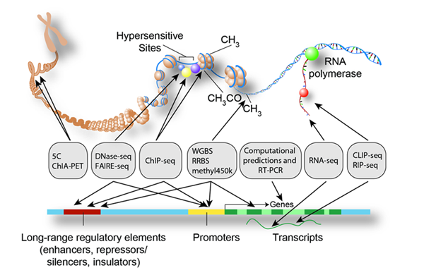
The Encyclopedia Of DNA Elements Consortium
Goals:
Catalog all functional elements in the genome
Develop freely available resource for research community
Study human and mouse

Slide 3
Overview of The ENCODE Consortium
Data Production Groups
RNA
Histone
Mods
DNase
DNAme
TF
Binding
RBP
Binding
Technology Development
Groups
Data Coordination
Center
Data Analysis Center
Analysis Working Group
Computational Analysis
Groups
Gene
Models
Chromatin
States
Element
ID
The ENCYCLOPEDIA
Slide from Mike Pazin, NHGRI

Slide 4
Where is the Encyclopedia?
So far ENCODE data producers have generated thousands of experiments in humans
200+ DNase-seq
800+ Transcription Factor (TF) ChIP-seq
300+ Histone Mark ChIP-seq
RNA-seq, RNA-binding, DNAme
How do we:
Integrate different experiments and assays?
Find functional annotations?

Slide 5
Components of the Encyclopedia
Gene expression
Transcription start sites
Uniformly processed peaks from DNase-seq, histone mark ChIP-seq and TF ChIP-seq
3D chromatin contacts from Hi-C and ChIA-PET
Semi-automated genome annotations (ChromHMM and Segway)
Candidate regulatory elements
Target genes of regulatory elements

Slide 6
Components of the Encyclopedia
Gene expression
Transcription start sites
Uniformly processed peaks from DNase-seq, histone mark ChIP-seq and TF ChIP-seq
3D chromatin contacts from Hi-C and ChIA-PET
Semi-automated genome annotations (ChromHMM and Segway)
Candidate regulatory elements (enhancers)
Target genes of regulatory elements (enhancers)

Slide 7
Goals for Enhancer Prediction
Develop an unsupervised method applicable to both human and mouse
Incorporate multiple epigenomic features, such as DNase-seq and H3K27ac
Apply method to as many cell and tissue types as possible

Slide 8
Rationale for Developing Methods in Mouse
Rich matrix of data of uniformly processed data:
Histone modification ChIP-seq (Bing Ren)
RNA-seq (Barbara Wold)
DNA methylation (Joe Ecker)
DNase-seq (John Stam)

Slide 9
ENCODE Data for Embryonic Mouse
 | 11.5 | 13.5 | 14.5 | 15.5 | 16.6 | 0
Facial Prominence
Forebrain
Heart
Hindbrain
Intestine
Kidney
Limb
Liver
Lung
Midbrain
Neural Tube
Stomach
H3K27ac Data - Bing Ren
DNase Data – John Stam
H3K27ac
DNase + H3K27ac

Slide 10
Rationale for Developing Methods in Mouse
Rich matrix of data of uniformly processed data:
Histone Modification ChIP-seq (Bing Ren)
RNA-seq (Barbara Wold)
DNA Methylation (Joe Ecker)
DNase-seq (John Stam)
Experimental validations of enhancers in embryonic mice:
VISTA Database (Len Penacchio & Axel Visel)

Slide 11
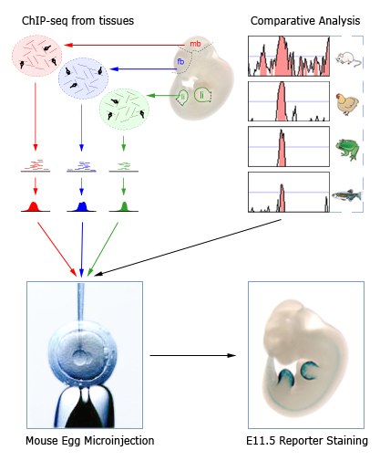
Over 2,000 total tested regions
Over 200 active enhancers in limb, brain sub regions, and heart
Pennacchio,…, Rubin (2006) Nature
Visel, …, Pennacchio (2009) Nature

Slide 12
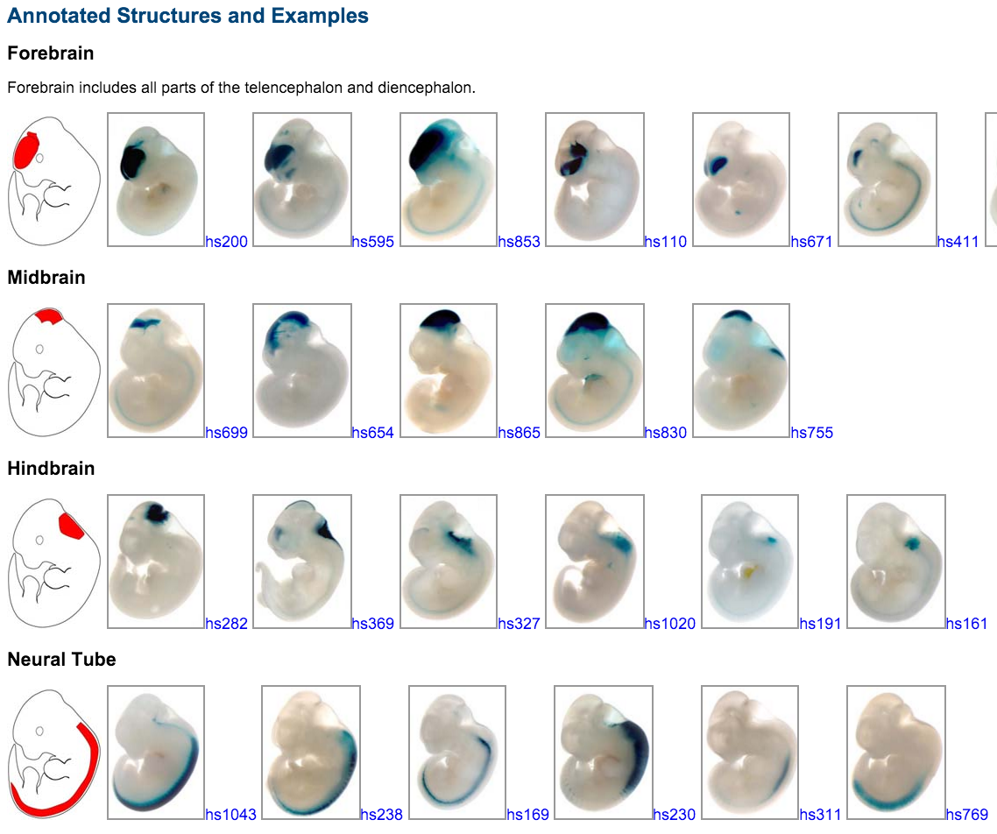
VISTA Database: Examples

Slide 13
Center Predictions
DNase Peaks
H3K27ac Peaks
How to Rank Peaks?
p-value
signal
multiple signals:
DNA Methylation
H3K4me1/2/3

Slide 14
Enhancer Prediction Method
 | VISTA Positive | VISTA Negative
Overlaps Peak | True Positive | False Positive
Does Not Overlap Peak | False Negative | True Negative

Slide 15
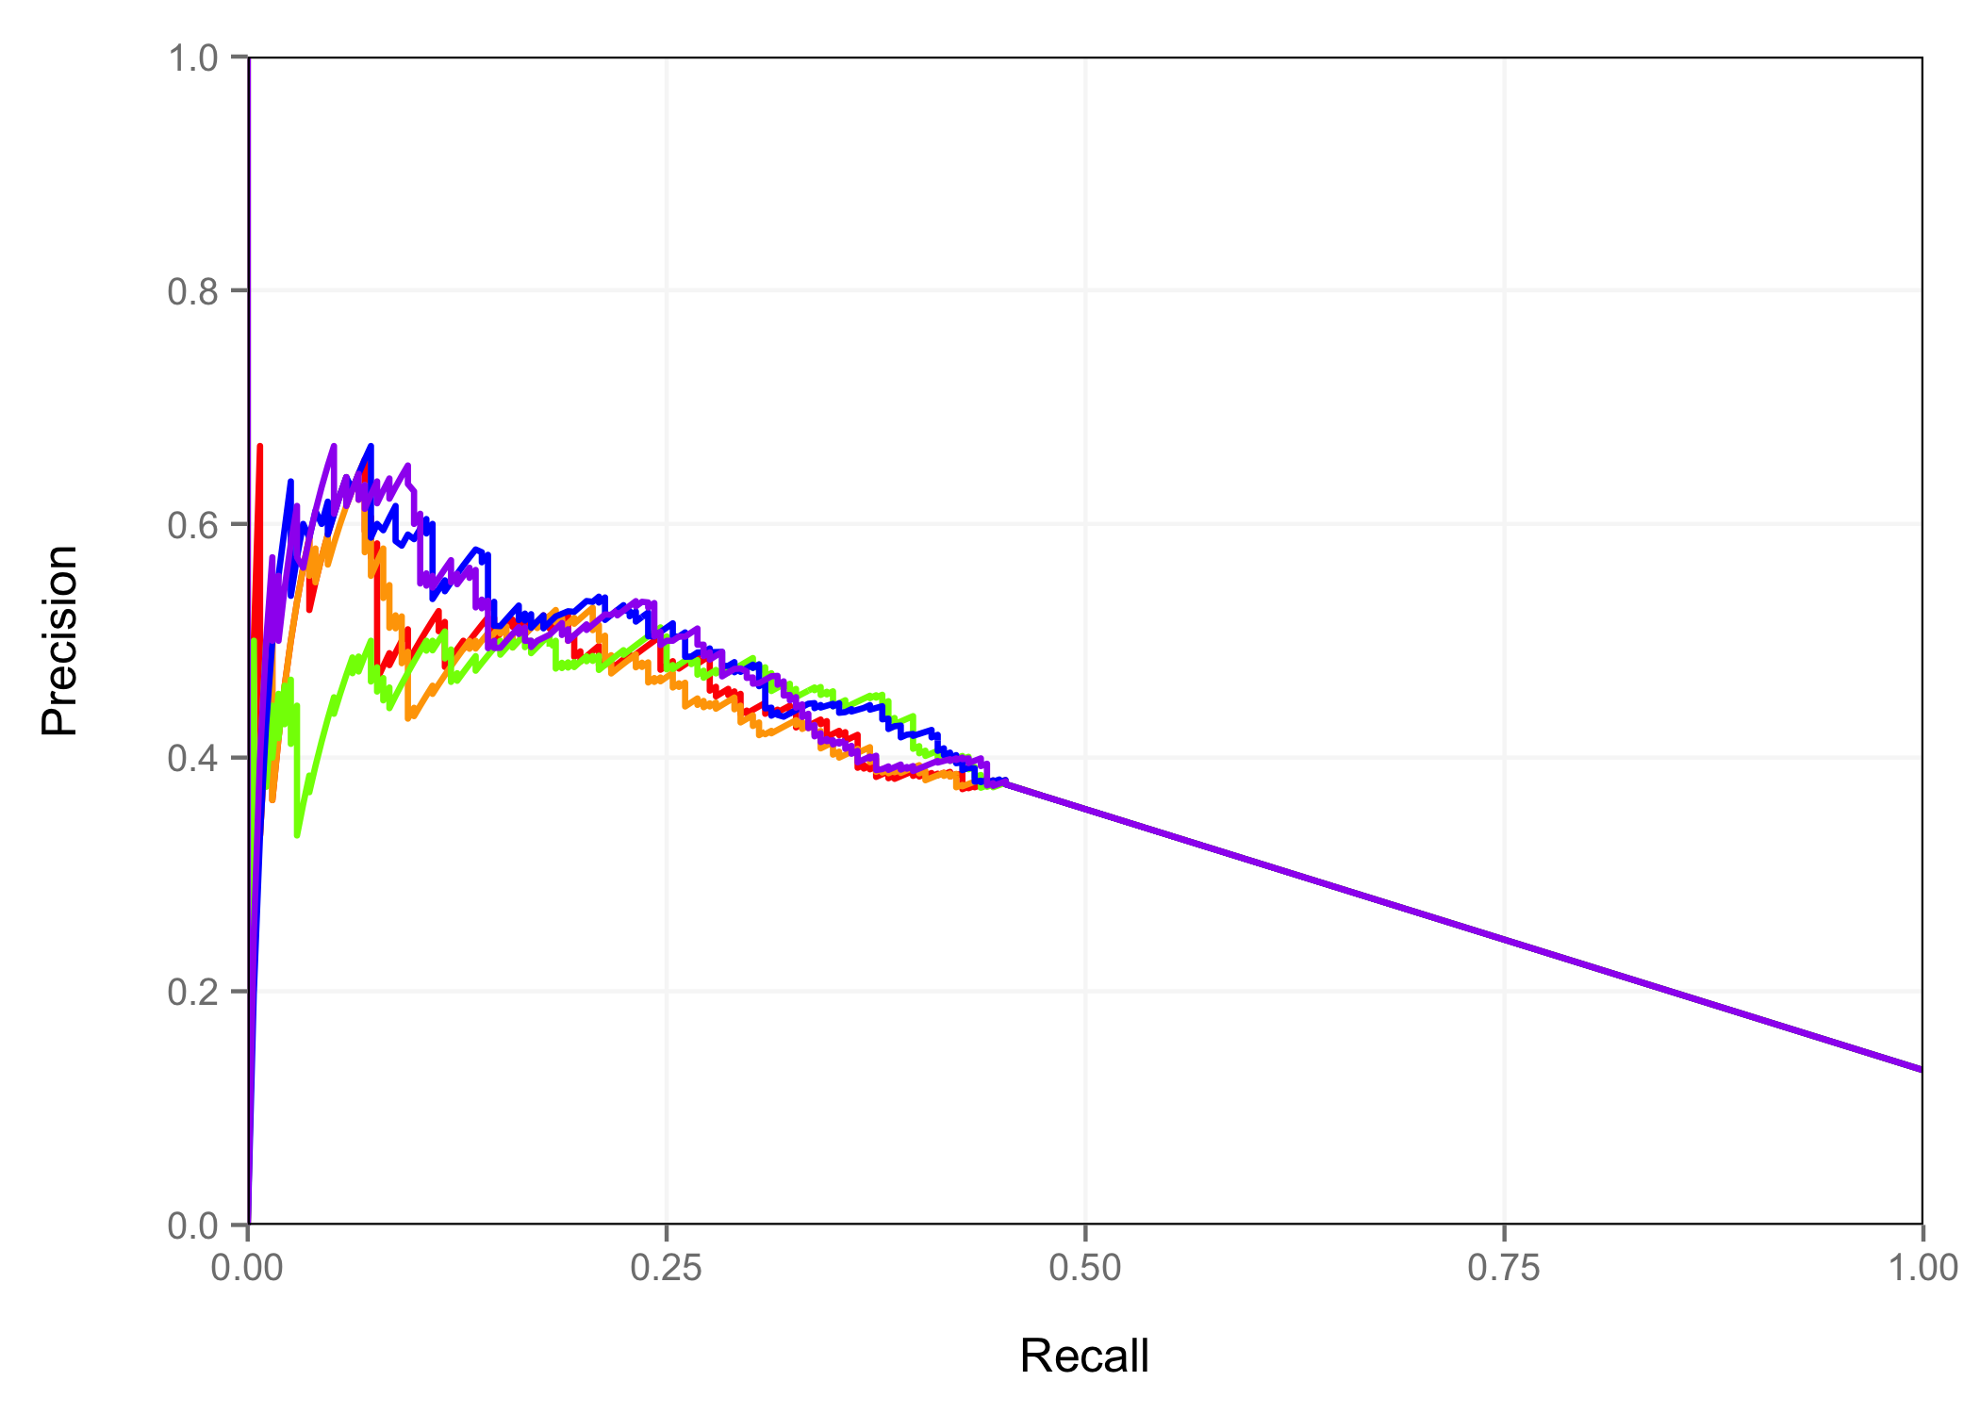
Hindbrain – Predictions Centered on DNase Peaks
Ranking Schemes
Peak P-value
DNase Signal
H3K27ac Signal
DNase Signal + H3K27ac Signal
DNase P-value +H3K27ac Signal

Slide 16
Results
Centering predictions on DNase peaks results in better performance than centering on H3K27ac peaks
Incorporating additional data such as DNA methylation, H3K4me1/2/3, H3K9ac, H3K27me3, or H3K9me3 did not improve performance

Slide 17
Enhancer Prediction Method
DNase
Peaks

Slide 18
Enhancer Prediction Method
DNase
Peaks
DNase
Signal

Slide 19
Enhancer Prediction Method
DNase
Peaks
DNase
Signal
H3K27ac
Signal

Slide 20
Enhancer Prediction Method
DNase
Peaks
DNase
Signal
H3K27ac
Signal

Slide 21
Enhancer Prediction Method
DNase
Peaks
Rank
4,826
Rank
57
DNase
Signal
Rank
31,898
Rank
43
H3K27ac
Signal

Slide 22
Enhancer Prediction Method
DNase
Peaks
Rank
4,826
Rank
57
DNase
Signal
Rank
31,898
Rank
43
H3K27ac
Signal
Average
Rank
18,362
50

Slide 23
Enhancer Prediction Method
DNase
Peaks
Rank
4,826
Rank
57
DNase
Signal
Rank
31,898
Rank
43
H3K27ac
Signal
Average
Rank
18,362
50
H3K27ac
Peaks

Slide 24
Enhancer Prediction Method
DNase
Peaks
Rank
4,826
Rank
57
DNase
Signal
Rank
31,898
Rank
43
H3K27ac
Signal
Average
Rank
18,362
50
H3K27ac
Peaks
Enhancer
Predictions

Slide 25
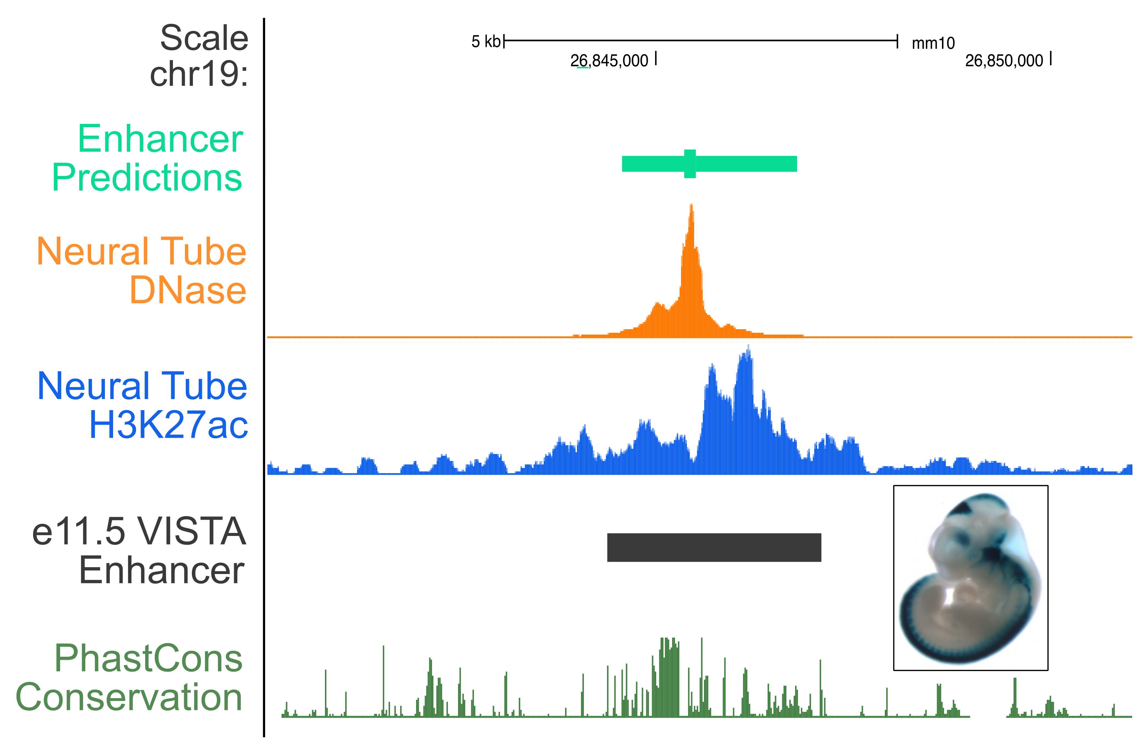
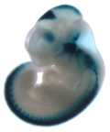
Example - Neural Tube (e11.5) Enhancer

Slide 26
Application to Human Datasets

Slide 27
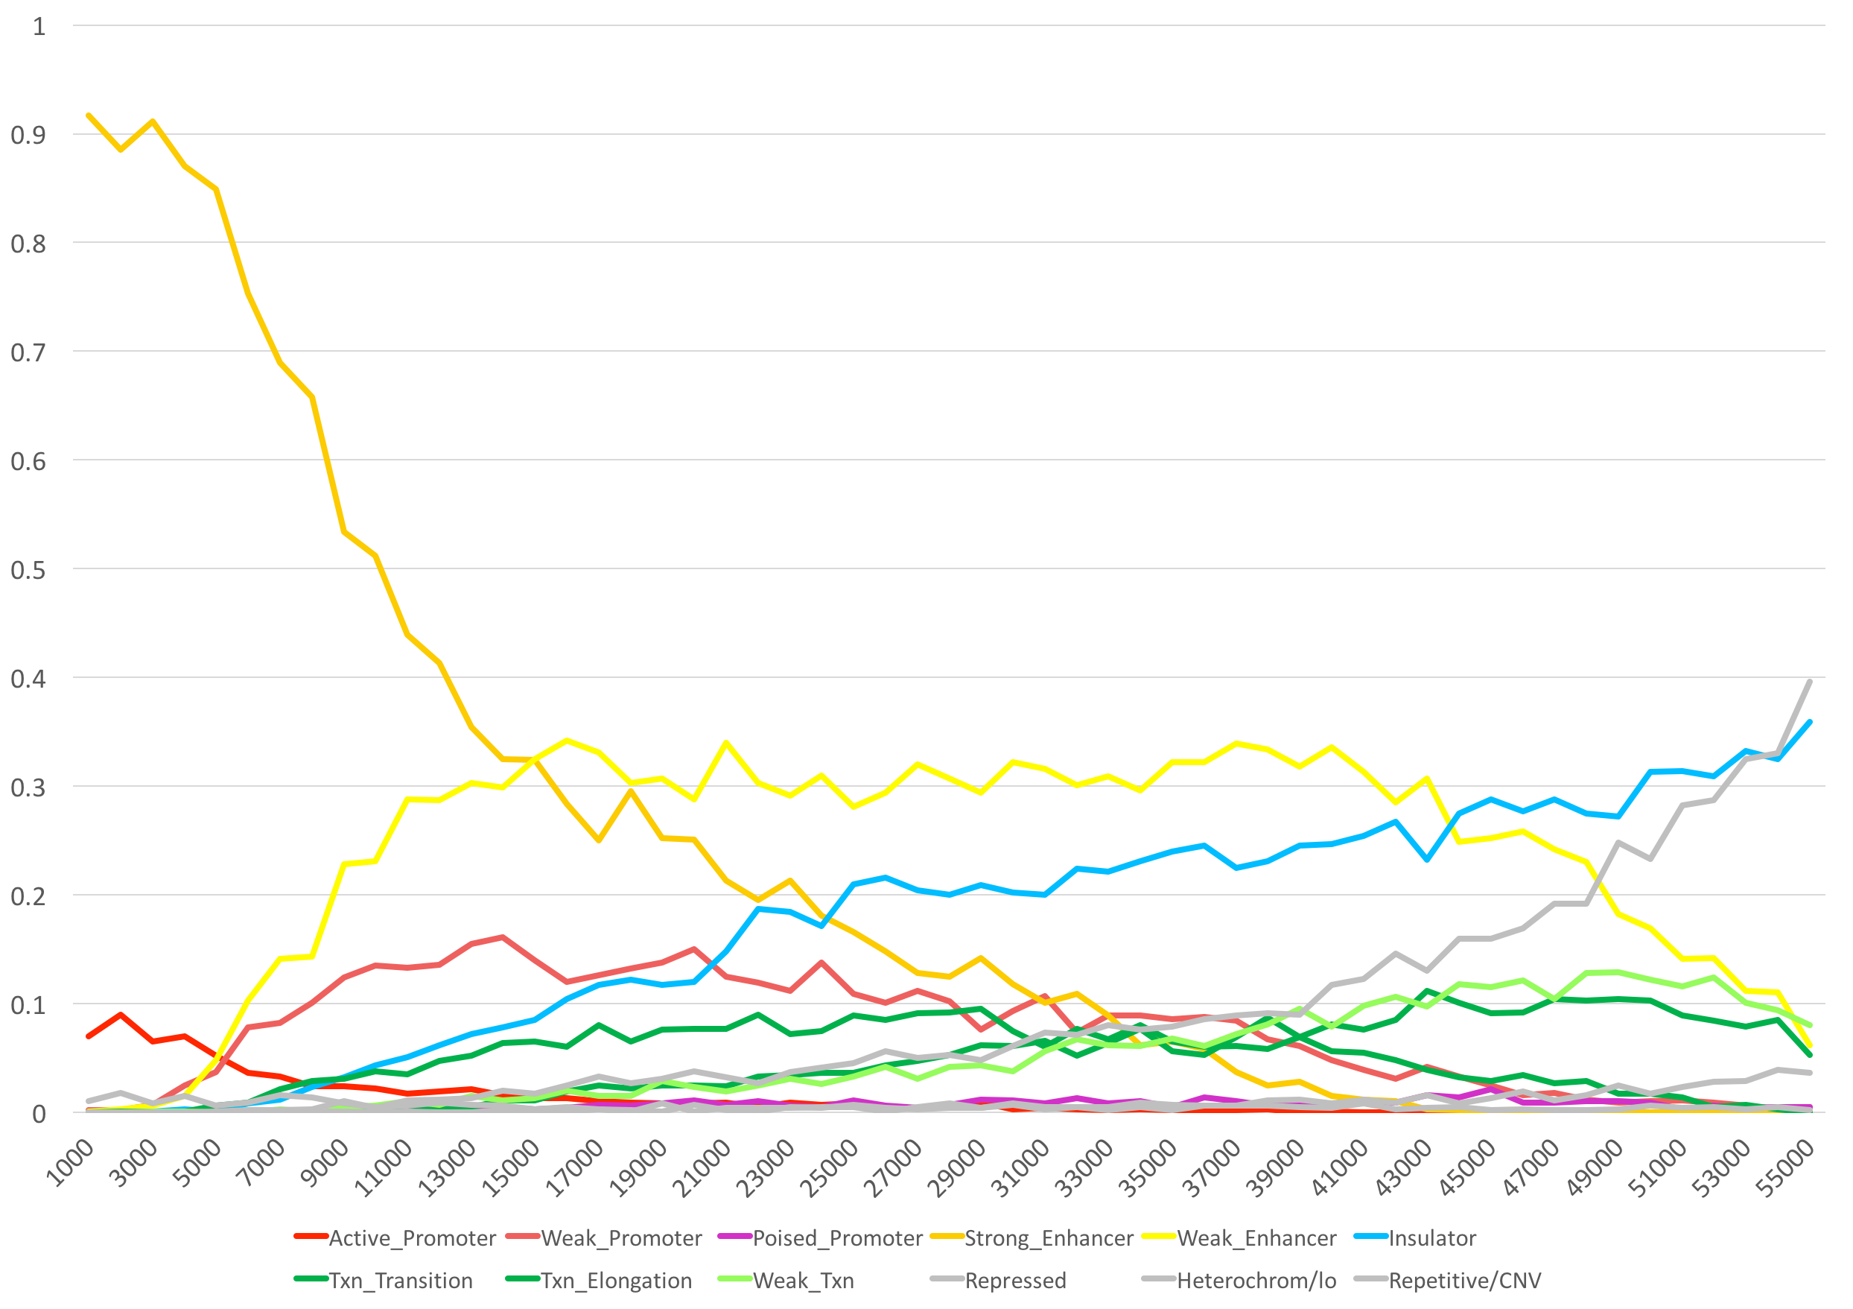
2012 ENCODE ChromHMM Model – GM12878
Strong Enhancers
Insulators
Weak Enhancers

Slide 28
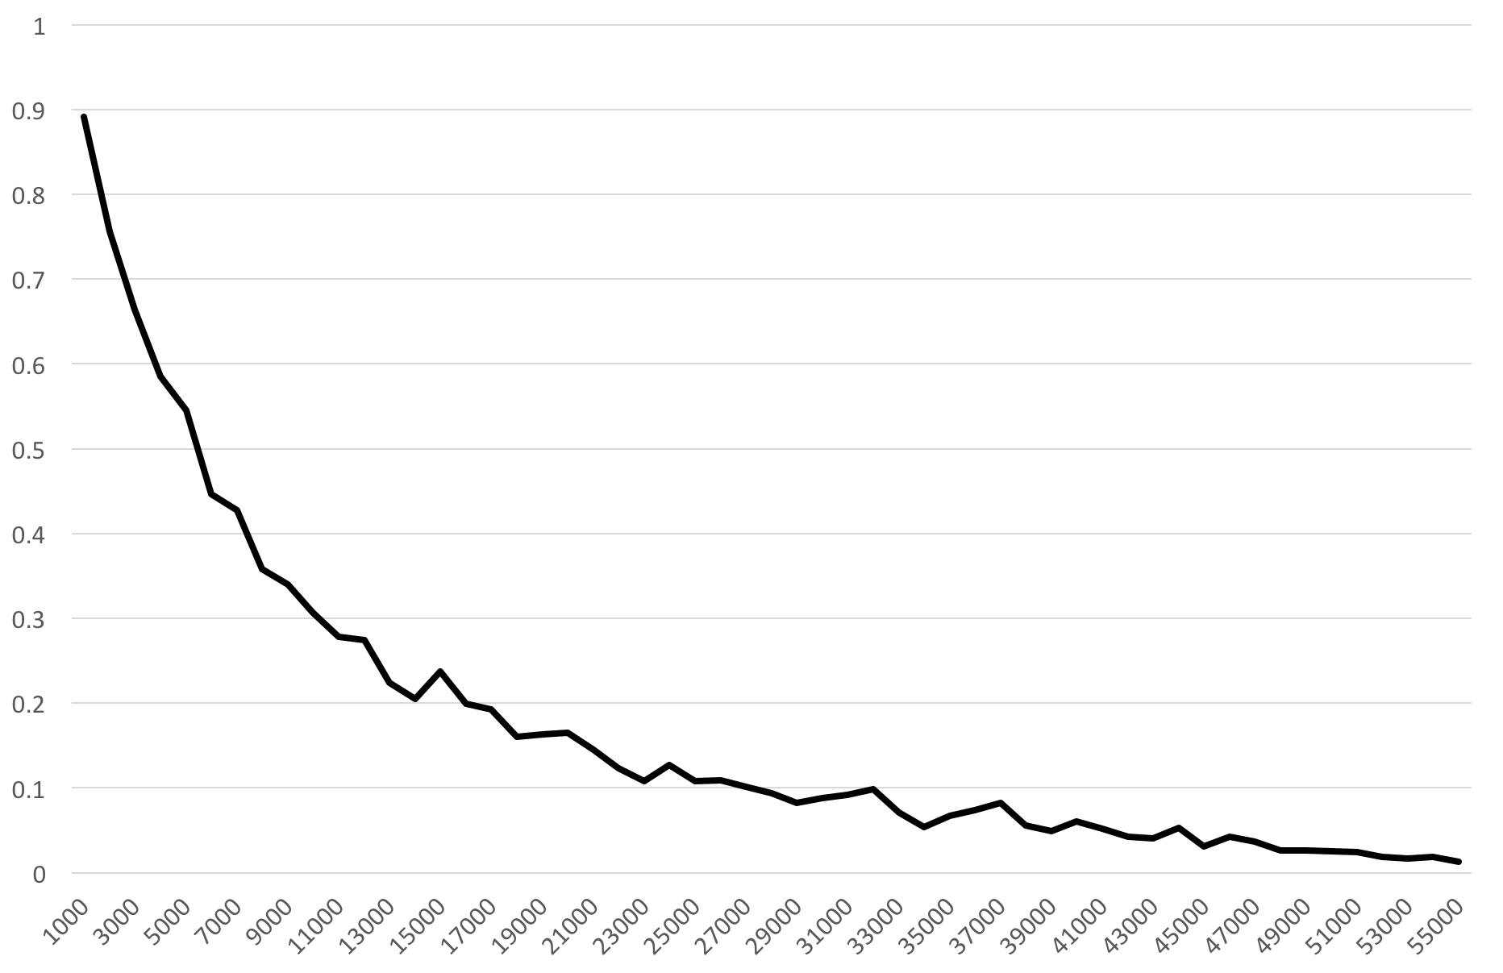
ENCODE P300 ChIP-seq – GM12878
Fraction of Enhancers
2 kb minimum intersection window

Slide 29
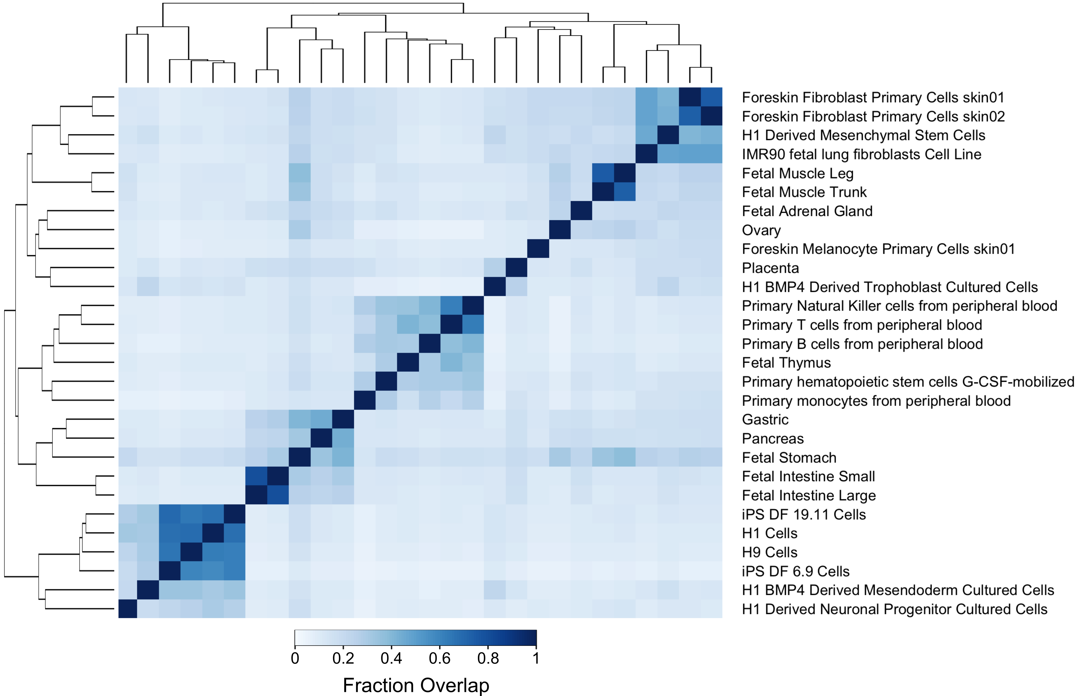
Application to Roadmap Epigenomics Data
Overlap of top 5,000 enhancers

Slide 30
Application to GWAS Data – rs11742570
Associated with Crohn’s Disease and Inflammatory Bowel Disease

Slide 31
rs11742570 Overlaps Predicted Enhancers
in Immune Cells & Tissues
Epigenome | Prediction Rank
Primary T cells from peripheral blood | 73
Primary Natural Killer cells from peripheral blood | 130
Fetal Thymus | 785
Primary hematopoietic stem cells G-CSF-mobilized Female | 1,344
Primary monocytes from peripheral blood | 1,500
Primary B cells from peripheral blood | 4,565
H1 Derived Mesenchymal Stem Cells | 10,670
Reported as epigenome with the most significant enrichment in Crohn’s disease SNPs using H3K4me1 peaks, Roadmap Epigenomics Consortium (2015) Nature

Slide 32
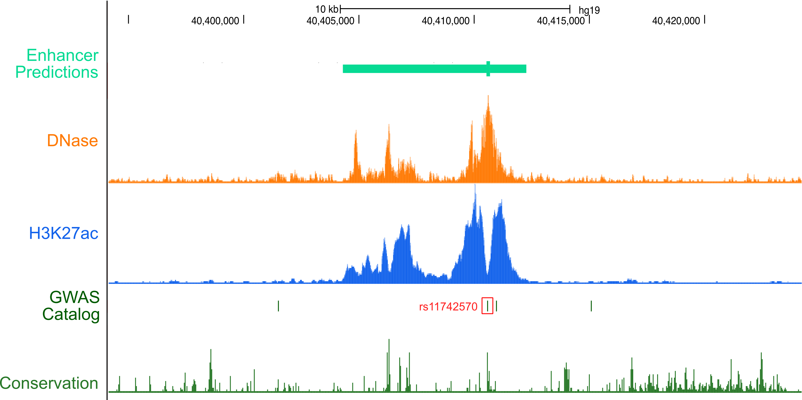
rs11742570 Overlaps Enhancer in Primary T Cells

Slide 33
What is the target gene of this enhancer?

Slide 34
Likely target gene for enhancer containing
rs11742570 is PTGER4
PTGER4 is known to activate T-cell signaling
Variants in PTGER4 are also associated with Crohn’s Disease
In CD34+ cells, there is a Hi-C link between this enhancer and the PTGER4 promoter¹
1. Mifsud, …, Osborne (2015) Nature Genetics

Slide 35
Predicting Target Genes of Regulatory Elements
Correlation of epigenomic datasets
Which datasets work best?
Which parameters produce the best results?
What should be our gold standard?
More complex data integration and machine learning methods
Participation from the following labs:
Manolis Kellis, Anshul Kundaje, John Stamatoyannopoulos, Mark Gerstein, Wei Wang
Notes:
ptger4

Slide 36
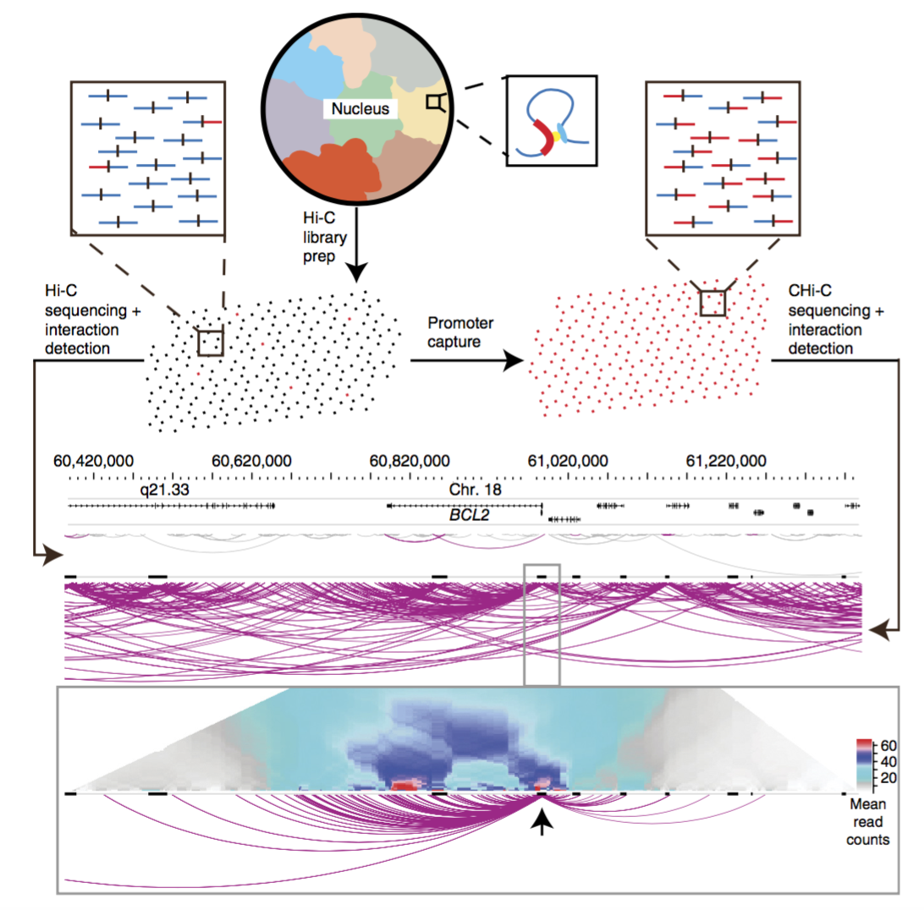
Using Promoter Capture Hi-C To Evaluate Methods
Mifsud, …, Osborne (2015) Nature Genetics

Slide 37
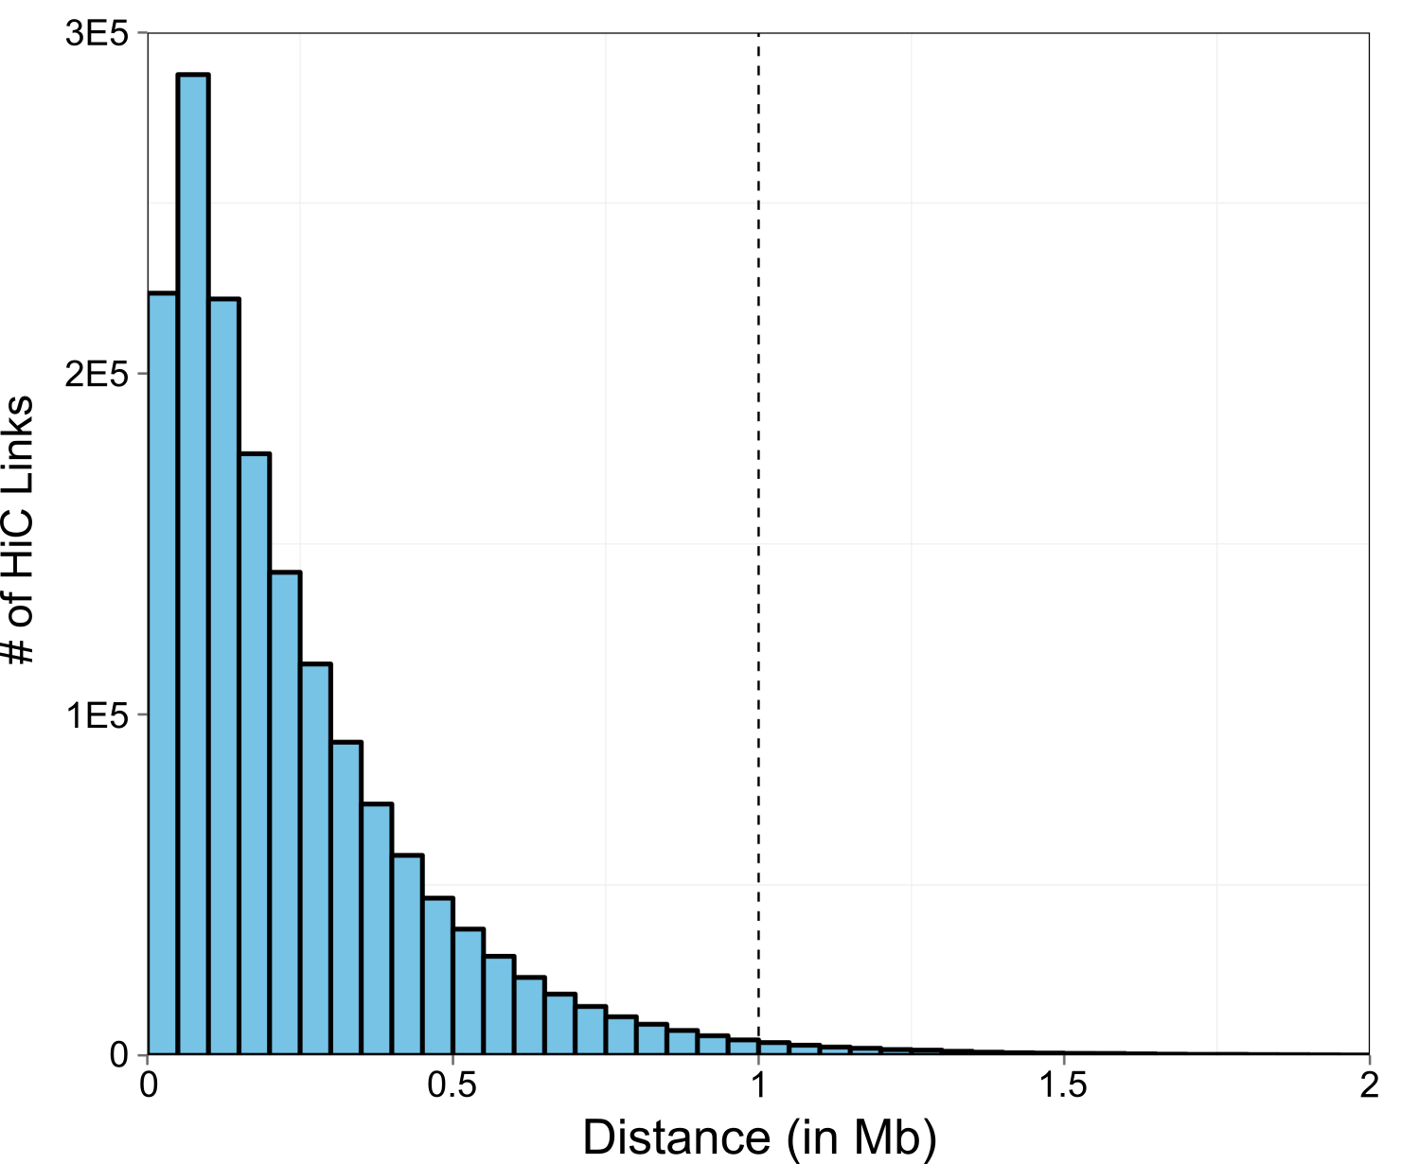
Distance From Promoter to Non-Baited Fragment
Under 100 Kb – 31.6%
Under 500 Kb – 88.7%
Under 1 Mb – 98.6%
Under 2 Mb – 99.9%

Slide 38
Creating Training/Testing/Validation Sets
Promoter Fragment
Non-Baited Fragment
Predicted
Enhancer
Gene A
Gene A
Within 1 Mb
Gene A
GENCODE v19 TSS
Will include as positive:
10,957 enhancers with 44,988 links to promoters

Slide 39
Creating Training/Testing/Validation Sets
Promoter Fragment
Non-Baited Fragment
Gene A
Predicted Enhancer
Gene B
Gene B
GENCODE v19 TSS
Will not include as positive or negative

Slide 40
Predicting Target Genes Using Signal Correlation
Predicted Enhancer
Gene
+/- 1 Kb
Average Signal
Average Signal
Cell Type | Enhancer Signal | Promoter Signal
GM12878 | 120.1 | 99.4
K562 | 3.4 | 2.6
HepG2 | 50.8 | 60.3
… | … | …

Slide 41
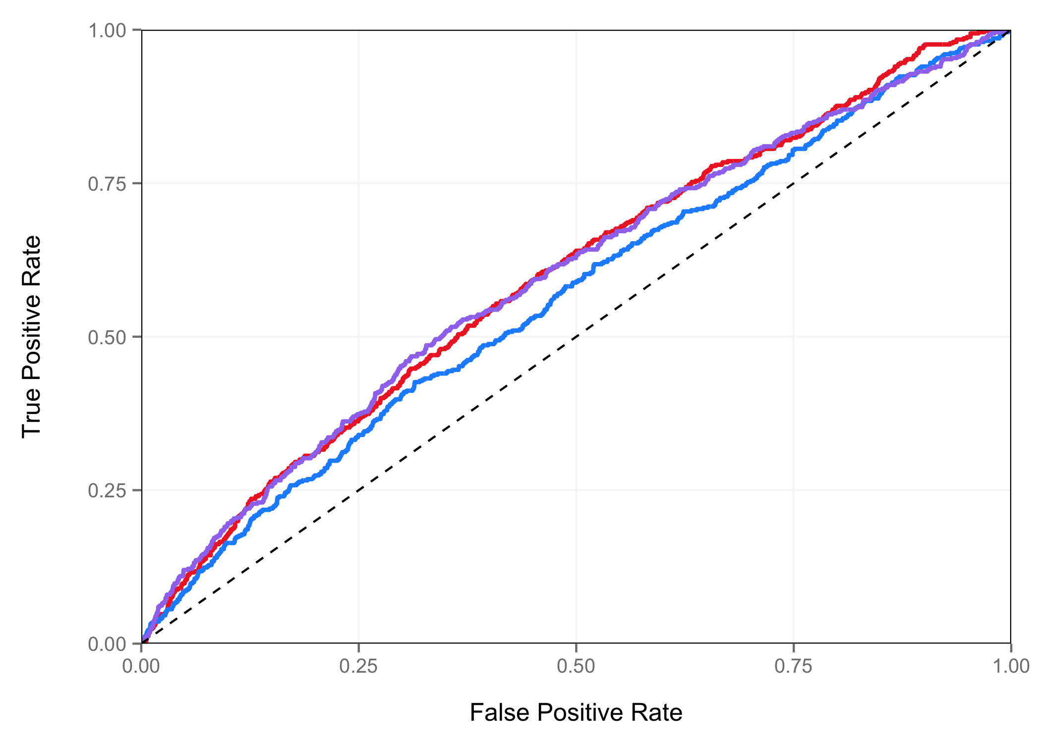
ROC Curves – Correlation Methods
DNase Signal, AUC = 0.60
H3K27ac Signal, AUC = 0.56
Average Rank, AUC = 0.60

Slide 42
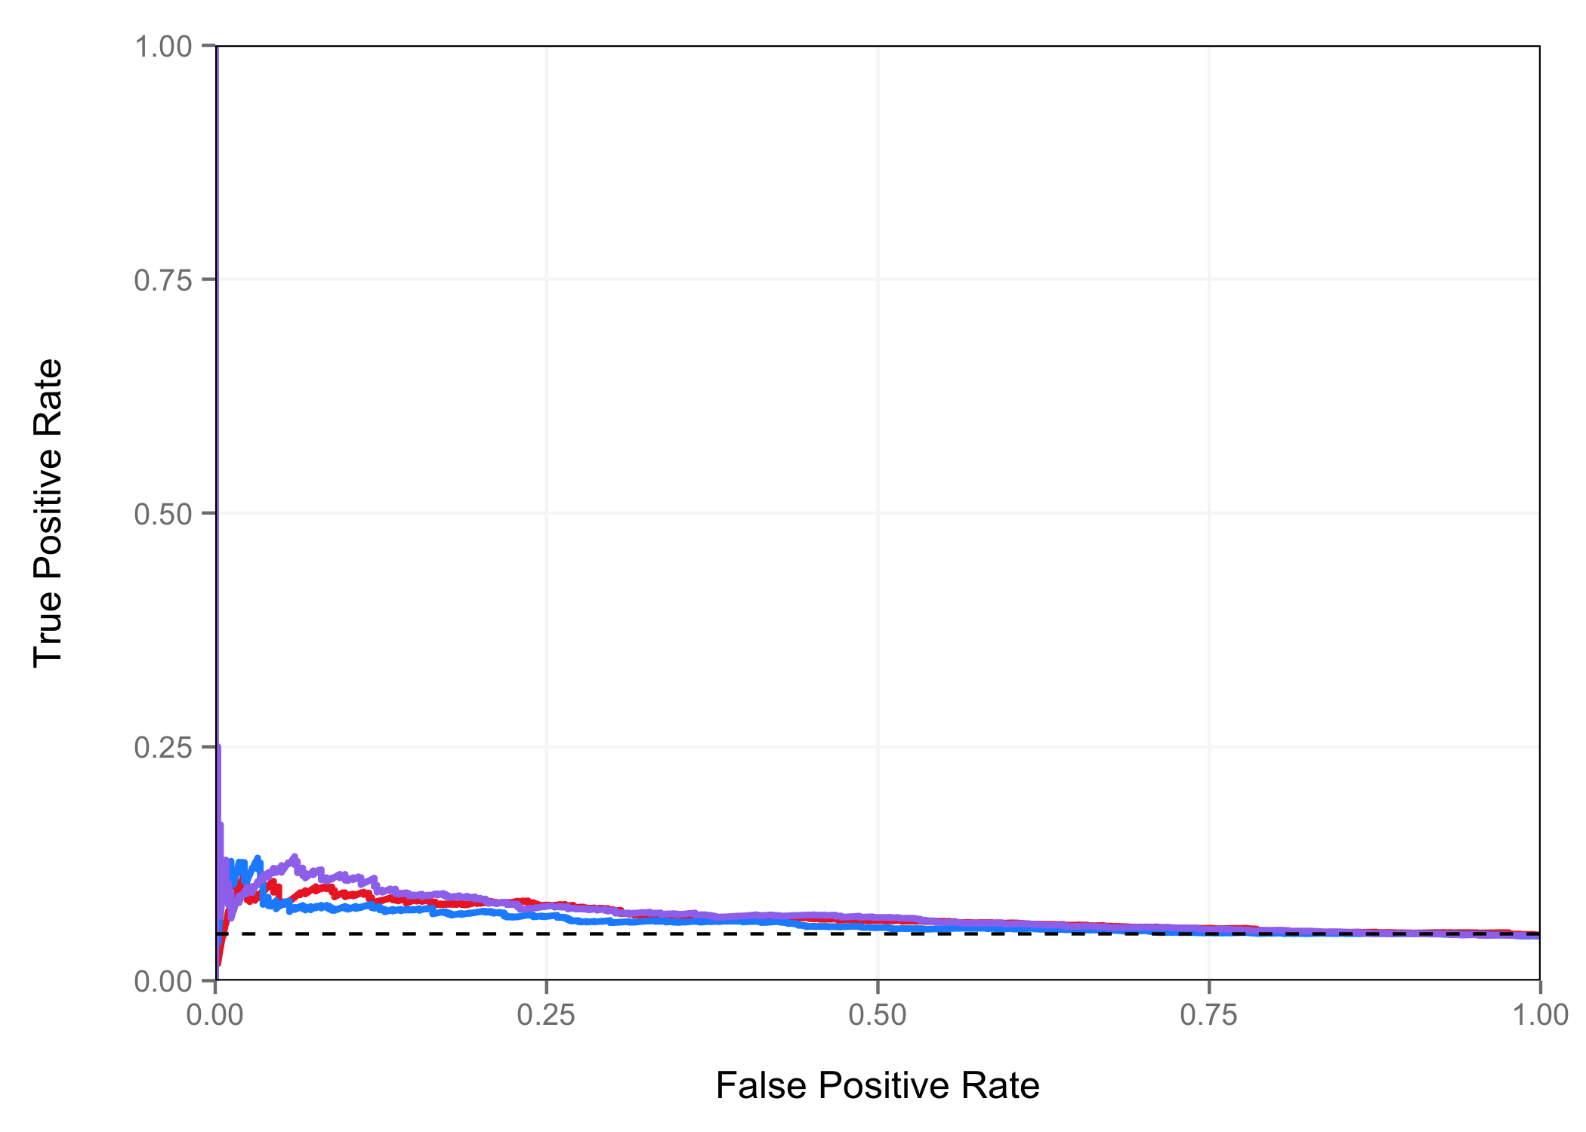
PR Curves – Correlation Methods
DNase Signal, AUPR = 0.06
H3K27ac Signal, AUPR = 0.06
Average Rank, AUPR = 0.07

Slide 43
Random Forest Model
Features:
Distance between enhancer and target gene
Expression of target gene in GM12878 cells
DNase and H3K27ac Signal in GM12878 cells
Correlations of DNase and H3K27ac Signals

Slide 44
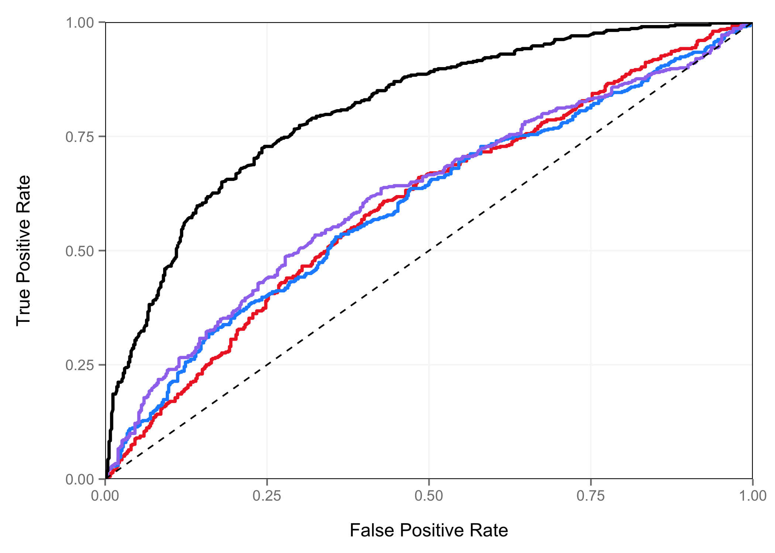
ROC Curve – Random Forest
DNase Signal, AUC = 0.60
H3K27ac Signal, AUC = 0.56
Average Rank, AUC = 0.60
Random Forest = 0.78

Slide 45
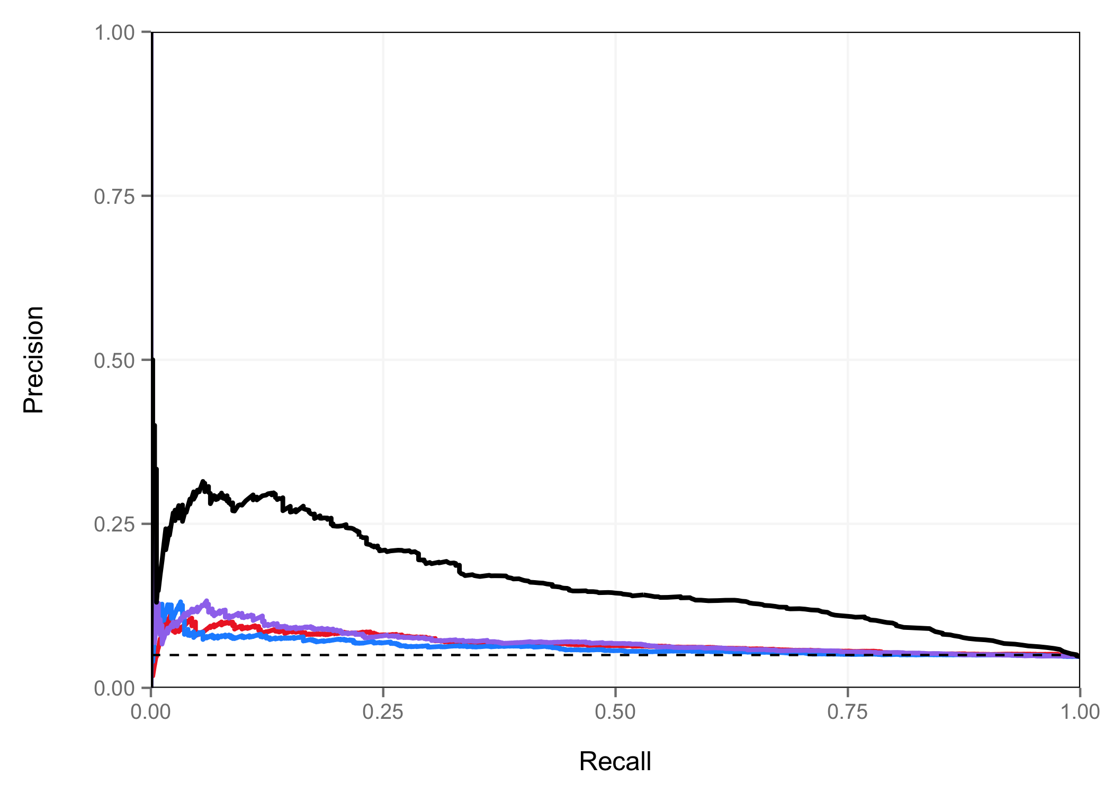
PR Curve – Random Forest
DNase Signal, AUPR = 0.06
H3K27ac Signal, AUPR = 0.06
Average Rank, AUPR = 0.07
Random Forest, AUPR = 0.16

Slide 46
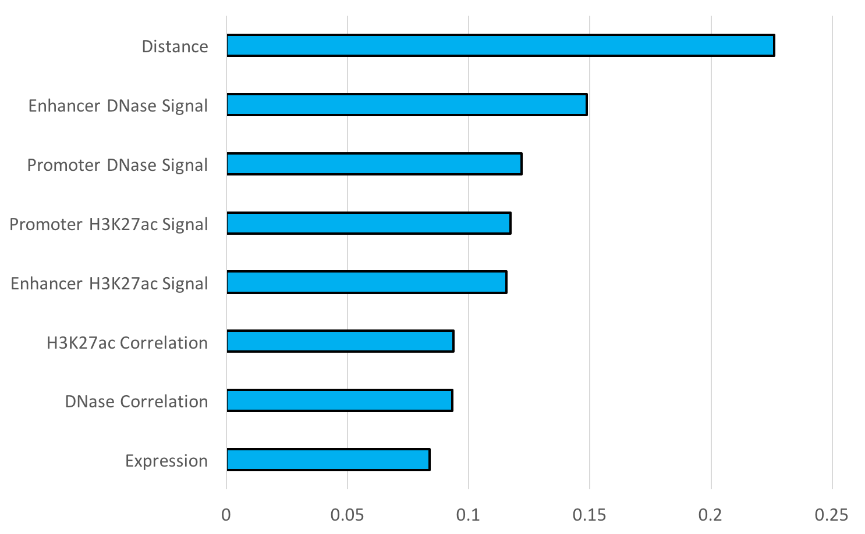
Random Forest Model – Feature Importance
Feature Importance

Slide 47
Future directions
In corporate additional training and testing data, such as massively parallel reporter assays, STARR-seq, enhancer-seq.
Retest additional features when more training data are used.
Prediction of target genes remains a major challenge. What additional features can be predictive?
Define other types of regulatory elements.

Slide 48
Factorbook

Slide 49
Motivation
Visualizes summarized data centered on TFs
not easily shown in a genome browser
includes a number of useful analyses and statistical information
Average histone profiles
Motifs
Heat maps
Transcription Factor (TF)-centric repository of all ENCODE ChIP-seq datasets on TF-binding regions
Will also visualize ChIP-seq Histone and DNase-seq datasets from ENCODE and ROADMAP soon!

Slide 50
ENCODE ChIP-seq TF Datasets
Human:
837 ChIP-seq TF datasets
167 TFs
104 cell types
Mouse:
170 ChIP-seq TF datasets
51 TFs
26 cell types
Last data import: February 29, 2016

Slide 51
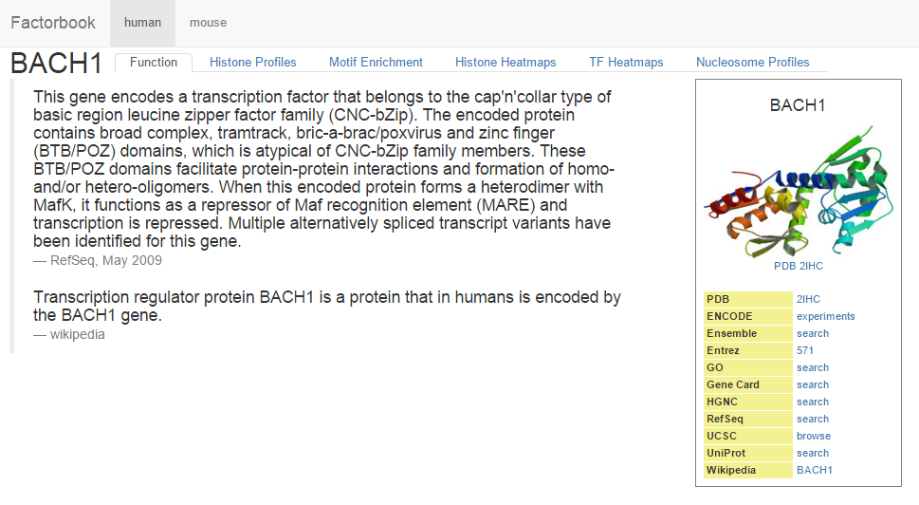
Function
brief overview of molecular function of TF
3D protein structure of TF (if available)
distilled from RefSeq, Gene Card, and wikipedia
links to external resources

Slide 52
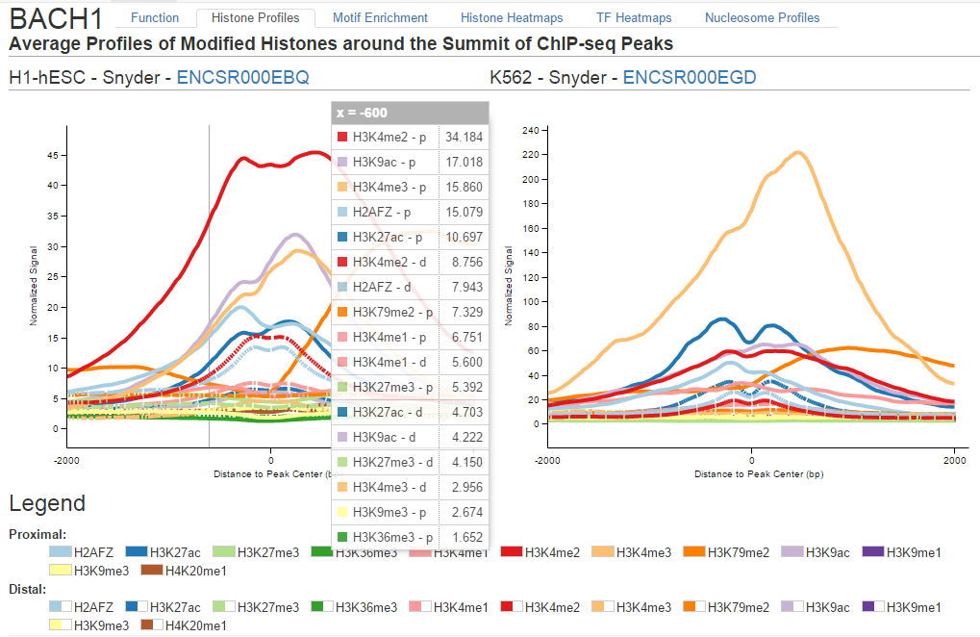
Average Histone Profiles
+/- 2kb (inclusive) window around peak summits
separated by distance to the nearest annotated transcription start site
proximal profiles have peaks within 1 kb of a TSS
distal profiles have all other peaks

Slide 53
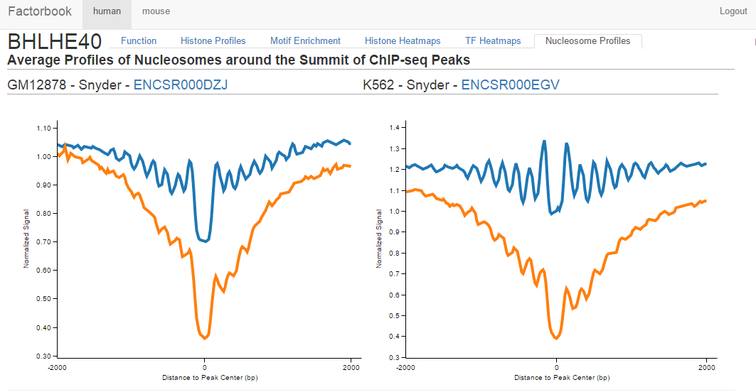
Average Nucleosome Profiles
show effect of binding of TFs on regional positioning of nucleosomes
+/- 2kb (inclusive) window around peak summits
red lines within 1 kb of a TSS
blue lines represent all other peaks
data from GM12878 and K562 MNase-seq

Slide 54
Motif Enrichment
sequences of the top 500 TF ChIP-seq peaks were used to identify enriched motifs de novo
MEME-ChIP
top 5 motifs shown

Slide 55
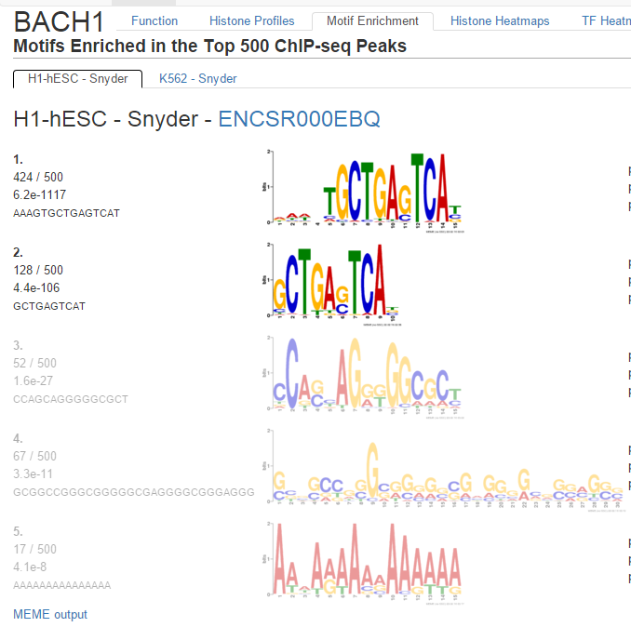
Motif Filtering
Automatically filter out motifs that may not be biologically significant

Slide 56
De novo motif discovery using MEME-ChIP on [-50bp, 50bp] centered on the peak summit for top 500 peaks ranked by ChIP signal, up to 5 motifs discovered for each dataset.
Training Set
Motif scan using FIMO on [-150bp,150bp] centered on the peak summit for 501-1000 ranked peaks.
Testing Set 1
Number of peaks with motif, T1
Motif scan using FIMO on 500 GC-matched random regions in the genome excluding the peak regions.
Control Set 1
Number of regions with motif;
randomly sample 100 times.
mean μ and standard deviation σ
Motif scan using FIMO on [-150bp,150bp] centered on the peak summit for all peaks ranked 501 and beyond.
Testing Set 2
% of peaks with motif, T2
Motif scan using FIMO on [-450bp,-150bp] and [150bp,450bp] flanking the peak summit for all peaks ranked 501 and beyond.
Control Set 2
% of flanking region with motif, C2
test T1 based on norm( μ,σ )
FDR<1e-5
T2 >= 10% AND
T2 / C2 >=0.95
No
No
discard the motif
Yes
Yes
discard the motif
further analysis
motif quality assessed in two ways
non-overlapping testing sets utilizing peaks beyond the top 500
Wang et al., Sequence features and chromatin structure around the genomic regions bound by 119 human transcription factors. Genome Res. 2012 Sep; Figure S1

Slide 57
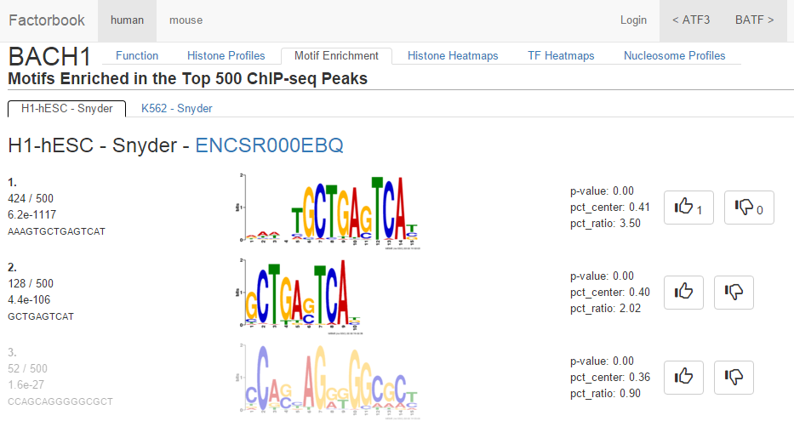
Vote on Motifs!

Slide 58
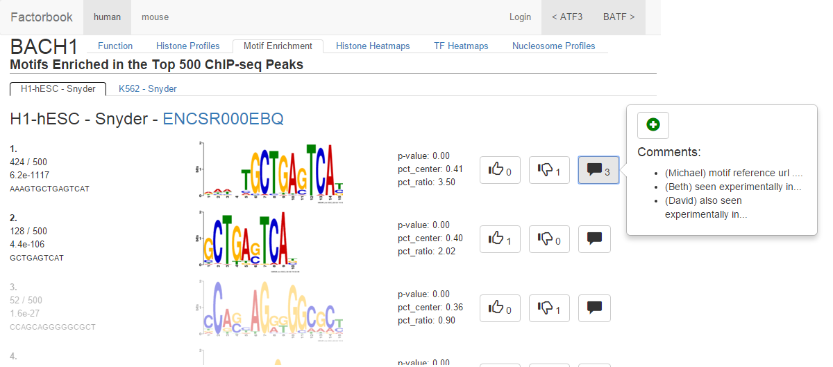
Moderated Motif Comments

Slide 59
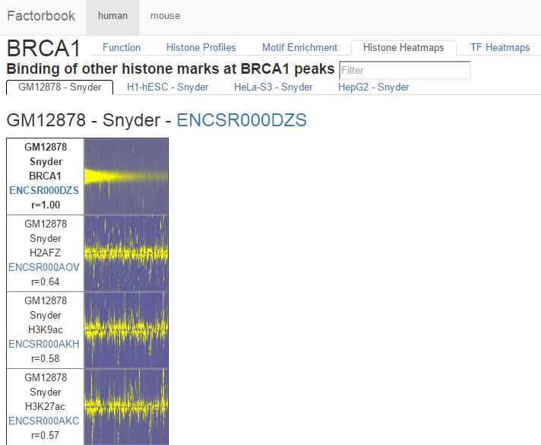
Histone and TF Heat Maps
each column in a heat map indicates a ChIP-seq peak of the currently selected (“pivot”) TF
Columns for the “pivot” TF are sorted (left-to-right) in descending order of ChIP-seq signal
compare a given TF in a specific cell type against the histone marks and other TFs in same cell type
Pearson correlation value also shown (“r”)
histone marks
enrichment represented in a normalized scale over a 10kb window centered on the peak summit
TFs
binding strengths are represented in a normalized scale over a 2kb window, also centered on the peak summit

Slide 60
Acknowledgements
Weng Lab
Jill Moore
Michael Purcaro
Arjan van der Velde
Tyler Borrman
Henry Pratt
Sowmya Iyer
Jie Wang
Stam Lab
John Stamatoyannopoulos
Bob Thurman
Richard Sandstrom
Gerstein Lab
Mark Gerstein
Anurag Sethi
ENCODE Consortium
Brad Bernstein
Ross Hardison
Len Pennacchio
Axel Visel
Bing Ren
Data Production Groups

