Slide 1
Spectral Algorithms for Learning HMMs and Tree HMMs for Epigenetics Data
Kevin C. Chen
Rutgers University
joint work with Jimin Song (Rutgers/Palentir),
Kamalika Chaudhuri and Chicheng Zhang (UCSD)

Slide 2
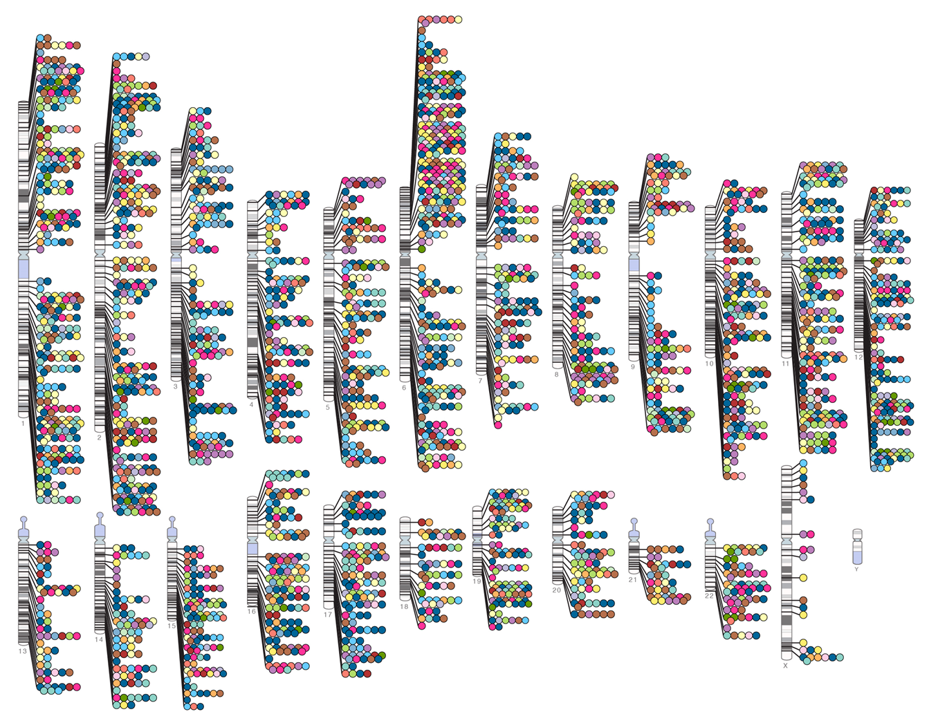
Human Genome-wide Association Studies
~12,000 human disease SNPs known
Follow-up studies of these SNPs are needed to advance personalized medicine
~90% of these disease SNPs are not in genes

Slide 3
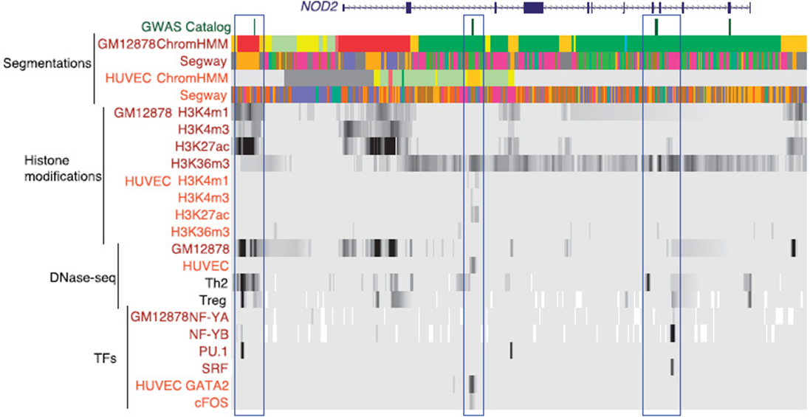
Chromatin State Annotation via HMMs
Input: a set of chromatin marks in a cell type
Output: hidden states (i.e. colors) representing biological features such as enhancers, promoters, etc.

Slide 4
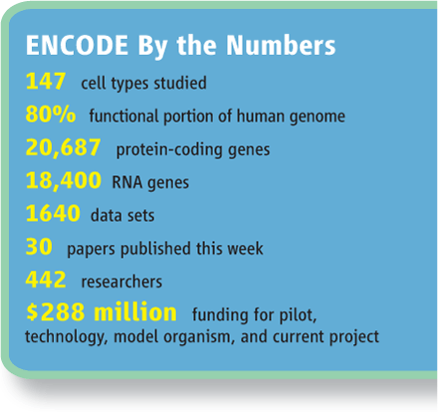
Major Human Epigenomics Projects
Raw data =
3000X coverage of the human genome = 10 trillion bases

Slide 5
Overview of the Talk
Spectral learning of HMMs for predicting chromatin states for a single cell type
Hsu, Kakade, Zhang, COLT 2009
AGHKT, J. Machine Learning Research 2014
Song and Chen, Genome Biology, 2015
Extension to multiple cell types using HMMs with very large but structured state spaces
Biesinger et al., BMC Bioinformatics 2013
Zhang, Song, Chaudhuri, Chen, NIPS 2015
Song, Zhang, Chaudhuri, Chen, in review

Slide 6
Input and Output
Input:
Single long sequence where at each position we are given a binary vector
We’ll treat the binary vector as a single character for learning the parameters
But we’ll display the parameters using the marginal probabilities of each component of the vector
For Tree HMMs, we have multiple such sequences all related by a fixed tree
Output:
HMM parameters and segmentation of the sequence
For Tree HMMs, multiple sets of HMM parameters and segmentations for each sequence

Slide 7
Spectral Learning for HMMs
Expectation-Maximization is slow and only finds local optimum, so we use the Method of Moments
The 2nd moment is a matrix of counts of pairs of consecutive observations
The 3rd moment is a tensor of counts of triples of consecutive observations
Notes:
+: moore-penrose pseudo-inverse

Slide 8
Symmetrization, Orthogonalization and Tensor Decomposition
Assuming the O_{i} are full rank, we can find linear transformations to symmetrize the pairs matrix and triples tensor
Orthogonalize the triples tensor with an SVD of the pairs matrix
Perform orthogonal tensor decomposition

Slide 9
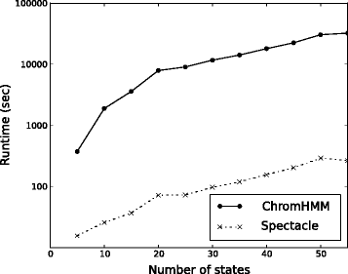
Running time comparisons
The workstation version of Segway took 5 days to train parameters

Slide 10
Empirical Sample Complexity
Theoretically, the sample complexity depends on the distribution of observations in the genome
Our data is power law distributed with an exponent of ~2, which results in a low theoretical sample complexity
Empirically, prediction accuracy plateaus after using ~50% of the genome for training

Slide 11
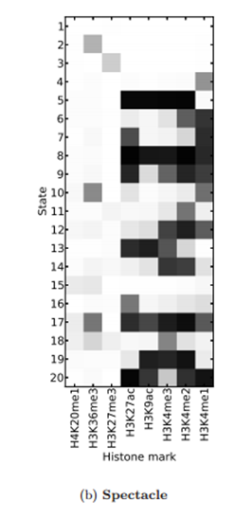
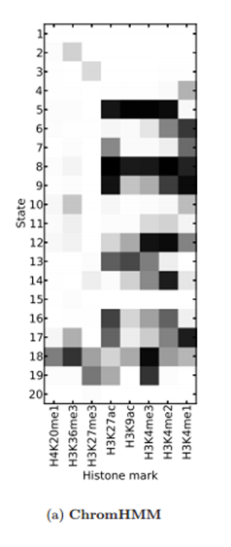
Comparison of Marginal Emission Matrices

Slide 12
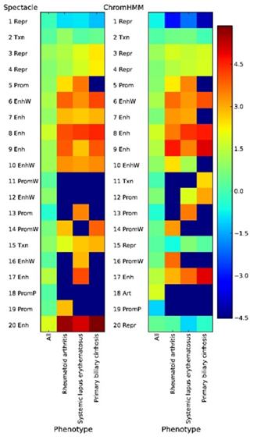
Enrichment of Disease-Associated Variants
There is higher enrichment of disease SNPs in chromatin state 20 which was found only by spectral learning

Slide 13
Using the spectral algorithm as an initializer to a local search algorithm (EM)

Slide 14
Precision-recall curve for experimentally validated biological features

Slide 15
HMMs with tree structured hidden states
Next we consider state structured HMMs
In our method Spectral-Tree, we introduce three algorithmic ideas
Separating root-to-leaf paths
Skeletensor construction
Product projections

Slide 16
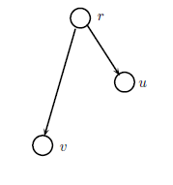
Idea 1 – Separating root-to-leaf paths
Let D be the number of nodes in the tree (e.g. 9)
The naïve algorithm runs an HMM with m^{D} possible states and n^{D} possible observations and has run time Ω (n^{D} m^{D})
We consider each root-to-leaf path separately
This gives run time O(DN m^{3d} + Dn^{2d} m^{d}) where d is length of the longest root-to-leaf path (e.g. 2 or 3)

Slide 17
Idea 2 - Skeletensor Construction
We capture the effect of the root-to-leaf path and project it from a tensor of dimension n^{d} into a tensor of dimension n (i.e. the size of one node), called the Skeletensor
This is the form of the symmetrization matrices:

Slide 18
Idea 3 - Product Projections
Avoid constructing the n dimensional (e.g. 256) tensors by projecting them to dimension m (e.g. 6)
This brings the runtime down to O(DNm^{2d} + Dn²m + Dm^{3d})
The idea is that the observation matrices at the nodes are conditionally independent given the hidden states
These 3 algorithmic ideas work well when
The tree has low depth
Number of observations >> Number of hidden states

Slide 19
Comparison of running times
The naïve exponential algorithm ran out of memory
A Structured Mean Field (SMF) variational Expectation-Maximization method that additionally constrains each node to have the same parameters took 13 hours
Our algorithm took 22 min

Slide 20
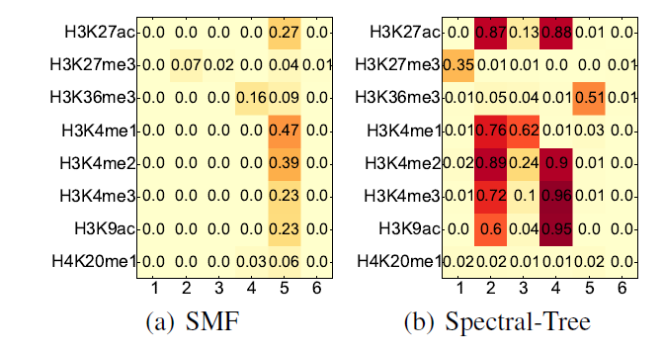
Comparison of Emission Parameters

Slide 21
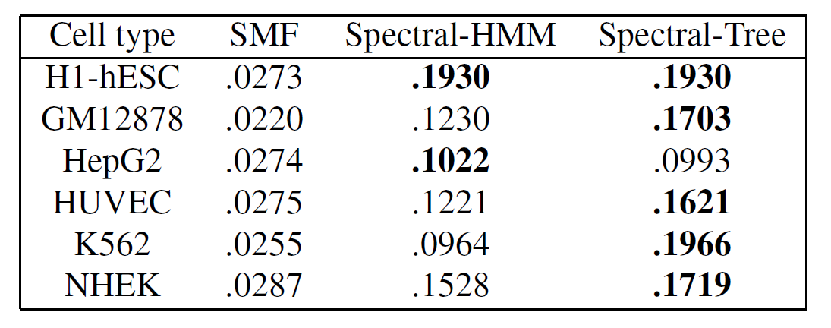
Prediction accuracy of experimentally validated promoters (F1 scores)

Slide 22
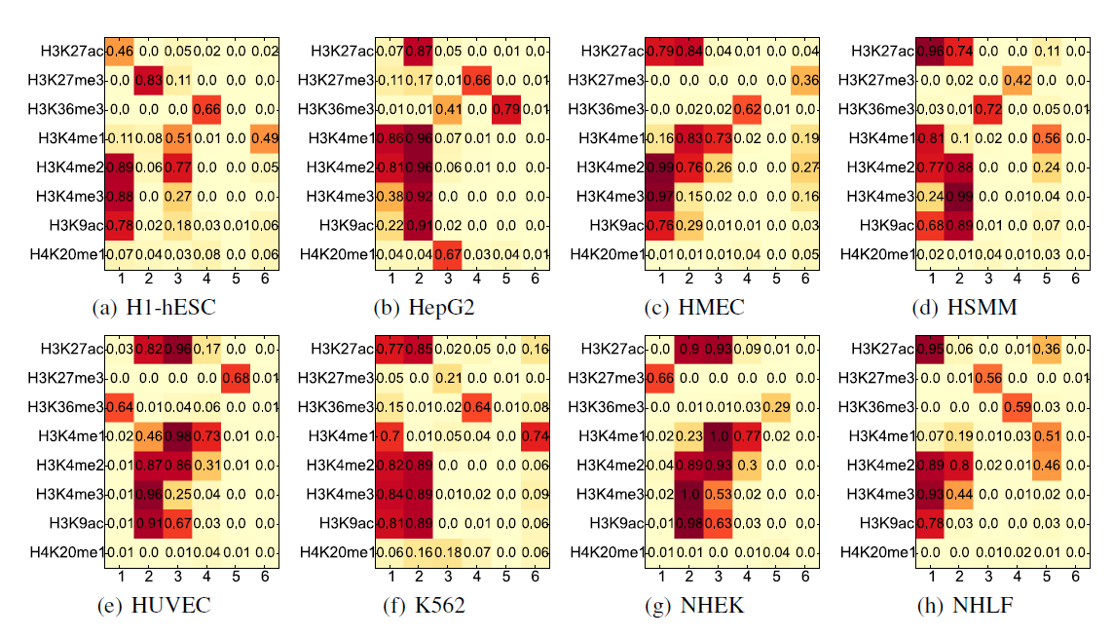
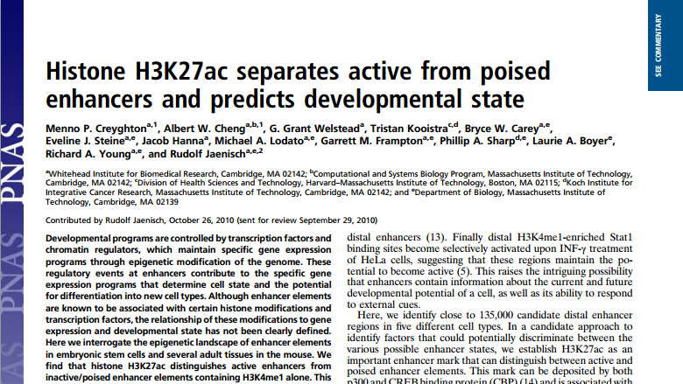
Cell Type Specific Emission Parameters

Slide 23
Spectral Learning is well-suited for Genomics
Large sample sizes in Genomics
One copy of the human genome = 3 billion bases
Efficient algorithms are needed
Enough samples to compute Method of Moments estimators
Biological interpretability
Simple models (e.g. Hidden Markov Models) seem quite close to the biology
Parameter estimation and interpretation is important
Neural Networks or Observable Operator Models do not allow for this
Class imbalance is pervasive in Genomics
Often, a few hidden states explain most of the data, i.e. high class imbalance
Spectral Learning is more robust to class imbalance than maximum likelihood

