Slide 1
Does bad logic make better cells?
David Dill
Department of Computer Science
Stanford University

Slide 2
Outline
Introduction and Background
Timing Robustness
Leaky Signals
Conclusions

Slide 3
Potential of Boolean Modeling
Boolean systems are well understood from digital circuit design.
Mathematics: Boolean algebra, logic, automata theory
Engineering knowledge
Software tools
Larger scale systems can be simulated/analyzed.
High-dimensional dynamics are tractable.
“Design principles” may emerge.

Slide 4
Is biology Boolean?
Maybe, some of the time.
Many biologists use Boolean models informally.
Many phenotypes are Boolean.
Alive vs. dead.
Cell is dividing or not.
Cells are of discrete types (encoded by gene expression).
Engineering arguments.
Boolean gates limit error propagation (why we use digital computers)

Slide 5
Update rules
When several events are enabled at once, update rule says what to do.
Many Boolean models of biology in the past have used the synchronous update rule: update all enabled actions in next time-step.
Advantages:
It is easy to work with.
It is deterministic – it says exactly what to update.
It is usually efficient.
Disadvantage: Not biologically realistic.

Slide 6
TIMING ROBUSTNESS

Slide 7
Timing robustness
Hypothesis: Cellular processes will perform function in spite of significant variations in reaction speeds.
In a Boolean model, reaction rates become delays between events.
Noise from many sources = delay variation.
Varying environmental conditions = delay variation.
Timing robustness confers an evolutionary advantage.
(unless there is too much “overhead” cost.)

Slide 8
Research approach
Start with very conservative fully asynchronous model.
Look for places it doesn’t work.
Understand the problem.
Try less conservative models when fully asynchronous model fails.

Slide 9
Asynchrony
Synchronous Boolean models are useless for exploring timing robustness. We need “sloppy timing”
Update rule determines degree of synchrony in model.
The traditional model uses a synchronous update rule: update all enabled actions in next time-step.

Slide 10
Asynchronous update rule
Asynchronous update rule: When several updates are possible, choose one arbitrarily.
I.e., models “interleaving concurrency.”
Models arbitrary timing variation.
Model checking can analyze all possible choices.
System is speed-independent if it meets requirements for all possible delays.

Slide 11
Verifying speed independence
Model checking automatically answers queries about state graphs.
Used extensively for analyzing hardware, software, protocol behavior.
Model checkers can see whether circuit satisfies property for all possible delays.
System description
Ad hoc translator
SMV modeling language
NuSMV model checker
“OK” or counter-example
Temporal logic properties

Slide 12
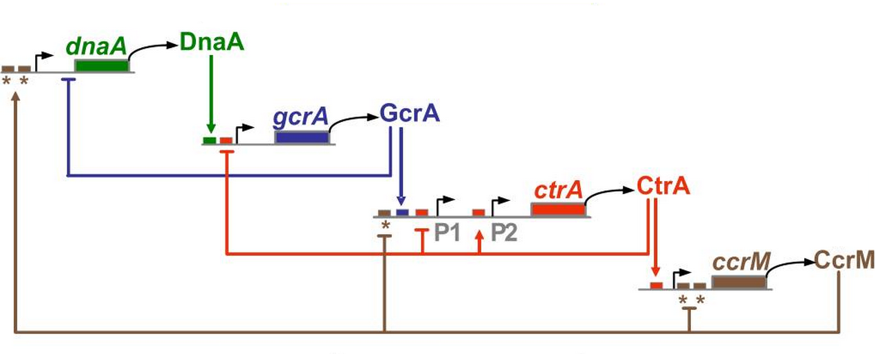
Core cell cycle transcription factors
ctrA gene not copied

Slide 13
Model checking the Caulobacter cell cycle
Checked Boolean asynchronous model of cell cycle control.
Arbitrary delays except for some 0-delay events (e.g. physical cell partition).
Cell cycle “worked” for (almost) all delay variations.
... except: GcrA can be degraded before ctrA gene is copied (very slow copy, fast GcrA degradation).
Cell cycle gets “stuck” in this case.
Architecture and inherent robustness of a bacterial cell-cycle control system, Shen, X., Collier, J., Dill, D., Shapiro, L., Horowitz, M., McAdams, H. H., PNAS, 2008

Slide 14
Stuck cell cycle
0
0
0
ctrA gene not copied

Slide 15
Leaky Signals

Slide 16
Leaky DnaA can build up, restarting cell cycle
low
0
X
0
0
ctrA gene not copied

Slide 17
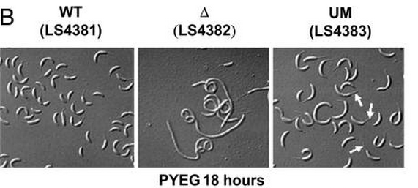
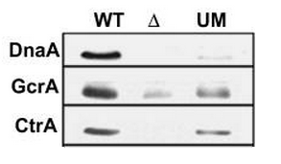
Evidence of leakiness in the dnaA promoter
DnaA (and subsequent) protein present in unhemimethylated strains
Collier et al A DNA methylation ratchet governs progression through a bacterial cell cycle. Proc Natl Acad Sci USA. 2007;104(43):17111-6.

Slide 18
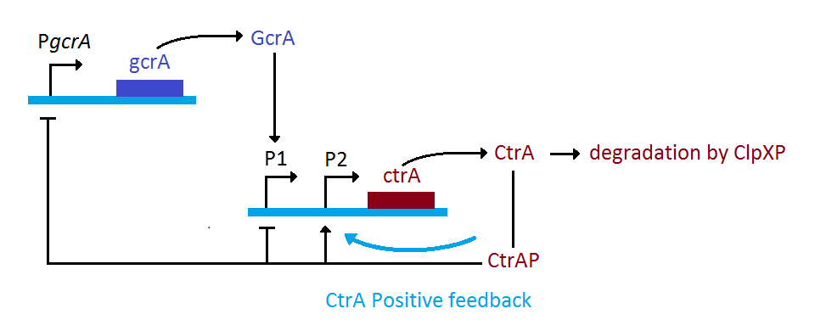
Regulation of CtrA
McAdams, H. H., & Shapiro, L. (2009) System-level design of bacterial cell cycle control. FEBS Letters, 583(24):3984-3991.

Slide 19
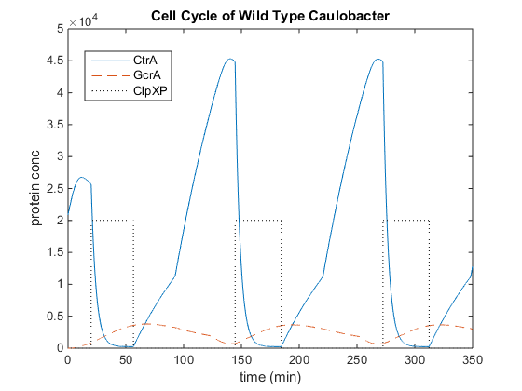
Normal cell cycle of Caulobacter

Slide 20
Regulation of CtrA
McAdams, H. H., & Shapiro, L. (2009) System-level design of bacterial cell cycle control. FEBS Letters, 583(24):3984-3991.

Slide 21
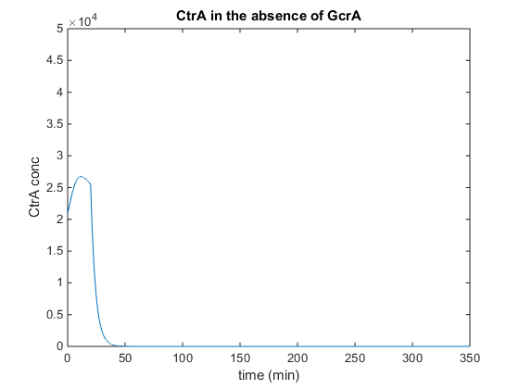
Model: GcrA deletion stops cell cycle

Slide 22
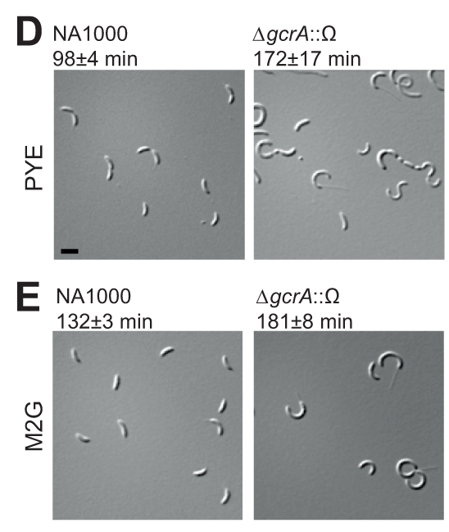
Experimental GcrA deletion
Cell cycle
restarts?
Murray, S. M., Panis, G., Fumeaux, C., Viollier, P. H., & Howard, M. (2013). Computational and Genetic Reduction of a Cell Cycle to Its Simplest, Primordial Components. PLoS Biology, 11(12), e1001749.

Slide 23
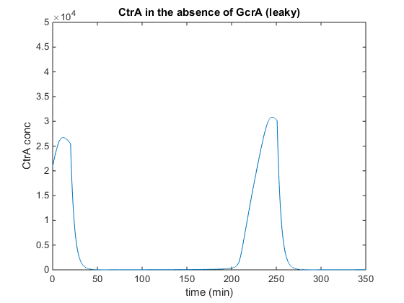
Cell cycle can restart after some time if the ctrA promoter is ‘leaky’

Slide 24
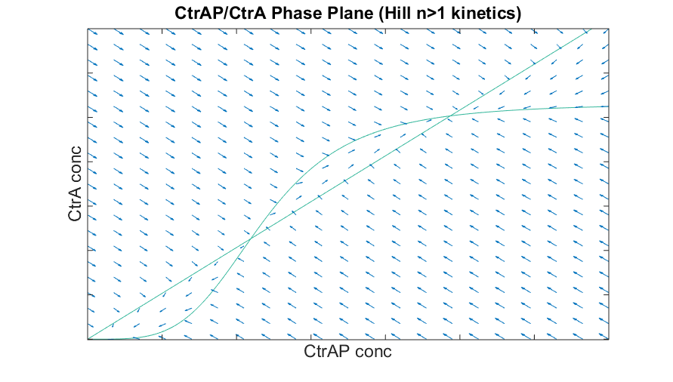
Bistability

Slide 25
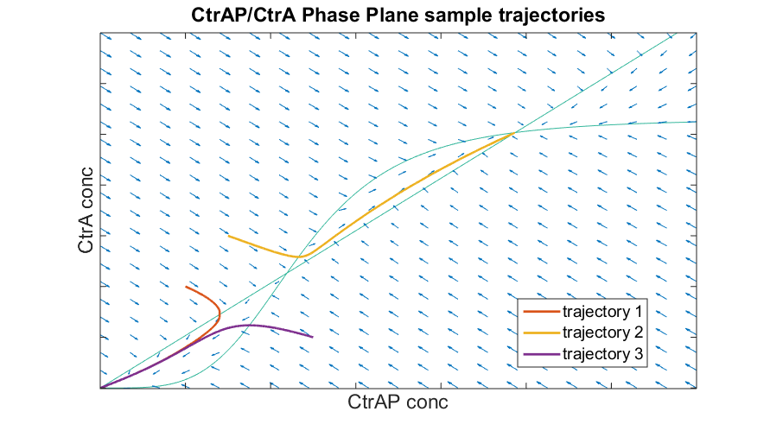
Bistability

Slide 26
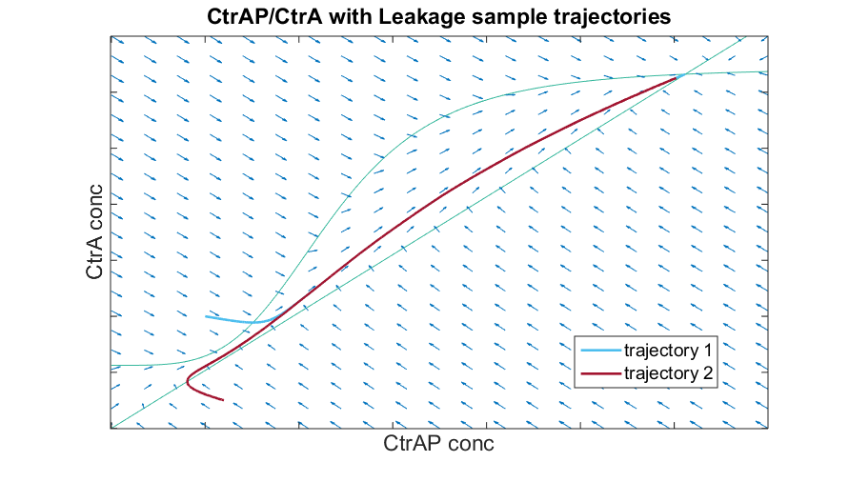
‘Leaky’ Promoter model has only one high stable equilibrium

Slide 27
Leakiness and robustness
“Leaky” 0 signals may provide a “timeout” mechanism
Normally, output waits for input.
If input arrives quickly, leaky output signal doesn’t matter.
If input does not array, leaky output builds up to “1” after a long delay.
This can restart a “stuck” cell cycle.
But, sometimes, the cell cycle should not restart!

Slide 28
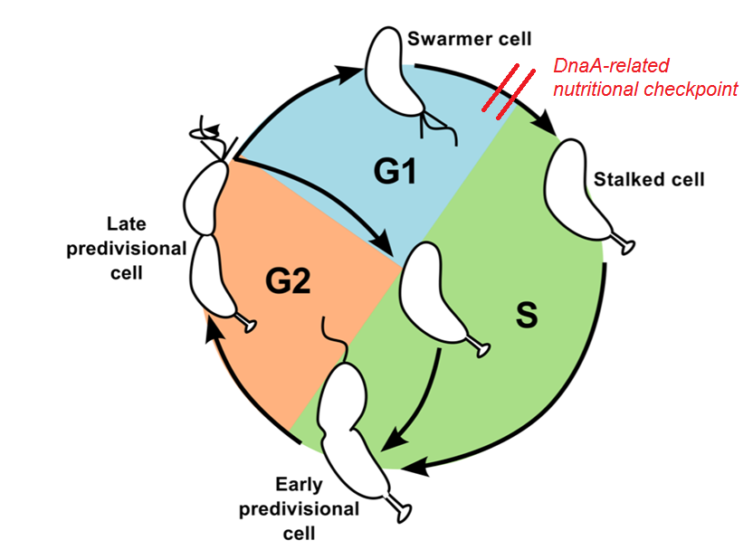
Checkpoint
from: http://people.cs.vt.edu/~ycao/Caulobactor/CCindex.html5

Slide 29
Conjecture
There is a special mechanism to prevent restarting during a checkpoint.
E.g., perhaps there is active degradation of the “leaky” signal so it’s not so leaky.

Slide 30
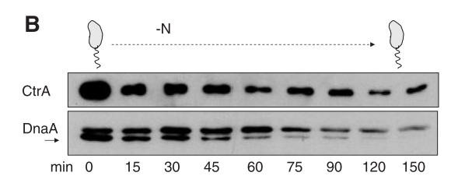
DnaA is rapidly proteolyzed in carbon and nitrogen starvation modes
Gorbatyuk et al Regulated degradation of chromosome replication proteins DnaA and CtrA in Caulobacter crescentus. Mol Microbiol. 2005;55(4):1233-45.

Slide 31
Conclusions

Slide 32
Major points
Timing robustness may be a “design principle” of biological state machines.
Aspects of models that violate timing robustness merit closer scrutiny.
“Leakiness” of promoters are not “digital” – but they may create a timeout mechanism that increases robustness.
Leakiness may help cells recover from failures of timing robustness.

Slide 33
Open questions
Is the mechanism actually correct?
Can the cell cycle get “stuck”?
Timing problems?
Noise?
Infection?
Does restarting provide a competitive advantage?
Does the cell prevent undesirable restarting?
Does the cell restart at the best cell cycle stage?

Slide 34
Project members
Dill Lab
Zoey Cui
Dante Ricci
Yifei Men
James Pham
David Dill
Shapiro & McAdams Labs
Dante Ricci
Virginia Kolageraki
Harley McAdams
Lucy Shapiro
(and various others)

Slide 35
The end

