Slide 1
Coding for Modern Distributed Storage Systems: Part 2. Locally Repairable Codes
Parikshit Gopalan
Windows Azure Storage, Microsoft.

Slide 2
Rate-distance-locality tradeoffs
Def: An ${\left[n,k,d\right]}_{q}$ linear code has locality $r$ if each co-ordinate can be expressed as a linear combination of $r$ other coordinates.
What are the tradeoffs between $n, k, d, r$?
[G.-Huang-Simitci-Yekhanin’12]: In any linear code with information locality r,
$$n ≥\frac{\left(r+1\right)}{r}k+d −2.$$
Algorithmic proof using linear algebra.
[Papailiopoulus-Dimakis’12] Replace rank with entropy.
[Prakash-Lalitha-Kamath-Kumar’12] Generalized Hamming weights.
[Barg-Tamo’13] Graph theoretic proof.

Slide 3
Generalizations
Non-linear codes
[Papailiopoulos-Dimakis, Forbes-Yekhanin].
Vector codes
[Papailoupoulos-Dimakis, Silberstein-Rawat-Koyluoglu-Vishwanath, Kamath-Prakash-Lalitha-Kumar]
Codes over bounded alphabets
[Cadambe-Mazumdar]
Codes with short local MDS codes
[Prakash-Lalitha-Kamath-Kumar, Silberstein-Rawat-Koyluoglu-Vishwanath]

Slide 4
Explicit codes with all-symbol locality.
[Tamo-Papailiopoulos-Dimakis’13]
Optimal length codes with all-symbol locality for $q=exp⁡(k)$.
Construction based on RS code, analysis via matroid theory.
[Silberstein-Rawat-Koyluoglu-Vishwanath’13]
Optimal length codes with all-symbol locality for $q=2^{n}$.
Construction based on Gabidulin codes (aka linearized RS codes).
[Barg-Tamo’ 14]
Optimal length codes with all-symbol locality for $q=O(n)$.
Construction based on Reed-Solomon codes.

Slide 5
Stronger notions of locality
Codes with local Regeneration
[Silberstein-Rawat-Koyluoglu-Vishwanath, Kamath-Prakash-Lalitha-Kumar…]
Codes with short local MDS codes [Prakash-Lalitha-Kamath-Kumar, Silberstein-Rawat-Koyluoglu-Vishwanath]
Avoids the slowest node bottleneck [Shah-Lee-Ramachandran]
Sequential local recovery [Prakash-Lalitha-Kumar]
Multiple disjoint local parities [Wang-Zhang, Barg-Tamo]
Can serve multiple read requests in parallel.
Problem: Consider an ${\left[n,k\right]}_{q}$ linear code where even after $d$ arbitrary failures, every (information) symbol has locality $r$. How large does $n$ need to be?
[Barg-Tamo’14] might be a good starting point.
Notes:
879

Slide 6
Tutorial on LRCs
Part 1.1: Locality
Locality of codeword symbols.
Rate-distance-locality tradeoffs: lower bounds and constructions.
Part 1.2: Reliability
Beyond minimum distance: Maximum recoverability.
Constructions of Maximally Recoverable LRCs.

Slide 7
Beyond minimum distance?
Is minimum distance the right measure of reliability?
Two types of failures:
Large correlated failures
Power outage, upgrade.
Whole data center offline.
Can assume further failures are independent.

Slide 8
Beyond minimum distance?
4 Racks
6 Machines per Rack
Machines fail independently with probability $p$.
Racks fail independently with probability $q≈p^{3}$.
Some 7 failure patterns are more likely than 5 failure patterns.

Slide 9
Beyond minimum distance?
Data locality and information locality.
Lower bounds and explicit LRC constructions that achieve optimal length.
Is distance the right measure of reliability?
Two types of failures:
Large correlated failures
Power outage, upgrade, whole data center offline.
Further failures are independent, small in number.
Set of likely erasure patterns tied to the topology of the network.

Slide 10
Beyond minimum distance
4 Racks
6 Machines per Rack
Want to tolerate 1 rack failure + 3 additional machine failures.

Slide 11
Beyond minimum distance
Want to tolerate 1 rack + 3 more failures (9 total).
Solution 1: Use a $[24,15,10]$ Reed-Solomon code.
Corrects any 9 failures.
Poor locality after a single failure.

Slide 12
Beyond minimum distance
Want to tolerate 1 rack + 3 more failures (9 total).
[Plank-Blaum-Hafner’13]: Sector-Disk (SD) codes.
Solution 1: Use $[24, 15, 6]$ LRCs derived from Gabidulin codes.
Rack failure gives a $\left[18, 15, 4\right]$ MDS code.
Stronger guarantee than minimum distance.

Slide 13
Beyond minimum distance
Want to tolerate 1 rack + 3 more failures (9 total).
[Plank-Blaum-Hafner’13]: Partial MDS codes.
Solution 1: Use $[24, 15, 6]$ LRCs derived from Gabidulin codes.
Rack failure gives a $\left[18, 15, 4\right]$ MDS code.
Stronger guarantee than minimum distance.

Slide 14
Maximally Recoverable Codes
Codes used for storage often have a fixed topology.
[Chen-Huang-Li’07, G.-Huang-Jenkins-Yekhanin’14]
A code with a given topology should correct every pattern that its topology allows it to correct.
Reed-Solomon codes:
$n$ symbols that satisfy $n− k$parity check equations.
MDS property: Any $k$ symbols suffice for full data recovery.
$n−k$ unkowns, $n−k$equations.
Any system with sufficiently many (independent) constraints is invertible.

Slide 15
Maximally Recoverable Codes [Chen-Huang-Li’07, G.-Huang-Jenkins-Yekhanin’14]
Code has a topology that decides linear relations between symbols (locality).
Any erasure with sufficiently many (independent) constraints is correctible.
[G-Huang-Jenkins-Yekhanin’14]: Let $α_{1},…, α_{t}$ be variables.
Topology is given by a parity check matrix, where each entry is a linear function in the $α_{i}$s.
A code is specified by choice of $α_{i}$s.
The code is Maximally Recoverable if it corrects every error pattern that its topology permits.
Relevant determinant is non-singular.
There is some choice of $α$s that corrects it.

Slide 16
Example 1: MDS codes
$h$ global equations:
$$\sum_{i=1}^{n}{α_{i,j}X_{i}=0.}$$
Reed-Solomon codes are Maximally Recoverable.

Slide 17
Example 2: LRCs (PMDS codes)
Assume $r|k, (r+1)|n$. Want length $n$ codes satisfying
Local constraints: Parity of each column is 0.
$h$Global constraints: Linear constraints over all symbols.
The code is MR if puncturing one entry per column gives an ${\left[k+h, k\right]}_{q}$ MDS code.
The code is SD if puncturing any row gives an ${\left[k+h, k\right]}_{q}$ MDS code.
Known constructions require fairly large field sizes.

Slide 18
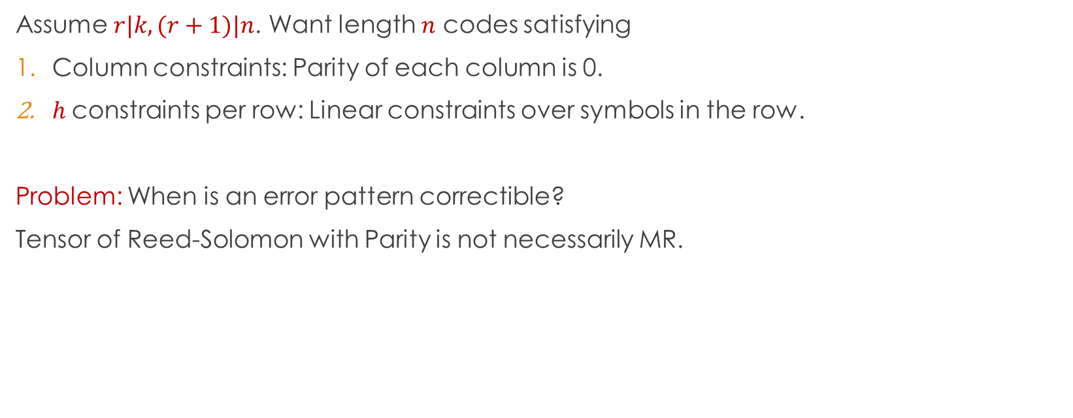
Example 3: Tensor Codes
Assume $r|k, (r+1)|n$. Want length $n$ codes satisfying
Column constraints: Parity of each column is 0.
$h$constraints per row: Linear constraints over symbols in the row.
Problem: When is an error pattern correctible?
Tensor of Reed-Solomon with Parity is not necessarily MR.

Slide 19
Maximally Recoverable Codes [Chen-Huang-Li’07, G.-Huang-Jenkins-Yekhanin’14]
Let $α_{1},…, α_{t}$ be variables.
Each entry in the parity check matrix is a linear function in the $α_{i}$s.
A code is specified by choice of $α_{i}$s.
The code is Maximally Recoverable if it corrects every error pattern possible given its topology.
[G-Huang-Jenkins-Yekhanin’14] For any topology, random codes over sufficiently large fields are MR codes.
Do we need explicit constructions?
Verifying a given construction is good might be hard.
Large field size is undesirable.

Slide 20
How encoding works
Encoding a file using an ${\left[n,k\right]}_{q}$ code $C$.
Ideally field elements are byte vectors, so $q =2^{8c}$.
Break file into $k$ equal sized parts.
Treat each part as a long stream over $F_{q}$.
Encode each row (of $k$ elements) using $C,$ to create $n − k$ more streams.
Distribute them to the right nodes.
a
b
b
g
z
c
f
g
a
d
n
g
j
g
v
x
d
f
v
b
r
t
y
j

Slide 21
How encoding works
Encoding a file using an ${\left[n,k\right]}_{q}$ code $C$.
Ideally field elements are byte vectors, so $q =2^{8c}$.
Break file into $k$ equal sized parts.
Treat each part as a long stream over $F_{q}$.
Encode each row (of $k$ elements) using $C,$ to create $n − k$ more streams.
Distribute them to the right nodes.
Step 3 requires finite field arithmetic over $F_{q}.$
Can use log tables up to $2^{24}$ (a few Gb).
Speed up via specialized CPU instructions.
Beyond that, matrix vector multiplication (dimension = bit-length).
Field size matters even at encoding time.

Slide 22
How decoding works
Decoding from erasures = solving a linear system of equations.
Whether an erasure pattern is correctible can be deduced from the generator matrix.
If correctible, each missing stream is a linear combination of the available streams.
Random codes are as “good” as explicit codes for a given field size.
a
b
b
g
z
c
f
g
d
f
v
b
r
t
y
j
a
d
n
g
j
g
v
x

Slide 23
Maximally Recoverable Codes [Chen-Huang-Li’07, G.-Huang-Jenkins-Yekhanin’14]
Thm: For any topology, random codes over sufficiently large fields are MR codes.
Large field size is undesirable.
Is there a better analysis of the random construction?
[Kopparty-Meka’13]: Random ${\left[k+d−1,k\right]}_{q}$codes are MDS only with probability $\exp\left(−k\right)$ for $q≤k^{d−1}$.
Random codes are MR with constant probability for $q =O(d⋅k^{d}).$
Could explicit constructions require smaller field size?

Slide 24
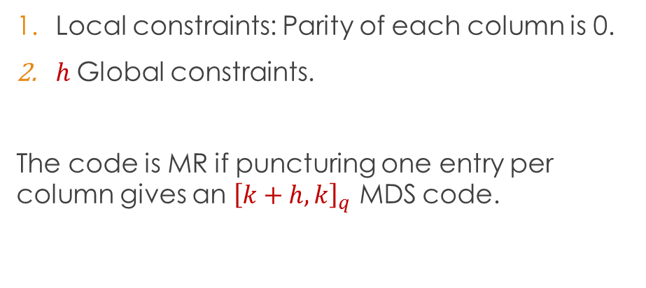
Maximally Recoverable LRCs
Local constraints: Parity of each column is 0.
$h$Global constraints.
The code is MR if puncturing one entry per column gives an ${\left[k+h, k\right]}_{q}$ MDS code.
Random gives MR LRCs for $q=O\left(k^{h}⋅r^{\frac{k}{r}}\right),$ SD for $q=O\left(k^{h}\right).$
[Silberstein-Rawat-Koylouglu-Vishwanath’13] Explicit MR LRCs with $q = 2^{n}.$
[G.-Huang-Jenkins-Yekhanin]
Basic construction: Gives $q=O\left(k^{h}\right).$
Product construction: Gives $q=O\left(k^{\left(1−ε\right)h}\right)$ for suitable $h, r$.

Slide 25
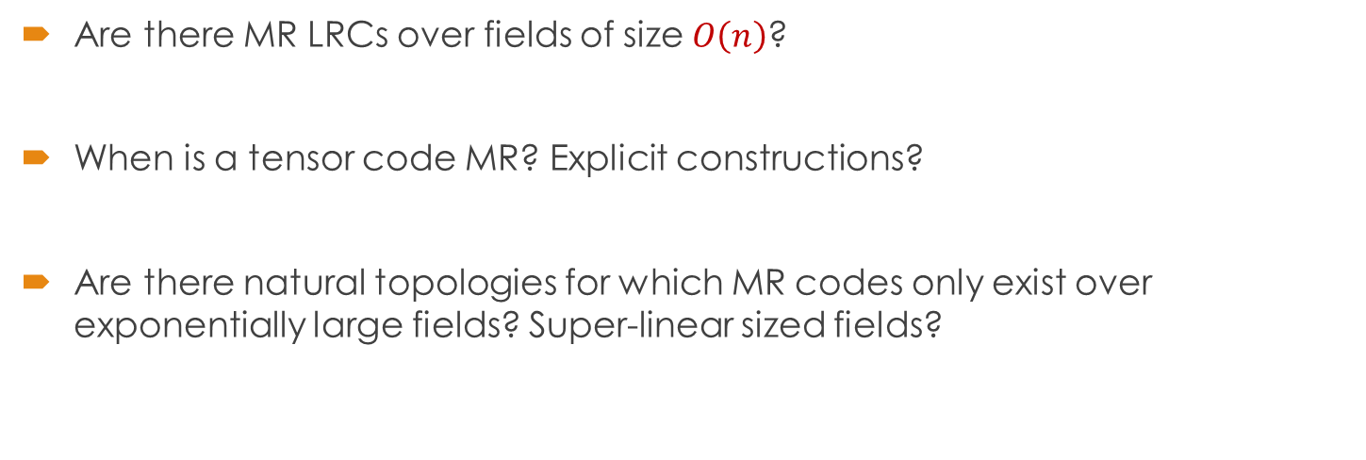
Open Problems:
Are there MR LRCs over fields of size $O\left(n\right)$?
When is a tensor code MR? Explicit constructions?
Are there natural topologies for which MR codes only exist over exponentially large fields? Super-linear sized fields?

Slide 26
Thank you
The Simons institute, David Tse, Venkat Guruswami.
Azure Storage + MSR: Brad Calder, Cheng Huang, Aaron Ogus, Huseyin Simitci, Sergey Yekhanin.
My former colleagues at MSR-Silicon Valley.

