Slide 1
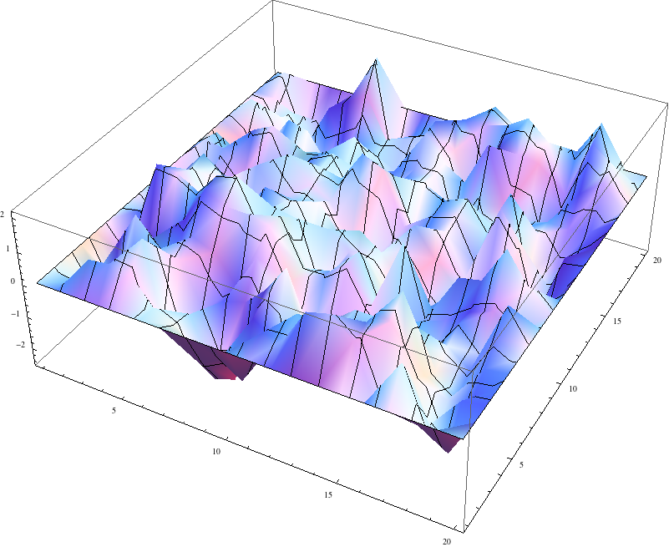
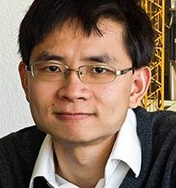
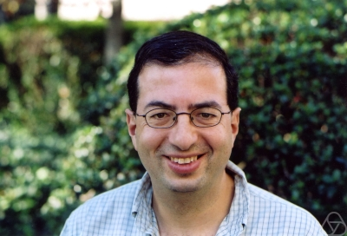
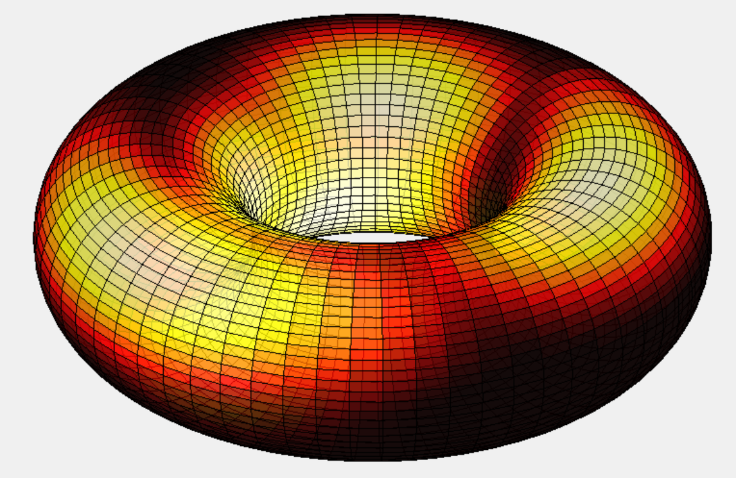
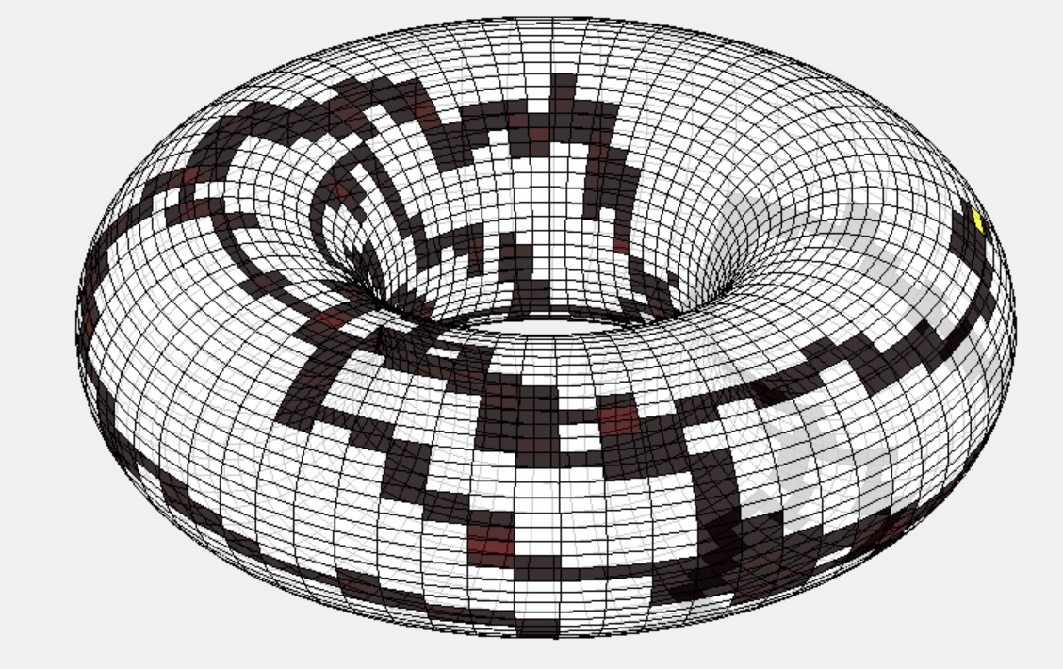
the Gaussian free field and cover times of graphs
James R. Lee
University of Washington

Slide 2
spectral graph theory: good for what?

Slide 3
spectrally track an individual particle?

Slide 4
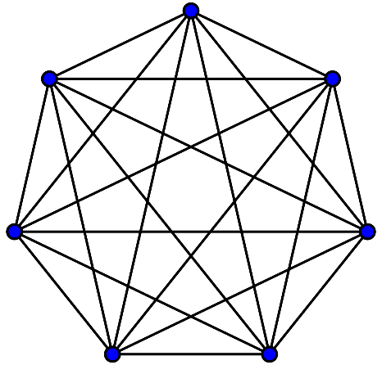
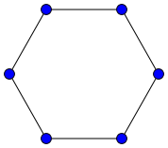
cover time of a graph
Consider a graph $G=(V,E)$.
Let $\{W_{t}\}$ denote the random walk on $G$.
$τ_{cov}=$ first time at which every vertex of $G$ has been visited
Cover time of $G$:
$$t_{cov}\left(G\right)= \max_{v∈V}{𝔼\left[τ_{cov} ∣ W_{0}=v\right]}$$
$$n\log{n}$$
$$n(n−1)/2$$

Slide 5
cover time of a graph
Consider a graph $G=(V,E)$.
Let $\{W_{t}\}$ denote the random walk on $G$.
$τ_{cov}=$ first time at which every vertex of $G$ has been visited
Cover time of $G$:
$$t_{cov}\left(G\right)= \max_{v∈V}{𝔼\left[τ_{cov} ∣ W_{0}=v\right]}$$
$$\left(1−o\left(1\right)\right)|V|\log{|V|≤t_{cov}\left(G\right)≤2|E||V|}$$
[Feige’95, Matthews’88]
[Alelinuas-Karp-Lipton-Lovasz-Rackoff’79]

Slide 6
a question and a conjecture
Aldous & Fill 1994:
Is there a deterministic polynomial-time algorithm that approximates
the cover time?
Winkler & Zuckerman 1996:
Conjecture: For every graph $G$, the blanket time and cover time are within an $O(1)$ factor.
[blanket time $=$ (expected) first time $T$ such that every node has been
visited at least $0.5 π\left(v\right)T$ times, $π=$ stationary measure]

Slide 7
cover time of graphs

Slide 8
on to other things…?
Cover time of $ℤ_{n}^{2}$:
$$\frac{1}{π} N{\left(\log{N}\right)}^{2}$$
[Dembo-Peres-Rosen-Zeitouni 2004]
$L=D−A$ the combinatorial Laplacian of $G$.
$v_{1}, v_{2},…, v_{N}$ the (unit) eigenvectors of $L$, and
$λ_{1},λ_{2},…, λ_{N}$ the eigenvalues
$g_{1}, g_{2},…, g_{N}$ are i.i.d. $N(0,1)$ random variables
$$\sum_{i=2}^{N}{\frac{g_{i}v_{i}}{\sqrt{λ_{i}}} }$$

Slide 9
on to other things…
Cover time of $ℤ_{n}^{2}$:
$$\frac{1}{π} N{\left(\log{N}\right)}^{2}$$
[Dembo-Peres-Rosen-Zeitouni 2004]
$L=D−A$ the combinatorial Laplacian of $G$.
$v_{1}, v_{2},…, v_{N}$ the (unit) eigenvectors of $L$, and
$λ_{1},λ_{2},…, λ_{N}$ the eigenvalues
$g_{1}, g_{2},…, g_{N}$ are i.i.d. $N(0,1)$ random variables
$${ \left\|\sum_{i=2}^{N}{\frac{g_{i}v_{i}}{\sqrt{λ_{i}}}}\right\|}_{∞}^{ }$$

Slide 10
on to other things…
Cover time of $ℤ_{n}^{2}$:
$$\frac{1}{π} N{\left(\log{N}\right)}^{2}$$
[Dembo-Peres-Rosen-Zeitouni 2004]
$L=D−A$ the combinatorial Laplacian of $G$.
$v_{1}, v_{2},…, v_{N}$ the (unit) eigenvectors of $L$, and
$λ_{1},λ_{2},…, λ_{N}$ the eigenvalues
$g_{1}, g_{2},…, g_{N}$ are i.i.d. $N(0,1)$ random variables
$${ \left\|\sum_{i=2}^{N}{\frac{g_{i}v_{i}}{\sqrt{λ_{i}}}}\right\|}_{∞}^{2}$$

Slide 11
on to other things…
Cover time of $ℤ_{n}^{2}$:
$$\frac{1}{π} N{\left(\log{N}\right)}^{2}$$
[Dembo-Peres-Rosen-Zeitouni 2004]
$L=D−A$ the combinatorial Laplacian of $G$.
$v_{1}, v_{2},…, v_{N}$ the (unit) eigenvectors of $L$, and
$λ_{1},λ_{2},…, λ_{N}$ the eigenvalues
$g_{1}, g_{2},…, g_{N}$ are i.i.d. $N(0,1)$ random variables
$${|E|\left\|\sum_{i=2}^{N}{\frac{g_{i}v_{i}}{\sqrt{λ_{i}}}}\right\|}_{∞}^{2}$$

Slide 12
on to other things…
Cover time of $ℤ_{n}^{2}$:
$$\frac{1}{π} N{\left(\log{N}\right)}^{2}$$
[Dembo-Peres-Rosen-Zeitouni 2004]
$L=D−A$ the combinatorial Laplacian of $G$.
$v_{1}, v_{2},…, v_{N}$ the (unit) eigenvectors of $L$, and
$λ_{1},λ_{2},…, λ_{N}$ the eigenvalues
$g_{1}, g_{2},…, g_{N}$ are i.i.d. $N(0,1)$ random variables
$${|E|\left\|\sum_{i=2}^{N}{\frac{g_{i}v_{i}}{\sqrt{λ_{i}}}}\right\|}_{∞}^{2}$$
$$= \frac{1}{π}N({\log{N)}}^{2}\left(1+o\left(1\right)\right)$$

Slide 13
DLP theorem
Theorem [Ding-L-Peres 2011]:
For any graph $G=(V,E)$.
$L=D−A$ the combinatorial Laplacian of $G$.
$v_{1}, v_{2},…, v_{N}$ the (unit) eigenvectors of $L$, and
$λ_{1},λ_{2},…, λ_{N}$ the eigenvalues
$g_{1}, g_{2},…, g_{N}$ are i.i.d. $N(0,1)$ random variables
$${\left|E\right|⋅𝔼\left\|\sum_{i=2}^{N}{\frac{g_{i}v_{i}}{\sqrt{λ_{i}}}}\right\|}_{∞}^{2}≍t_{cov}(G)$$
where $≍$ means “up to universal constant factor”

Slide 14
a question and a conjecture
Aldous & Fill 1994:
Is there a deterministic polynomial-time algorithm that approximates
the cover time? Yes.
Winkler & Zuckerman 1996:
Conjecture: For every graph $G$, the blanket time and cover time are within an $O(1)$ factor. True.
Best previous bounds were $O\left(\log{\log{n}}\right)$.
[Kahn-Kim-Lovasz-Vu 1999]

Slide 15
asymptotics
[Ding-L-Peres 2011]:
$$t_{cov}\left(G\right)≤{\left|E\right|⋅𝔼\left\|\sum_{i=2}^{N}{\frac{g_{i}v_{i}}{\sqrt{λ_{i}}}}\right\|}_{∞}^{2}+C\sqrt{t_{cov}\left(G\right){ t}_{hit}\left(G\right)}$$
[Ding 2012]: For trees and bounded-degree graphs:
where $C$ depends on the maximum degree of $G$.
$$≥{\left|E\right|⋅𝔼\left\|\sum_{i=2}^{N}{\frac{g_{i}v_{i}}{\sqrt{λ_{i}}}}\right\|}_{∞}^{2}−C\sqrt{t_{cov}\left(G\right){ t}_{hit}\left(G\right)}$$

Slide 16
asymptotics
[Alex Zhai 2014]:
$$t_{cov}\left(G\right)={\left|E\right|⋅𝔼\left\|\sum_{i=2}^{N}{\frac{g_{i}v_{i}}{\sqrt{λ_{i}}}}\right\|}_{∞}^{2}±C\sqrt{t_{cov}\left(G\right){ t}_{hit}\left(G\right)}$$

Slide 17
the Gaussian free field
$$\sum_{i=2}^{N}{\frac{g_{i}v_{i}}{\sqrt{λ_{i}}}}$$
What the hell is this thing?

Slide 18
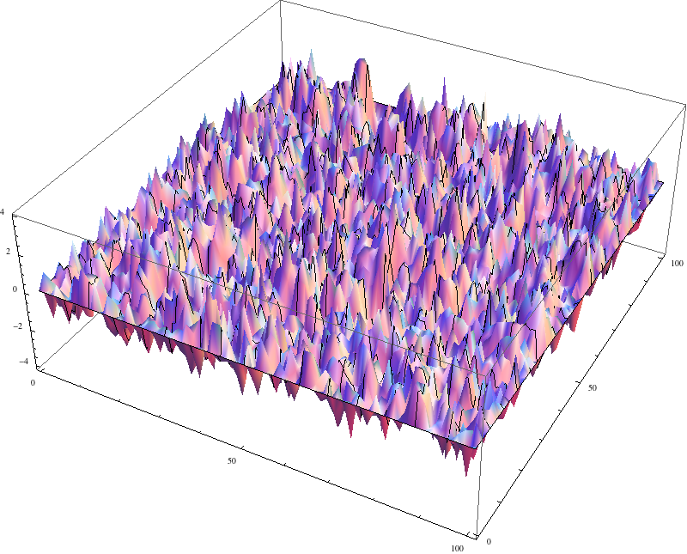
the Gaussian free field
Given a graph $G=\left(V,E\right)$, the Gaussian free field on $G$
grounded at some vertex $v_{0}∈V$ is the unique (centered)
Gaussian process $\{g_{v} :v∈V \}$ such that $g_{v_{0}}=0$ and
for all $u,v∈V$.
$$𝔼 {\left(g_{u}−g_{v}\right)}^{2}=R_{eff}\left(u,v\right)$$

Slide 19
the Gaussian free field
Given a graph $G=\left(V,E\right)$, the Gaussian free field on $G$
grounded at some vertex $v_{0}∈V$ is the unique (centered)
Gaussian process $\{g_{v} :v∈V \}$ such that $g_{v_{0}}=0$ and
for all $u,v∈V$.
$$𝔼 {\left(g_{u}−g_{v}\right)}^{2}=R_{eff}\left(u,v\right)$$
By [Spielman-Srivastava 2009] (using Laplacian solvers), can construct (approximately) the Gaussian free field in near-linear time.

Slide 20
the Gaussian free field
Given a graph $G=\left(V,E\right)$, the Gaussian free field on $G$
grounded at some vertex $v_{0}∈V$ is the unique (centered)
Gaussian process $\{g_{v} :v∈V \}$ such that $g_{v_{0}}=0$ and
for all $u,v∈V$.
$$𝔼 {\left(g_{u}−g_{v}\right)}^{2}=R_{eff}\left(u,v\right)$$
Equivalently, the density of $\{g_{v}\}$ is proportional to
$$\exp\left(−\frac{1}{2}\sum_{u∼v}{{\left(g_{u}−g_{v}\right)}^{2}}\right)$$

Slide 21
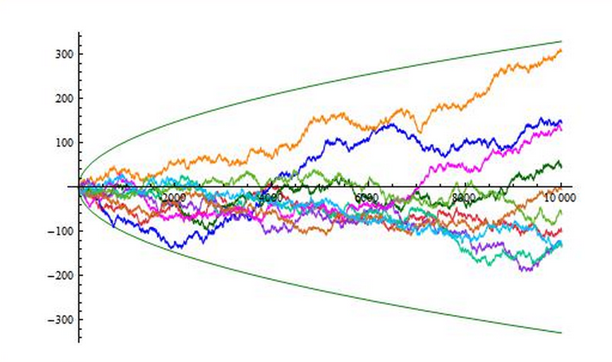
the Gaussian free field
Given a graph $G=\left(V,E\right)$, the Gaussian free field on $G$
grounded at some vertex $v_{0}∈V$ is the unique (centered)
Gaussian process $\{g_{v} :v∈V \}$ such that $g_{v_{0}}=0$ and
for all $u,v∈V$.
$$𝔼 {\left(g_{u}−g_{v}\right)}^{2}=R_{eff}\left(u,v\right)$$

Slide 22
cover times vs. the GFF
For every graph $G=(V,E)$, if $\{g_{v}\}$ is the GFF on $G$, then
$$t_{cov}\left(G\right)=\left|E\right|{\left(𝔼\max_{v∈V}{g_{v}}\right)}^{2}±C\sqrt{t_{cov}\left(G\right){ t}_{hit}\left(G\right)}$$

Slide 23
cover times vs. the GFF
For every graph $G=(V,E)$, if $\{g_{v}\}$ is the GFF on $G$, then
$$t_{cov}\left(G\right)=\left|E\right|{\left(𝔼\max_{v∈V}{g_{v}}\right)}^{2}±C\sqrt{t_{cov}\left(G\right){ t}_{hit}\left(G\right)}$$
[Meka 2012] showed that one can $\left(1+o\left(1\right)\right)$-approximate the
maximum of a Gaussian process deterministically.

Slide 24
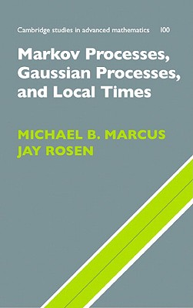
the Dynkin isomorphism theory

Slide 25
the Dynkin isomorphism theory
Local times:
Now we switch to the continuous-time random walk $\{Z_{t}\}$ that
waits for an $Exp(1)$ amount of time before making a jump.
For a time $t≥0$ and a vertex $v∈V$, define:
$$L_{t}^{v}=\frac{time spent at v up to time t}{\deg\left(v\right)}$$
Ray-Knight (1960s):
Characterized the local times of Brownian motion.
Dynkin (1980):
General connection of Markov process to Gaussian fields.

Slide 26
generalized 2nd Ray-Knight theorem
[Eisenbaum, Kaspi, Marcus, Rosen, and Shi 2000]
Fix $v_{0}∈V.$ Define $T(ℓ)=\inf{ \left\{t :L_{t}^{v_{0}}≥ℓ\right\}}$.
Let $\{g_{v} :v∈V\}$ be the GFF on $G$ with $g_{v_{0}}=0$.
Then for every $ℓ≥0$, it holds that:
$$\left\{L_{T}^{v}+\frac{1}{2}g_{v}^{2} :v∈V\right\}=\left.\left\{\frac{1}{2}{\left.\left(g_{v}−\sqrt{2ℓ}\right.\right)}^{2}:v∈V\right.\right\}$$
law
where $T=T\left(ℓ\right).$

Slide 27
a graph with one edge
For every $ℓ≥0$, it holds that:
$$\left\{L_{T\left(ℓ\right)}^{v}+\frac{1}{2}g_{v}^{2} :v∈V\right\}=\left.\left\{\frac{1}{2}{\left.\left(g_{v}−\sqrt{2ℓ}\right.\right)}^{2}:v∈V\right.\right\}$$
law
$$+\sum_{i=1}^{M}{Y_{i}}$$
$$\frac{1}{2}X^{2}$$
$$\frac{1}{2}{\left(X−\sqrt{2ℓ}\right)}^{2}$$
$$v_{0}$$
$$v$$
$Y_{1}, Y_{2},…$ i.i.d. $Exp\left(1\right)$
$$X∼N(0,1)$$
$$M∼Poi(ℓ)$$

Slide 28
generalized 2nd Ray-Knight theorem
Fix $v_{0}∈V.$ Define $T(ℓ)=\inf{ \left\{t :L_{t}^{v_{0}}≥ℓ\right\}}$.
Let $\{g_{v} :v∈V\}$ be the GFF on $G$ with $g_{v_{0}}=0$.
Then for every $ℓ≥0$, it holds that:
$$\left\{L_{T}^{v}+\frac{1}{2}g_{v}^{2} :v∈V\right\}=\left.\left\{\frac{1}{2}{\left.\left(g_{v}−\sqrt{2ℓ}\right.\right)}^{2}:v∈V\right.\right\}$$
law
where $T=T\left(ℓ\right).$

Slide 29
Jian’s conjecture (Alex’s theorem)
$$\left\{\sqrt{L_{T\left(ℓ\right)}^{v} }:v∈V\right\}≼\frac{1}{\sqrt{2}}\left.\left\{\max\left(g_{v}+\sqrt{2ℓ},0\right):v∈V\right.\right\}$$

Slide 30
Alex’s proof [see also Lupu]
$$\left\{\sqrt{L_{T\left(ℓ\right)}^{v} }:v∈V\right\}≼\frac{1}{\sqrt{2}}\left.\left\{\max\left(g_{v}+\sqrt{2ℓ},0\right):v∈V\right.\right\}$$

Slide 31
Alex’s proof [see also Lupu]
$$\left\{\sqrt{L_{T\left(ℓ\right)}^{v} }:v∈V\right\}≼\frac{1}{\sqrt{2}}\left.\left\{\max\left(g_{v}+\sqrt{2ℓ},0\right):v∈V\right.\right\}$$
$$\left\{L_{T}^{v}+\frac{1}{2}g_{v}^{2} :\overline{V}\right\}=\left.\left\{\frac{1}{2}{\left.\left(g_{v}+\sqrt{2ℓ}\right.\right)}^{2}:v∈\overline{V}\right.\right\}$$

Slide 32
Alex’s proof [see also Lupu]
$$\left\{\sqrt{L_{T\left(ℓ\right)}^{v} }:v∈V\right\}≼\frac{1}{\sqrt{2}}\left.\left\{\max\left(g_{v}+\sqrt{2ℓ},0\right):v∈V\right.\right\}$$
Define $f :\overline{V}→ℝ$ by
$$f\left(x\right)=\left(g_{x}+\sqrt{2ℓ}\right)−{\hat{g}}_{x}$$
$$U=\{v∈V :L_{T}^{v}>0 \}$$
$f\left(v\right)>0$ for $v∈U$
$$\left\{L_{T}^{v}+\frac{1}{2}{\hat{g}}_{v}^{2} :\overline{V}\right\}=\left.\left\{\frac{1}{2}{\left.\left(g_{v}+\sqrt{2ℓ}\right.\right)}^{2}:v∈\overline{V}\right.\right\}$$

