Slide 1
Spectral Partitioning for Metrics*
Alexandr Andoni (Columbia)
Assaf Naor (Princeton)
Aleksandar Nikolov (Toronto)
Ilya Razenshteyn (MSR Redmond)
Erik Waingarten (Columbia)
* and nearest neighbor search too

Slide 2
Approximate Near Neighbors (ANN)
Dataset: $n$ points in a metric space $X$
(denoted by $P$)
Approximation $c>1$, distance threshold $r>0$
Query: $q∈X$ such that there is $p^{∗}∈P$ with $d_{X}(q,p^{∗})≤r$
Output: $\tilde{p}∈P$ such that
$$d_{X}(q,\tilde{p})≤cr$$
Parameters: approximation vs space&query time
$$cr$$
$$r$$
$$q$$

Slide 3
FAQ
Q: why approximation?
A: exact version is hard for the high-dimensional problem.
Q: what does “high-dimensional” mean?
A: dimension $d=ω(\log{n})$.
Q: how is the dimension defined?
A: metric often on $R^{d}$; alternatively, doubling dimension, etc.
This talk: a metric on $R^{d}$, where $ω\left(\log{n}\right)≤d≤n^{o(1)}$
Dependence on $d$ as $d^{O(1)}$

Slide 4
Which metric to use?
A distance function
Must capture semantic similarity well
Must be algorithmically tractable
E.g.: Hamming, Euclidean, Earth-mover distance, Spectral norm
Not-quite-solution: ANN for any metric with small doubling dimension
[Clarkson’99,Krauthgamer-Lee’04,Beygelzimer-Kakade-Langford’06]
~$2^{k}$ for doubling dimension 𝑘
Goal: classify metrics by the complexity of high-dimensional ANN
For theory: what’s the relevant property of the metric
For practice: universal algorithm for ANN

Slide 5
The classics: $ℓ_{1}/ℓ_{2}$ case
Most ANN data structures are designed for $ℓ_{1}$ or $ℓ_{2}$ distances
Starting with LSH
[Indyk, Motwani ‘98], [Kushilevitz, Ostrovsky, Rabani ‘98]…
To data-dependent hashing
[A, Razenshteyn 2015], [A, Laarhoven, Razenshteyn, Waingarten 2017]
space $n^{1+ε}$, query time $n^{ε}$,
achieving approximation $c=\sqrt{\frac{1}{2}+\frac{1}{2ε}}=O\left(\frac{1}{\sqrt{ε}}\right)$

Slide 6
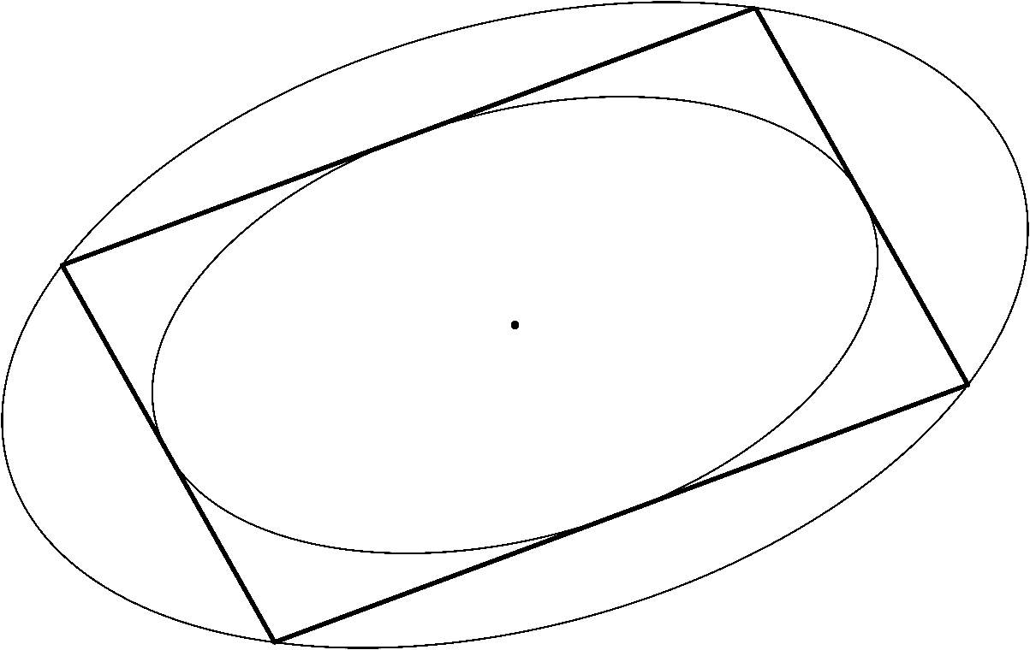
General norms ?
[John 1948]: every $d$-dimensional normed space is within $\sqrt{d}$ from $ℓ_{2}^{d}$
For any symmetric convex body $K$, there exists an ellipsoid $E$ s.t.:
$$E⊆K⊆\sqrt{d}⋅E$$
Tight bound (eg, $ℓ_{1}/ℓ_{∞}$)

Slide 7
Baseline ANN for norms: via embedding
For every $d$-dimensional norm, ANN with:
Space $O(n^{1+ε})$
Query time $O(n^{ε})$
Approximation $c=O(\sqrt{d/ε})$

Slide 8
Our results
Result | Approximation | Comments
Baseline (John’s ellipsoid) | $$O(\sqrt{d})$$
General norm [this talk] | $$O(\log{d})$$ | Cell-probe model
[next talk] | $$\exp{(\log^{1/2}{d})}$$
$ℓ_{p},S_{p}$ (Schatten) [next talk] | $$O(p)$$ | Improves on $2^{O(p)}$ [Naor Rabani’06, Bartal Gottlieb’14]
Spectral norm ($S_{∞}$) [next talk] | $$O(\log{d})$$

Slide 9
New approach
Cutting modulus: well-defined quantity for every metric
governs the complexity of ANN
goes beyond embeddings
New partitioning procedure for metric spaces
not ball carving

Slide 10
Cutting modulus
Ball of radius $r⋅Ξ(X,ε)$ with $Ω(n)$ vertices
$$≤r$$
$$≤r$$
For a metric space $M=(X,D)$, the cutting modulus $Ξ(M, ε)$ is the smallest number st:
for any graph embedded into $M$ with edges of “length” at most $r$
either there is a ball of radius $r⋅Ξ(M, ε)$ containing $Ω(n)$ vertices
or the graph has an $ε$-sparse cut
$$≤r$$
$$≤r$$
$$≤r$$
$$≤r$$
$$≤r$$
$$≤r$$
$$≤r$$
$$≤r$$
$$≤r$$
$$≤r$$
$$≤r$$
$$≤r$$
$$≤r$$
$$≤r$$
$$≤r$$
$$≤r$$
$$≤r$$
A cut with conductance at most $ε$

Slide 11
Example: real line, $ℓ_{2}$
$$≤r$$
$$≤r$$
$$≤r$$
$$≤r$$
$$≤r$$
$$≤r$$
$$≤r$$
Claim: $Ξ\left(ℝ,ε\right)≲1/ε$
For every (regular) $G=(V,E)$ and $f:V→ℝ$: by def. of $λ_{2}\left(G\right)$
$$E_{u,v∼V}{\left(f\left(u\right)−f\left(v\right)\right)}^{2}≤\frac{1}{1−λ_{2}\left(G\right)}⋅E_{\left(u,v\right)∈E}{\left(f\left(u\right)−f\left(v\right)\right)}^{2}$$
If no ball of radius ${≲r}/ε$ with $Ω(n)$ vertices
$⇒$ $1−λ_{2}\left(G\right)≪ε^{2}$
Cheeger’s inequality $⇒$ there is an $ε$-sparse cut
$Ξ(ℓ_{2}^{d},ε)≲1/ε$, since ${\left\|⋅\right\|}_{2}^{2}$ is additive over coordinates
$$≤r$$
$$≤r$$
$≤r^{2}$
$$Ω{\left(\frac{r}{ε}\right)}^{2}≤$$

Slide 12
Cutting modulus vs embeddings
Well-behaved under embeddings:
if $M$ embeds into $ℓ_{2}$ with distortion $c_{2}(M)$, then:
$$Ξ(M,ε)≲O_{ε}(c_{2}(M))$$
Oftentimes, $Ξ(M,ε)$ is much smaller!
related to non-embeddability of large expanders into $M$

Slide 13
Cutting modulus for norms
“Baseline” bound (John’s ellipsoid):
$Ξ\left((ℝ^{d},\left\|⋅\right\|),ε\right)≲\sqrt{d}/ε$
[Naor 2017]:
$Ξ\left((ℝ^{d},\left\|⋅\right\|),ε\right)≲\frac{\log{d}}{ε^{2}}$
Better bounds for special cases:
$Ξ\left(ℓ_{p}^{d},ε\right)=O(p/ε)$ for $p>2$ [Matousek 1997]
$Ξ\left(S_{p},ε\right)$ is similar [Matousek’97, Naor’14, Ricard’15]

Slide 14
Cutting modulus $⇒$ ANN
Thm: For metric space $M=(X,D)$ and $ε>0$, exists randomized ANN data structure with:
Approximation: $c≲Ξ\left(M, ε\right)$
Space: $n^{1+O(ε)}⋅\log^{O(1)}{|X|}$
Query procedure: inspects $n^{O(ε)}⋅\log^{O(1)}{|X|}$ memory locations
For $d$-dimensional normed spaces, $\log{|X|}≈d$
If a space does not contain large expanders, ANN is possible

Slide 15
ANN: core partitioning procedure
$M=(X,D)$ with $\left|X\right|=2^{d}$, and $ε,r>0$
Build collection $ℱ⊂2^{X}$ s.t. for every $n$-point dataset $P⊂X$:
either there is a ball of radius $≲r⋅Ξ\left(M,ε\right)$ with $Ω(n)$ points
or there is distribution $𝒟$ of cuts partitioning $P$ ~evenly and:
for every $x_{1},x_{2}∈X$ with $D\left(x_{1},x_{2}\right)≤r$:
$$\underset{A∼𝒟}{Pr}\left[A \text{separates} x_{1} \text{and} x_{2}\right]≲ε$$
Small description: $log⁡|ℱ|=O(d^{3}∕ε)$
$𝒟$: over $d/ε$ sets from $ℱ$
Enough for ANN [Indyk’98], [A-Razenshteyn‘15]

Slide 16
Cutting modulus $⇒$ core partitioning
Can: find an $ε$-sparse cut in a graph with short edges and $Ξ(X,ε)$-separated vertices
Want: a random partition that is good for every close pair with reasonable probability
Idea: duality in spirit of the minimax theorem
To guarantee the limited use of the dataset (small $ℱ$), invoke the (nested) Multiplicative Weights Update algorithm

Slide 17
Cuts: algorithmic aspect
How to check on which side of the cut?
Cut comes from 2nd eigenvector
No apriori structure!
Cuts can have complex boundary => no bound on the query time
Need: if a graph is embedded into a metric/normed space, then there is a geometrically/algorithmically nice sparse cut
For $ℓ_{p}$, one can always find a coordinate cut: $\{x|x_{i}≤u\}$
For $S_{p}$, a bit more complicated, but still nice enough
General norm: next talk by Ilya!

Slide 18
Conclusions and open problems
Cutting modulus: generic recipe
nonlinear spectral gap $⇒$ ANN data structures
Spectral partitioning + Multiplicative Weights Update
Time-efficient data structures with approximation $O_{ε}(\log{d})$?
Preprocessing time: polynomial?
Cutting modulus of Wasserstein metrics, edit distance, Riemannian manifolds, other nice/important metrics?
Next talk by Ilya:
$$\exp{(\log^{1/2}{d})}$$
Thanks!

Slide 20
Useful primitive
Let $μ$ be a probability measure over $M$
Either finds a ball $B$ of radius $≲Ξ\left(M,ε\right)⋅r$ with $μ\left(B\right)=Ω(1)$
Or finds a distribution $𝒟$ over ${\log{N}}/ε$ sets that are $μ$-balanced such that
For every $x_{1},x_{2}∈X$ with $D\left(x_{1},x_{2}\right)≤r$:
$$\underset{A∼𝒟}{Pr}\left[A \text{separates} x_{1} \text{and} x_{2}\right]≲ε$$
Maintains a distribution over close pairs via MWU
Why can’t just apply to $μ$ being uniform over the dataset?
Can’t control the total number of possible sets!

Slide 21
Guessing the dataset via MWU
Set $ν$ to be uniform over $M$
Run the primitive with $ν$
If the ball or a distribution are good w.r.t. the dataset, done
Otherwise, can perform an update and reduce $KL(ν^{∗}||ν)$
A ball that is heavy w.r.t. $ν$, but contains too few datapoints
A set that is $ν$-balanced, but is not dataset-balanced
Can encode the whole run of MWU using a few bits
Hence $|ℱ|$ is not too large!

Slide 22
Algorithmically-nice cuts for norms
Thm: Fix $(ℝ^{d},\left\|⋅\right\|)$, and graph $G=(V,E)$ which admits a 1-Lipschitz embedding such that:
unless there’s a dense balls of radius $\exp\left(O_{ε}\left(\sqrt{\log{d}\log{\log{d}}}\right)\right)$
There is a coordinate cut of conductance $ε$ after applying the transformation $x↦F(x−w)$, where:
$F:ℝ^{d}→ℝ^{d}$ is a map that depends only on the norm
Calderon’s complex interpolation
Shift $w∈ℝ^{d}$ depends on everything
Brouwer’s fixed-point theorem

Slide 23
Catalog of cutting moduli
$Ξ\left((ℝ^{d},\left\|.\right\|),ε\right)=O\left(\frac{\log{d}}{ε^{2}}\right)$ [Naor 2017]
$Ξ\left(ℓ_{2}^{d},ε\right)=O(1/ε)$ (Cheeger’s inequality)
$Ξ\left(ℓ_{p}^{d},ε\right)=O({1/ε}^{2/p})$ for $1≤p<2$ (via embedding)
$Ξ\left(ℓ_{p}^{d},ε\right)=O(p/ε)$ for $p>2$ [Matousek 1997]
$Ξ\left(S_{p},ε\right)$ is bounded similar to $Ξ\left(ℓ_{p}^{d},ε\right)$ [Matousek 1997] [Naor 2014] [Ricard 2015]

Slide 24
Communication game
Alice: $P⊂X$, $\left|P\right|=n$
Bob: wants a good random partition of $P$
$O\left(\frac{\log^{3}{N}}{ε}\right)$ bits sent by Alice
Gives an upper bound on $|ℱ|$! No explicit description…

Slide 25
Non-linear spectral gaps
For any graph embedded in $M$ with edges of “length” at most $K$
Either there is a ball of radius $Ξ(M,ε)⋅K$ covering $Ω(n)$ vertices
Or the graph has an $ε$-sparse cut
To bound $Ξ\left(ℝ,ε\right)≲1/ε$, we used:
$E_{u,v∼V}{\left(f\left(u\right)−f\left(v\right)\right)}^{2}≤\frac{1}{1−λ_{2}\left(G\right)}⋅E_{\left(u,v\right)∈E}{\left(f\left(u\right)−f\left(v\right)\right)}^{2}$.
[Mendel, Naor 2014]: generalizations to other metrics?
[Naor 2017]: for every $X=\left(ℝ^{d},{\left\|⋅\right\|}_{X}\right)$:
$E_{u,v∼V}{\left\|f\left(u\right)−f\left(v\right)\right\|}_{X}^{2}≲{\left(\frac{\log{d}}{1−λ_{2}\left(G\right)}\right)}^{2}⋅E_{\left(u,v\right)∈E}{\left\|f\left(u\right)−f\left(v\right)\right\|}_{X}^{2}$.

Slide 26
The core lemma
Let ${\left\|⋅\right\|}_{A}$ and ${\left\|⋅\right\|}_{B}$ be two norms on $ℝ^{m}$ such that
$∀x: {\left\|x\right\|}_{A}≤{\left\|x\right\|}_{B}≤Φ⋅$ ${\left\|x\right\|}_{A}$
Let $T:ℝ^{m}→ℝ^{m}$ be such that:
${\left\|T\right\|}_{A→A}≤1$
${\left\|T\right\|}_{B→B}≤1−ε$
Then, ${\left\|{\left(\text{id}−T\right)}^{−1}\right\|}_{A→A}≲\frac{\log{Φ}}{ε}$
The bound $≲Φ/ε$ is trivial

Slide 27
The proof of Naor’s inequality: notation
Want: for every (regular) graph $G=(V,E)$ and $f:V→{(ℝ}^{d},{\left\|⋅\right\|}_{X})$
$E_{u,v∼V}{{\left\|f\left(u\right)−f\left(v\right)\right\|}_{X}^{2}}^{ }≲{\left(\frac{\log{d}}{1−λ_{2}\left(G\right)}\right)}^{2}⋅E_{\left(u,v\right)∈E}{\left\|f\left(u\right)−f\left(v\right)\right\|}_{X}^{2}$.
Let ${\left\|⋅\right\|}_{H}$ be a Euclidean norm that is $\sqrt{d}$-close to ${\left\|⋅\right\|}_{X}$
Let $S=\left\{\left(x_{1},x_{2},…,x_{n}\right)∈{\left(ℝ^{d}\right)}^{n} | \sum_{i}{x_{i}=0}\right\}$
Two norms on $S$: $ℓ_{2}(X)$ and $ℓ_{2}(H)$; within $\sqrt{d}$ from each other
Let $𝒜:S→S$ be a linear map that acts on a tuple of vectors as a (normalized) adjacency matrix of $G$ acts on $ℝ^{n}$

Slide 28
The proof of Naor’s inequality: the argument
One has:
${\left\|\frac{\text{id}+𝒜}{2}\right\|}_{ℓ_{2}(H)}≤\frac{1+λ_{2}(G)}{2}$ (“scalar” considerations)
${\left\|\frac{\text{id}+𝒜}{2}\right\|}_{ℓ_{2}(X)}≤1$ (triangle inequality + Jensen)
Hence, by the core Lemma:
${\left\|{\left(\frac{\text{id}−𝒜}{2}\right)}^{−1}\right\|}_{ℓ_{2}(X)}≲\frac{\log{d}}{1−λ_{2}(G)}$
Easily implies the desired inequality

Slide 29
Metric class: High-dimensional norms
Important case: $X$ is a normed space
$d_{X}\left(x_{1},x_{2}\right)=\left\|x_{1}−x_{2}\right\|$, where $\left\|⋅\right\|:R^{d}→R_{+}$ is such that
$\left\|x\right\|=0$ iff $x=0$
$\left\|αx\right\|=|α|\left\|x\right\|$
$\left\|x_{1}+x_{2}\right\|≤\left\|x_{1}\right\|+\left\|x_{2}\right\|$
Lots of tools (functional analysis)
E.g., can characterizate norms that allow efficient sketching (succinct summarization), which implies efficient ANN [A, Krauthgamer, Razenshteyn 2015]

Slide 30
Unit balls of norms
A norm given by its unit ball $B_{X}=\left\{x∈R^{d} | \left\|x\right\|≤1\right\}$
Claim: $B_{X}$ is a symmetric convex body
Claim: any such body can be a unit ball
${\left\|x\right\|}_{K}=\inf\left\{t>0 | \frac{x}{t}∈K\right\}$
John’s theorem: any symmetric convex body is close to an ellipsoid (gives ANN with approximation $\sqrt{d}$)
$$\left\|x\right\|≈2$$
What property of a convex body makes ANN wrt it tractable?
$$B_{X}$$

Slide 31
This talk will be about data structures
What is a data structure? [Fefferman, Klartag 2009]: introduction for mathematicians

Slide 32
Data structures
Given some dataset
Numbers, text, graphs, geometric, etc.
Answer queries of a certain kind quickly
Example:
Given a sequence $a_{i}$ of $n$ numbers
Answer queries quickly: given $1≤i≤j≤n$, find $\sum_{k=i}^{j}{a_{k}}$
Computing the sum naively takes $O(n)$ time
Can we do it faster?
No! Need to look at every number
2 7 1 4 6 3 2 9
$$i$$
$$i$$
$$j$$
$$j$$
$$6+3+2+9=20$$
$$1+4+6+3+2=16$$

Slide 33
Power of auxiliary information
Idea: compute and store additional information
Speed up queries
Naïve way: store all possible answers!
$S_{ij}=\sum_{k=i}^{j}{a_{k}}$
Space $O(n^{2})$, query time $O(1)$
Possible to do better?
Yes! $S_{ij}=S_{1j}−S_{1 i−1}$ (prefix sums)
Space $O(n)$, query time $O(1)$
2 1 7 4 6 3 2 9
2 3 10 14 20 23 25 34
1 8 12 18 21 23 32
7 11 17 20 22 31
4 10 13 15 24
6 9 11 20
3 5 14
2 11
9

Slide 34
Summary
Data structures are characterized by space and query time
Usually, two simple approaches are possible:
No additional information, naïve computation
Store all possible answers, retrieve them quickly
The interesting question is to go beyond these two possibilities

Slide 35
A less silly example
Instead of $\sum_{k=i}^{j}{a_{k}}$, want to output $\min_{i≤k≤j}{a_{k}}$
The trick with prefix sums does not work!
Two trivial solutions:
Space $O(n)$, query time $O(n)$ (naïve computation)
Space $O(n^{2})$, query time $O\left(1\right)$ (store all the answers)
Space $O(n)$, query time $O(\log{n})$
Any interval is a union of $O(\log{n})$ dyadic intervals
Space $O(n)$, query time $O(1)$ is possible but highly non-trivial! [Bender, Farach-Colton 2000]

Slide 36
A very non-silly example
Given: an array of $n$ numbers $a_{1}$, $a_{2}$, …, $a_{n}$
Query: $l≤r$
Goal: find any $a_{i}$ such that $l≤a_{i}≤r$
Can do in space $O(n)$ and time $O(1)$!
[Alstrup, Brodal, Rauhe 2001]
Binary search requires time $\sim \log{n}$

Slide 37
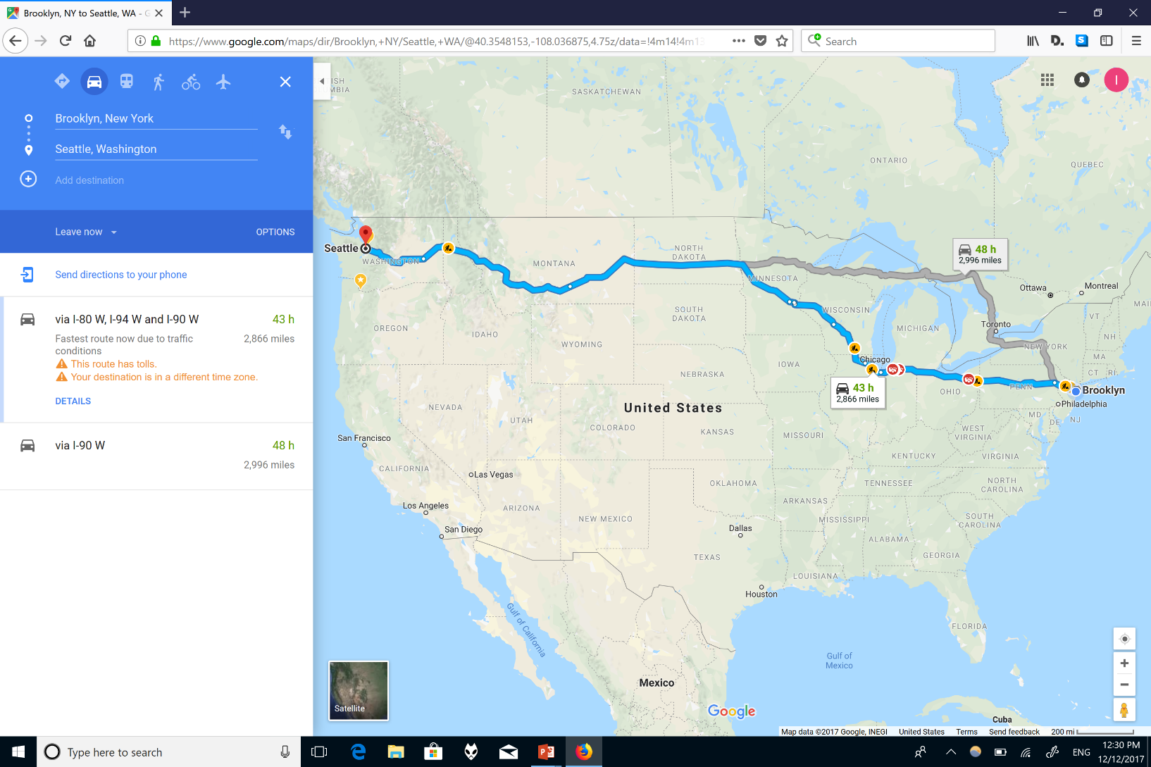
The most popular data structure

Slide 38
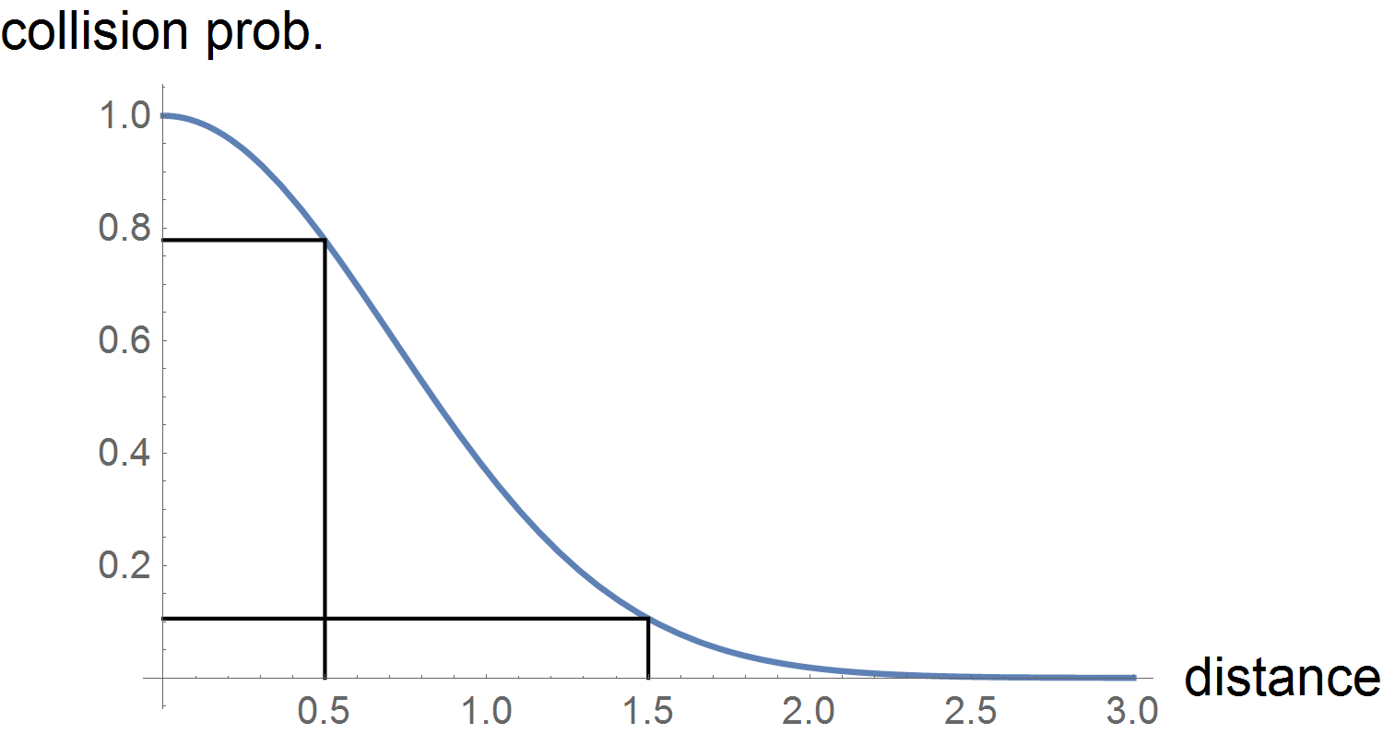
Locality-Sensitive Hashing (LSH)
Introduced in [Indyk, Motwani 1998]
Main idea: random partition of $R^{d}$ s.t. closer points end up in the same part more often
More precisely: for every $p, q∈R^{d}$:
For close $p$ and $q$,
$$\operatorname{Pr}\left[p \text{and} q \text{collide}\right]≥p_{1}$$
For far $p$ and $q$
$$\operatorname{Pr}\left[p \text{and} q \text{collide}\right]≤p_{2}$$
$$p_{1}$$
$$ρ=\frac{\ln{1/p_{1}}}{\ln{1/p_{2}}}$$
$$p_{2}$$
$$r$$
$$cr$$
Measures the gap between $p_{1}$ and $p_{2}$

Slide 39
From LSH to ANN
LSH implies ANN with
Space ${O(n}^{1+ρ}+nd)$
Query time $O(n^{ρ}+dn^{o(1)})$,
Where $ρ=\frac{\ln{1/p_{1}}}{\ln{1/p_{2}}}∈(0;1)$
On a query, retrieve all the data points from the same part
Implemented with a hash table
Several tables for high probability of success

Slide 40
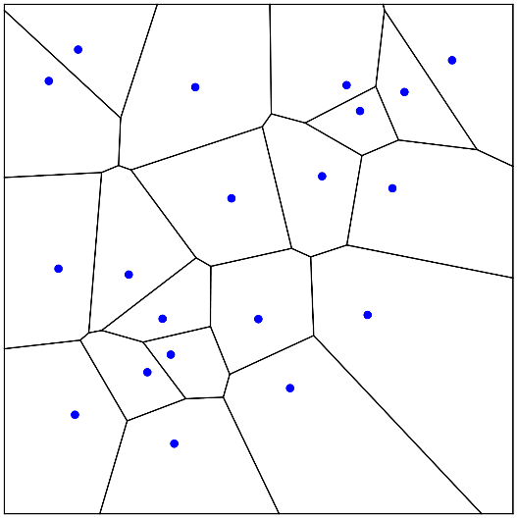
How to do better than LSH?
Main idea: data-dependent space partitions
Reminder: for every $p, q∈R^{d}$:
For close $p$ and $q$, $\operatorname{Pr}\left[p \text{and} q \text{collide}\right]≥p_{1}$
For are far $p$ and $q$, $\operatorname{Pr}\left[p \text{and} q \text{collide}\right]≤p_{2}$
Too strong! Enough for $p$ from the dataset and $q∈$ $R^{d}$
Exploit the geometry of the dataset
[Andoni, Indyk, Nguyen, R 2014]: slightly improve upon (the best possible) LSH for large approximation
[Andoni, R 2015]: optimal data-dependent partitions

Slide 41
Catalog of “easy” spaces
$ℓ_{∞}$: approximation is $c=O(\log{\log{d})}$ [Indyk 1998]
$ℓ_{p}$: $c=\text{min}{\{2^{O\left(p\right)},O(\log{\log{d})}\}}$ [Naor, Rabani 2006], [Andoni 2009], [Bartal, Gottlieb 2014]
$ℓ_{p}$-direct sums of easy spaces [Indyk 2002], [Andoni, Indyk, Krauthgamer 2009], [Andoni 2009]
Let $M_{i}=(X_{i},D_{i})$ for $1≤i≤k$ be metric spaces
Then ${\left(\sum_{i}{M_{i}}\right)}_{p}=\left(X_{1}×X_{2}×…×X_{k},D\right)$, where:
$$D\left(\left(x_{1},x_{2},…,x_{k}\right),\left(y_{1},y_{2},…,y_{k}\right)\right)={\left\|(D_{1}\left(x_{1},y_{1}\right),D_{2}\left(x_{2},y_{2}\right),…, D_{k}(x_{k}, y_{k}))\right\|}_{ℓ_{p}}$$
All the above examples are highly regular (see [Andoni, Nguyen, Nikolov, R, Waingarten 2017] for a few more similar examples)

Slide 42
Metric embeddings
A map $f:M→N$ is an bi-Lipschitz embedding with distortion $C≥1$, if for some $λ>0$ and for every $x,y∈M$:
$${λD_{M}(x,y)≤D}_{N}\left(f\left(x\right),f\left(y\right)\right)≤λCD_{M}(x,y)$$
Reductions for geometric problems involving distances (sometimes weaker guarantee is enough)
$$f$$
$$f(a)$$
$$a$$
$cC$-approx. ANN for $M$
$c$-approx. ANN for $N$
$$M$$
$$N$$
$$f$$
$$b$$
Caveat: the embedding must be computationally efficient
$$f(b)$$

Slide 43
Catalog of embeddings
Not enough for ANN:
Any $N$-point metric spaces embeds isometrically into $ℓ_{∞}^{N}$
Any $d$-dimensional normed space embeds with distortion $1+ε$ into $ℓ_{∞}^{d^{′}}$ for $d^{′}=2^{O_{ε}(d)}$
[Bourgain 1985]: Any $N$-point metric space embeds into $ℓ_{2}^{O(\log{N)}}$ with distortion $O(\log{N)}$
Enough for ANN:
Hausdorff, Wasserstein-1, edit, Ulam, $ℓ_{p}$ ($1<p<2$) distances
[Andoni, Nguyen, Nikolov, R, Waingarten 2017]: symmetric norms (embedding into a nested direct sum)

Slide 44
Critical scale
For a metric $M=(X,D)$ and $ε>0$, the critical scale $Ξ(M,ε)$ is the smallest $R>0$ satisfying the following
Every undirected graph $G=\left(V,E\right)$, which admits an embedding $f: V→X$ such that:
The endpoints of every edge are within distance $1$
A typical pair of vertices is at least $R$ apart
Has a cut $S⊂V$ of conductance at most $ε$
$$Φ_{G}\left(S\right)=\frac{E(S,V∖S)}{min⁡\{\sum_{v∈S}{\text{deg}\left(v\right)},\sum_{v∉S}{\text{deg}}(v)\}}≤ε$$

Slide 45
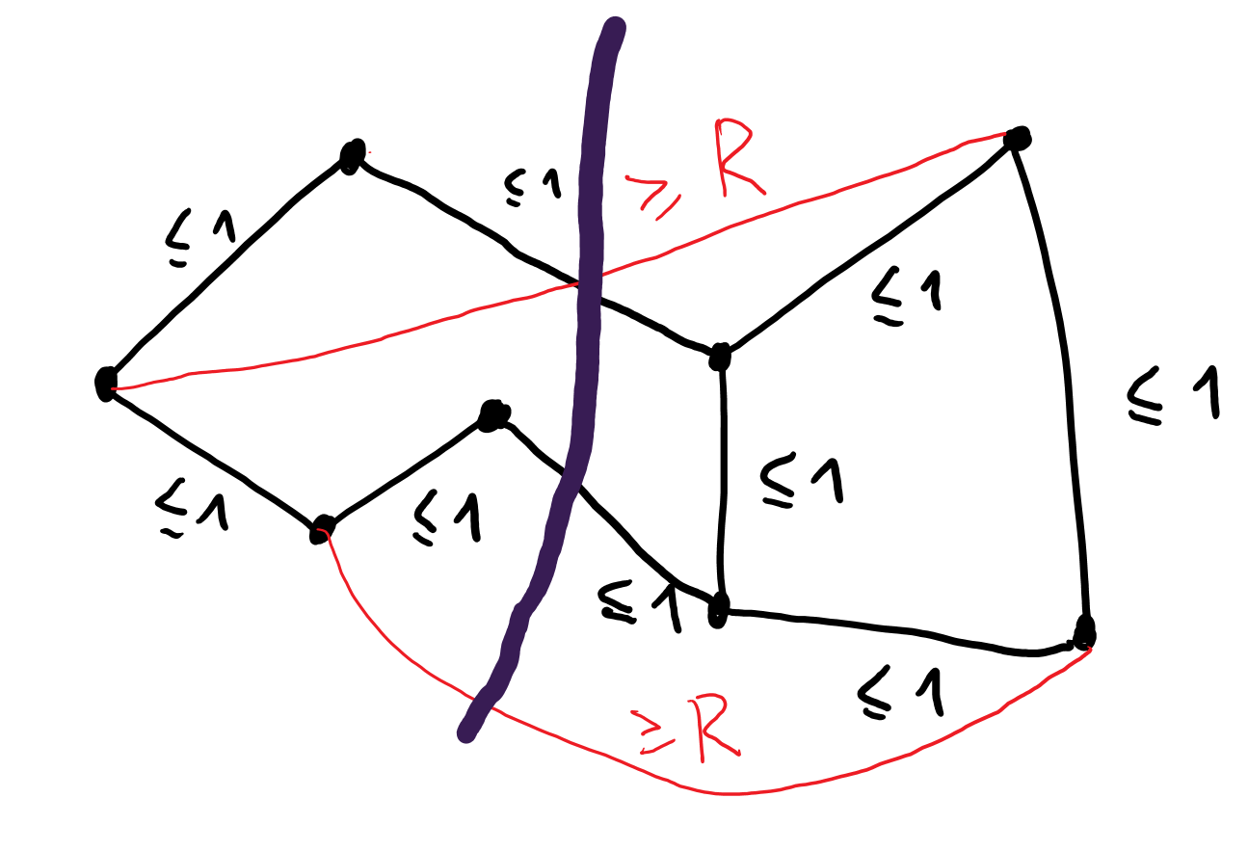
Critical scale
Informally: a graph with short edges but well-separated vertices must have a sparse cut
Related to bi-Lipschitz non-embeddability of expander graphs
Reminiscent of planar separators

Slide 46
Embeddings versus Critical Scale
Embeddings: nice spaces embed well into $ℓ_{1}$/$ℓ_{2}$
Critical scale: expanders don’t embed into nice spaces
The latter is a much weaker condition

Slide 47
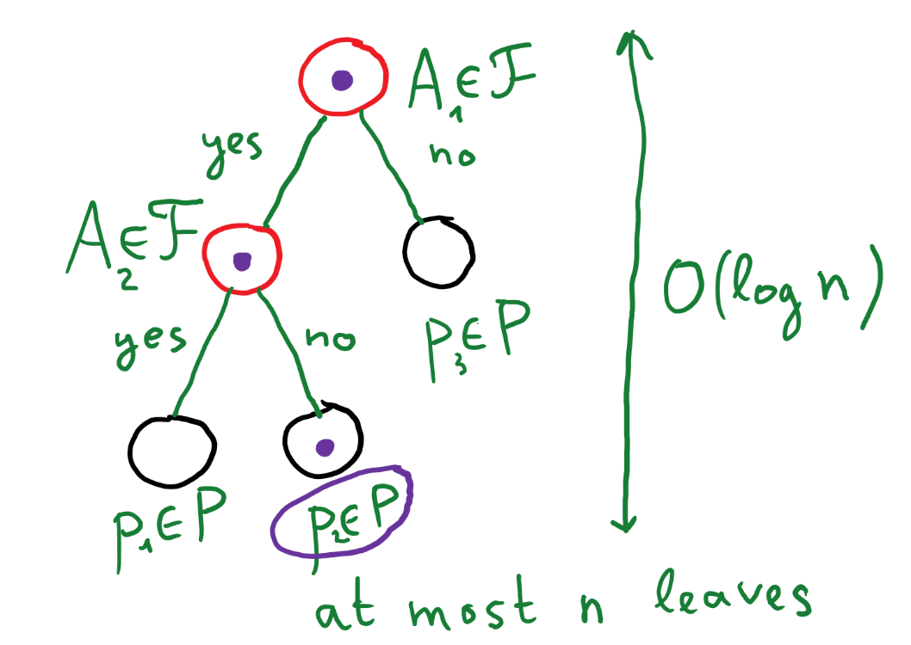
The core partitioning procedure
For every metric space $M=(X,D)$ with $\left|X\right|=N$ and every $ε>0$, there exists a collection of subsets $ℱ⊂2^{X}$ with $\left|ℱ\right|=\exp\left({\left({\log{N}}/ε\right)}^{O(1)}\right)$ s.t.
For every dataset $P⊂X$ with $\left|P\right|=n$, there exists a distribution over decision trees
Which finds a point within distance $O(Ξ\left(M,ε\right))$ from a query with probability $n^{−O(ε)}$
Can be seen as a crude and faulty counterpart of the Voronoi diagram

Slide 48
The core primitive (with a little lie)
Given a dataset $P⊂X$ with $\left|P\right|=n$
Either finds a ball $B_{M}(u,R)$ with $R=O(Ξ(X, ε))$ s.t. $\left|P∩B_{M}\left(u,R\right)\right|≥n/10$
Or finds a distribution $𝒟$ over ${\left(\frac{\log{N}}{ε}\right)}^{O(1)}$ subsets of $X$ s.t.
For every $x_{1},x_{2}∈X$ with $D\left(x_{1},x_{2}\right)≤1$, one has:
$$\underset{A∼𝒟}{Pr}\left[A \text{does} \text{not} \text{separate} x_{1} \text{and} x_{2}\right]≥1−10ε$$
For every $x∈X$, one has:
$$E_{A∼𝒟}\left[\left|\left\{p∈P | A \text{does} \text{not} \text{separate} p \text{from} x\right\}\right|\right]≤0.9 n$$
Accesses the dataset in a limited way; ${\left(\frac{\log{N}}{ε}\right)}^{O(1)}$ bits revealed

Slide 49
From partitioning to ANN
If there is a ball of radius $O(Ξ\left(X,ε\right))$ with $Ω(n)$ points, recurse on the remainder
Otherwise, sample a set $A∼𝒟$, recurse on $P∩A$ and on $P∖A$
The result is a decision tree, nodes store balls or sets $A∈ℱ$
Query and near neighbor are unlikely to be separated.
On average, the dataset size decreases.
If query is in the ball, output any point from the ball.
If outside, decrease the dataset size.
Depth of the tree is $O(\log{n})$. Probability of success is ${\left(1−O(ε)\right)}^{O(\log{n})}≥n^{−O\left(ε\right)}$
Balls can re-appear during the recursion.

Slide 50
Normed spaces
Normed spaces are infinite
One needs to discretize

Slide 51
Critical scale
For a metric $M=(X,D)$ and $ε>0$, the critical scale $Ξ(M,ε)$ is the smallest $R>0$ satisfying the following
Every undirected graph $G=\left(V,E\right)$, which admits an embedding $f: V→X$ such that:
The endpoints of every edge are within distance $1$
A typical pair of vertices is at least $R$ apart
Has a cut $S⊂V$ of conductance at most $ε$
$$Φ_{G}\left(S\right)=\frac{E(S,V∖S)}{min⁡\{\sum_{v∈S}{\text{deg}\left(v\right)},\sum_{v∉S}{\text{deg}}(v)\}}≤ε$$

Slide 52
Cheeger’s inequality
Let $G=(V,E)$ be an undirected $d$-regular graph
$A=M/d$ is a symmetric stochastic matrix
Where $M$ is the adjacency matrix of $G$
$1=λ_{1}\left(A\right)≥λ_{2}\left(A\right)≥…≥λ_{n}\left(A\right)≥−1$
[Cheeger 1970] [Alon, Milman 1985]: there exists a cut $S⊂V$ such that its conductance is $Φ_{G}\left(S\right)=O(\sqrt{1−λ_{2}\left(A\right)})$
Algorithm idea: sort the eigenvector, consider all prefixes

Slide 53
The goal
Given a $d$-regular graph $G$ embedded into a metric space
Edges are short
Vertices are mostly well-separated
Upper bound the spectral gap ${1−λ}_{2}(A)$

Slide 54
Nonlinear (metric) spectral gaps
$A=(a_{ij})$ is a symmetric $n×n$ stochastic matrix
Exercise: for every $u∈R^{n}$
$$\frac{1}{n^{2}}\sum_{i,j}{{\left(u_{i}−u_{j}\right)}^{2}}≤\frac{1}{{1−λ}_{2}\left(A\right)}⋅\frac{1}{n}\sum_{i,j}{a_{ij}{\left(u_{i}−u_{j}\right)}^{2}}$$
Corollary: for every $x:\left[n\right]→ℓ_{2}$
$$\frac{1}{n^{2}}\sum_{i,j}{{\left\|x_{i}−x_{j}\right\|}_{ℓ_{2}}^{2}}≤\frac{1}{{1−λ}_{2}\left(A\right)}⋅\frac{1}{n}\sum_{i,j}{a_{ij}{\left\|x_{i}−x_{j}\right\|}_{ℓ_{2}}^{2}}$$
[Mendel, Naor 2014]: other metrics (goes back to Gromov)?

Slide 55
Spectral gaps for general norms
Trivial observation: for every norm $\left\|⋅\right\|$ over $R^{d}$ one has
$$\frac{1}{n^{2}}\sum_{i,j}{{\left\|x_{i}−x_{j}\right\|}_{}^{2}}≤\frac{d}{{1−λ}_{2}\left(A\right)}⋅\frac{1}{n}\sum_{i,j}{a_{ij}{\left\|x_{i}−x_{j}\right\|}_{}^{2}}$$
[Naor 2017]: in fact,
$$\frac{1}{n^{2}}\sum_{i,j}{{\left\|x_{i}−x_{j}\right\|}_{}^{2}}≤\frac{O(\log^{2}{d})}{{\left(1−λ_{2}(A)\right)}^{2}}⋅\frac{1}{n}\sum_{i,j}{a_{ij}{\left\|x_{i}−x_{j}\right\|}_{}^{2}}$$
The logarithmic dependence is sharp (for, say, $ℓ_{∞}$)
Two proofs

Slide 56
From spectral gaps to critical scales
Let $f:V→(R^{d},\left\|⋅\right\|)$ be an embedding with typical vertices being $\frac{C⋅\log{d}}{ε^{2}}$-separated
[Naor 2017]:
$$\frac{1}{n^{2}}\sum_{i,j}{{\left\|f(i)−f(j)\right\|}_{}^{2}}≤\frac{O(\log^{2}{d})}{{\left(1−λ_{2}(A)\right)}^{2}}⋅\frac{1}{n}\sum_{i,j}{a_{ij}{\left\|f(i)−f(j)\right\|}_{}^{2}}$$
Hence, ${1−λ}_{2}\left(A\right)≤O(ε^{2})$
By Cheeger’s inequality, get a cut of conductance $O(ε)$
Thus, the critical scale is $O\left(\frac{\log{d}}{ε^{2}}\right)$.

Slide 57
Nice cuts
No bound on the query time is due to not having control over sparse cuts
The spectral gap estimate of [Naor 2017] tells us nothing about the eigenvector we apply Cheeger’s inequality to
Need: if a graph is embedded into a metric/normed space, then there is a geometrically nice sparse cut
For $ℓ_{p}$, one can always find a coordinate cut: $\{x|x_{i}≤u\}$
For $S_{p}$, the situation is a bit more complicated, but still nice enough

Slide 58
Nice cuts for general norms
For every $(R^{d},\left\|⋅\right\|)$, and every graph $G=(V,E)$ which admits an embedding $f: V→R^{d}$ such that:
The endpoints of every edge are within distance $1$
A typical pair is at least $R=\exp\left(O_{ε}\left(\sqrt{\log{d}\log{\log{d}}}\right)\right)$ apart
Then, there is a coordinate cut of conductance $ε$ after applying the transformation $x↦F(x−w)$, where:
$F:R^{d}→R^{d}$ is a continuous map that depends only on the norm
Calderon’s complex interpolation
The shift $w∈R^{d}$ can depend on everything
Brouwer’s fixed-point theorem

Slide 59
Generalized Mazur maps
Let $X=(R^{d},\left\|.\right\|)$ be a normed space
[John 1948]: there exists a bi-Lipschitz map between unit spheres of $X$ and $ℓ_{2}^{d}$ with constant $\sqrt{d}$
This work: there exists a $Ω\left(\frac{1}{\sqrt{\log{d}}}\right)$-bi-Holder map between unit spheres of $X′$ and $H′$ with constant ${\left(\log{d}\right)}^{O(1)}$, where:
$X′$ is $d^{o(1)}$-close to $X$
$H′$ is $O(1)$-close to $ℓ_{2}^{d}$
$${\left\|F\left(x\right)−F\left(y\right)\right\|}_{H^{′}}≤{\left(\log{d}\right)}^{O\left(1\right)}⋅{\left\|x−y\right\|}_{X^{′}}^{Ω\left(1/{\sqrt{\log{d}}}\right)}$$

Slide 60
From protocols to ANN
For a metric, good communication protocols for distance estimation imply ANN data structures
New connections via the new framework
Enough to prove a communication lower bound for expanders!

