Slide 1
Oscillating Networks From a Biological Point of View
Nancy Kopell
Boston University
My scientific journey, with help from Steve

Slide 2
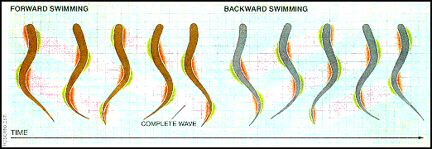
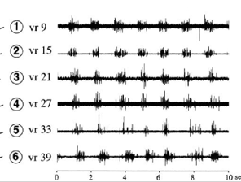
Lamprey swimming and chains of oscillators
Swimming corresponds to wave of activity.
Question:
What is the origin of this wave?
Spinal cord of lamprey is isolated and pinned down
Electrical activity is measured at nodes along cord
Phases of period activity change along cord
Creates a wave of activity traveling “head” to “tail”.

Slide 3
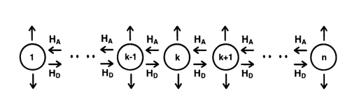
Mathematical Lamprey Spinal Cord
Cord is chain of oscillators
Coupling in both directions, same along chain
Question: what creates wave of activity along chain?
Cannot have H_{A} and H_{B} be sin.
If coupling is weak, system can be reduced to one phase per oscillator
Coupling depends only on the phases θ_{k}
Coupling functions depend only on differences of phases
φ_{k} = θ_{k+1} - θk Kopell and Ermentrout
₁₉₈₆

Slide 4
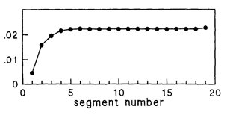
A continuum limit
Steady state equation is discretization of singularly perturbed boundary value equation:
0 = 2f(φ)_{x} + 1/N g(φ)_{xx} on [0, 1], with f = g at x = 0 and f = -g at x= 1.
f and g depend on even and odd parts of H_{A} and H_{D}
Expected behavior (from asymptotics): boundary layer at one end.
Convergence to continuum solution requires g’ > 0 around φ = 0. (rules out H = sin)
Implication for lamprey swimming
One direction of coupling is “dominant”: it determines the (constant) phase lags along the chain
Edge effect identifies the non-dominant coupling.
NK and Ermentrout 1986

Slide 5
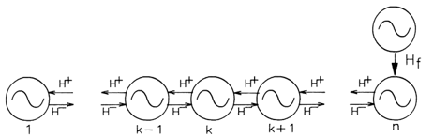
Related mathematical prediction: “forcing” one end of chain
Introduce a periodic input into the one end of the chain
Try to “entrain” the oscillators: make them go at same frequency as input.
Conclusion:
Forcing at dominant end can entrain above AND below natural frequency
Forcing at non-dominant end can entrain only below OR only above natural frequency
Kopell, Ermentrout and Williams, 1991.

Slide 6
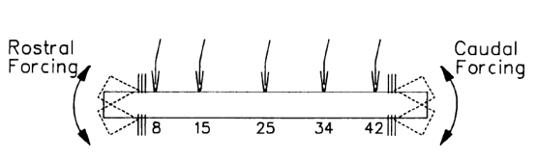
From Mathematics to Biology
Forcing the oscillators by wiggling one end with a motor
Outcome:
It works!
Dominant direction is tail to head (opposite of wave)
Coupling is dominated by inhibition
Thelma Williams
Karen Sigvardt
1994

Slide 7
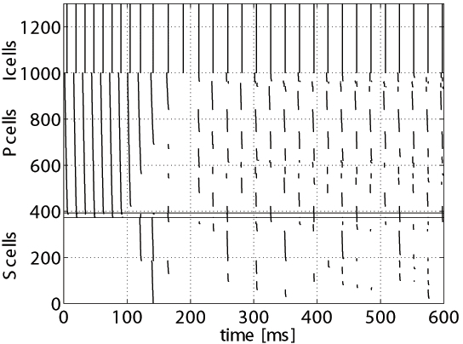

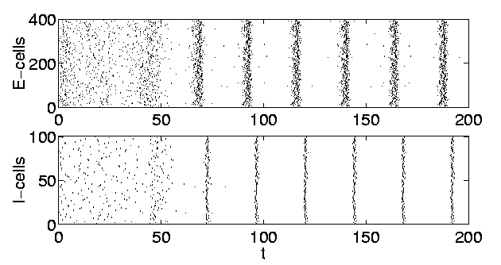
Pyramidal Interneuron Network Gamma (PING)
Whittington et al., J. Physiol. 1997
PING is associated with cell assemblies
Other 40-Hz rhythms have different mechanisms, different functions.
PING is coherent with heterogeneity, sparse coupling (Borgers, NK PNAS 2005)

Slide 8
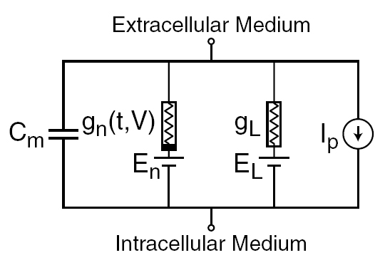
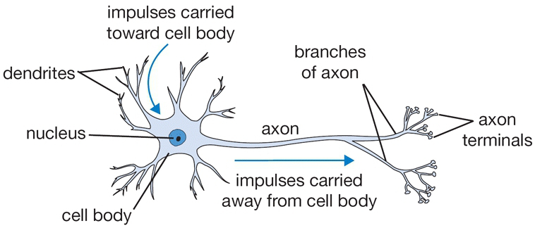
General Mathematical Framework: Hodgkin-Huxley equations.
Conductance x Electromotive force
(1/ Resistance)
m and h satisfy

Slide 9
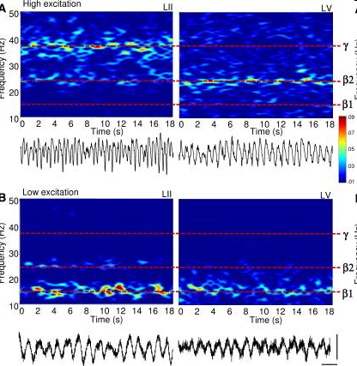
A Complicated Rhythm With an Important Function
Roopun et al 2006, 2008
Beta 1 (15 Hz) appears after stimulus fades
In vitro (S2, rodent):
Add kainate: get gamma/beta2
Lower kainate: Both layers switch to beta 1
Beta 1 is concatenation of gamma cycle and beta 2 cycle
In vivo : switch is also seen
Function: integration of evidence ?
Beta 2 can last for much longer than bouts of gamma
Can be scaffold for formation of cell assemblies of cells involved in gamma oscillations over time. (Kramer et al 2008, Gelastopoulos 2019)
superficial
deep

Slide 10
Brain Rhythms and Attention
Kastner, Fiebelkorn
More going on physiologically
Attention Task
Good phase
Poor phase
Alpha: 10-13 Hz
Beta 1: 12-20 Hz
Beta 2: 20-30 Hz
Gamma: 30-80 Hz
Behavioral outcome:
Hz 4-8 Hz rhythm.
Note:
Rhythms are different in good/poor theta phase
Inputs do not entrain their targets

Slide 11
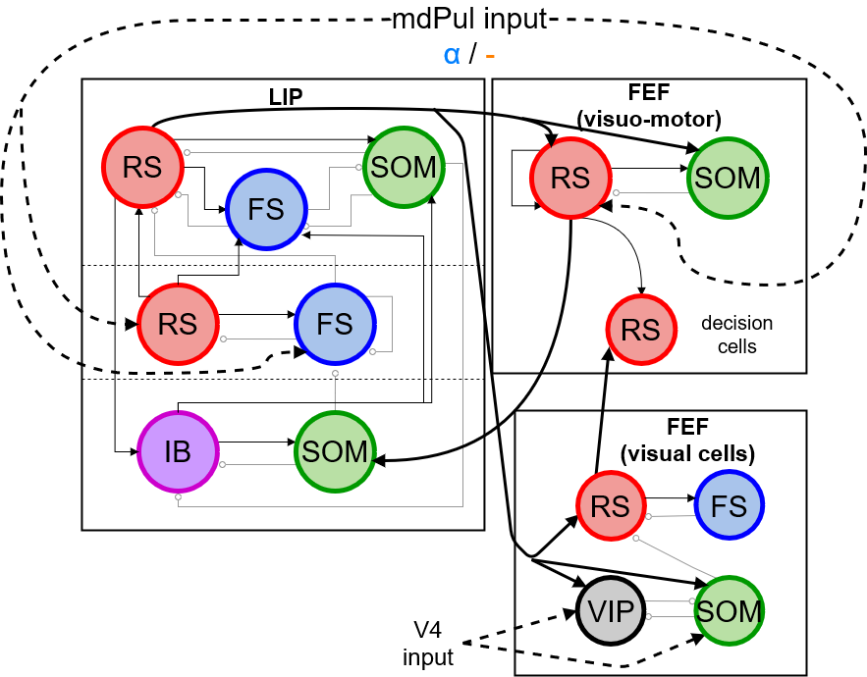
Physiology, Rhythms and Function
Our questions:
What is the physiological origin of all of these rhythms?
What does the physiology + the dynamics tell us about attention?
Aussel, et al, 2024
Origin of rhythms:
Gamma is PING
Beta 2 comes from timescale of SOM interneuron
Beta 1 in LIP comes from
interaction of gamma and beta 2 (from FEF) when input (from Pul) is removed. (Kramer et al 2008)
Model produces periodic hit rate. (Enables attention to switch among the various targets)
Model

Slide 12
From Mathematics to Mathematical Thinking
Regulated timing underlies a significant amount of brain function.
Understanding the origin and function of regulated timing requires mathematical thinking (if not theorems).
Much of the relevant mathematics is related to dynamical systems.
There is much (!) more to be done.
  Thank you, Steve!

