Slide 1
A Lower Bound on the Overhead of Indistinguishability Obfuscation
Noam Mazor
Based on joint works with:
Zhenjian Lu (University of Victoria)
Igor C. Oliveira (University of Warwick)
Rafael Pass (Technion, Tel Aviv University & Cornell Tech)

Slide 2
The Question: The minimal overhead of Indistinguishability Obfuscation
*
$iO$ gets a Boolean circuit $C$ and outputs a Boolean circuit $C′$.
Question: Can $C′$ be of roughly the same size as $C$?
If $P=NP$, there exists $iO$ with $\left|C^{′}\right|≤|C|$
Assuming $P≠NP$, can you prove that $\left|C^{′}\right|≥(1+ε)|C|$ for $ε=Ω(1)$?
This talk: For $C:{\left\{0,1\right\}}^{n}→{\left\{0,1\right\}}^{n}$, $ε≥\frac{1}{\log{|C|}}$
* NOT, OR, AND gates, with fan-in 2

Slide 3
This Talk
Obfuscation $⇒$ Barriers on proving NP- completeness of GapMCSP
NP-completeness of $⇒$ Lower-bounds on obfuscation
GapMCSP

Slide 4
Minimal Circuit Size Problem (MCSP)
Input: Truth-table $T∈{\left\{0,1\right\}}^{n}$ of a function
Q: What is the minimal size of a circuit $C:{\left\{0,1\right\}}^{\log{n}}→\{0,1\}$ that computes $T$?
Answer: 1
$$x_{0}x_{1} C(x)$$
00
01
10
11
0
1
1
1
OR
$$T$$

Slide 5
GapMCSP[$s,ℓ$] ($s<ℓ$)
Given$T∈{\left\{0,1\right\}}^{n}$, distinguish between:
$∃$ small circuit No large circuit
There is a circuit of size $s$ that computes $T$
There is no circuit of size $ℓ$ that computes $T$
GapMCSP is in NP
Assuming one-way functions, GapMCSP is hard
(PRF $⇒$GapMCSP is hard)

Slide 6
Is GapMCSP NP-Hard?
Some variants known to be NP-complete:
Multi-MCSP [Ilango-Loff-Olivera]
McKTP [Liu-Pass, Hirahara]
MCSP* [Hirahara]
MCSP with random oracle [Ilango]
…
Some barriers to prove NP-completeness:
[Ko, Ren-Santhanam, Murray-Williams, Kabanets-Cai, Saks-Santhanam,
Allender-Hirahara, …]
This talk: Barrier on proving NP-completeness under Levin reductions

Slide 7
Poly-Time Reductions
$$f$$
Karp reduction from SAT to$GapMCSP\left[s,ℓ\right]$:
Levin reduction: Karp reduction with a constructive proof.
A triplet of efficient functions $(f,g,g′)$
The natural (and useful) way to prove correctness
Most reductions are Levin, including the PCP
$$φ$$
$$T$$
$$g$$
$$w$$
$$\left|C\right|≤s$$
$$g′$$
$$w′$$
$$\left|C^{′}\right|≤ℓ$$
Notes:
21

Slide 8
Is GapMCSP Levin NP-Complete?
Thm: Under cryptographic assumptions and for some constant $c$,
GapMCSP[$s,s^{c}$] is not NP-Complete w.r.t. Levin reductions.
Similar results for $K^{t}$, and for randomized, non-uniform and subexponential Levin reductions
Cryptographic assumptions:
Mild assumption
Indistinguishability Obfuscation (iO)

Slide 9
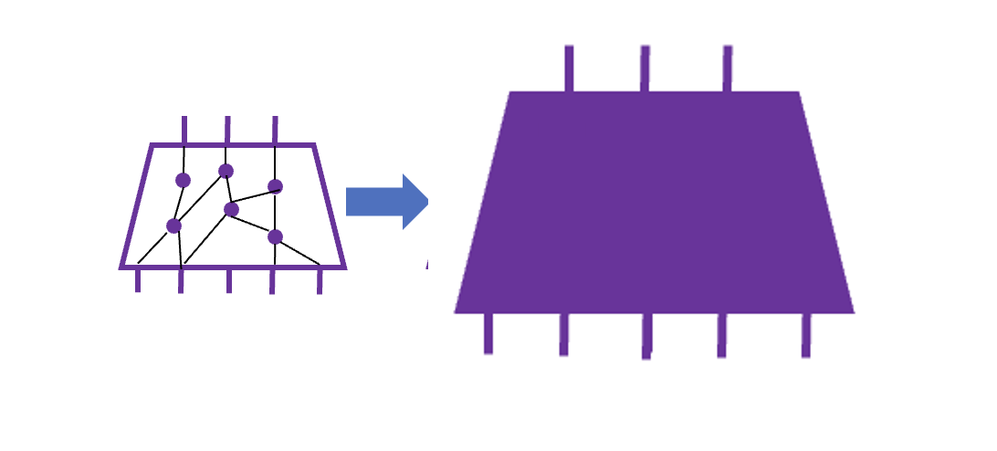
Indistinguishability Obfuscation (iO)
Def: An efficient randomized algorithm $iO$ such that:
1. for every circuit $C$, $iO(C)$ returns equivalent circuit, and,
for every $C_{1}≡C_{2}$ with ${|C}_{1}|={|C}_{2}|$ , $iO\left(C_{1}\right)$is comp. indistinguishable from $iO\left(C_{2}\right)$.
Can be used to construct many cryptographic primitives
(iO+ $NP⊈BPP⇒$ OWF, PKE, MPC,…)
Overhead: $|iO(C)|$ compared to $|C|$
At most polynomial

Slide 10
Levin NP-Completeness and obfuscation
Thm: Assuming iO with overhead $p$ (and other mild assumptions),
GapMCSP[$s,p(s)$] is not Levin NP-Complete.
Thm[M-Pass, CCC’24]: Under cryptographic assumptions and for some constant $c$,
GapMCSP[$s,s^{c}$] is not NP-Complete w.r.t. Levin reductions.
Assuming Indistinguishability Obfuscation: $GapMCSP∈BPP ⟺ NP⊆BPP$
[Impagliazzo-Kabanets-Volkovich]
Pf:
iO+ $NP⊈BPP⇒$ OWF [KMNPRY]
OWF $⇒$ $GapMCSP∉BPP$
Not a Levin (or Karp) reduction

Slide 11
Proof Idea
Assumptions:*
Indistinguishability Obfuscation (iO)
Collision Resistant Hash (CRH)
Actually, enough to assume Target Collision Resistant hash (TCR)
iO + $NP⊈BPP⇒$ OWF $⇒$ TCR [KMNPRY, Rompel]
Idea: We use the Levin reduction and the iO to find a collision in the CRH
* Assuming $|f\left(x\right)|≥{|x|}^{Ω(1)}$
Def: $H:{\left\{0,1\right\}}^{m}→{\left\{0,1\right\}}^{ℓ}$ is a CRH if $ℓ<m$, and any efficient algorithm cannot find $x≠x^{′}$ such that $H\left(x\right)=H(x′$)

Slide 12
Finding Collisions
Let $(f,g,g′)$ be a Levin reduction from SAT to GapMCSP, and let $H$ be a CRH.
Def: let $φ_{y}$ be SAT formula s.t. $φ_{y}\left(x^{′}\right)=1$ iff $H\left(x^{′}\right)=y$
Given $x←{\left\{0,1\right\}}^{n}$, let $y=H\left(x\right)$ and $T=f(φ_{y})$
$H\left(x\right)=H\left(x^{′}\right)=y$
$x^{′}≠x$?
By the security of the iO
$$f$$
$$φ_{y}$$
$$T$$
$$g$$
$$x$$
$$C$$
$$iO$$
$$g′$$
$x$’
$$C′$$

Slide 13
Finding Collisions
$x^{′}≠x$?
Let $x_{1}≠x_{2}$ such that $H\left(x_{1}\right)=H\left(x_{2}\right)=y$
By the security of $iO$, $x_{1}^{′}≈x_{2}^{′}$, so $x_{1}≠x_{1}^{′}$ or $x_{2}≠x_{2}^{′}$
$$f$$
$$f$$
$$φ_{y}$$
$$T$$
$$φ_{y}$$
$$T$$
$$g$$
$$g$$
$$x_{1}$$
$$C_{1}$$
$$x_{2}$$
$$C_{2}$$
$$iO$$
$$iO$$
$$g′$$
$$g′$$
$$x_{1}^{′}$$
$$C_{1}^{′}$$
$$x_{2}^{′}$$
$$C_{2}^{′}$$

Slide 14
Levin NP-Completeness $⇒$ No obfuscation
Thm: Assuming iO with overhead $p$ (and other mild assumptions),
GapMCSP[$s,p(s)$] is not Levin NP-Complete.
Corollary: GapMCSP is Levin NP-Complete $⇒$ No obfuscation
MultiMCSP is Levin NP-Complete $⇒$ No obfuscation
[Ilango-Loff-Oliveira, Lu-M-Oliveira-Pass]: Multi-MCSP is Levin NP-Complete
(With a small Gap)
(With a small overhead)

Slide 15
MultiMCSP
Input: Truth-table $T∈{\left\{0,1\right\}}^{n×m}$ of a function
Q: What is the minimal size of a circuit $C:{\left\{0,1\right\}}^{\log{n}}→{\left\{0,1\right\}}^{m}$ that computes $T$?

Slide 16
GapMultiMCSP[$s,ℓ$] ($s<ℓ$)
Given$T∈{\left\{0,1\right\}}^{n×m}$, distinguish between:
$∃$ small circuit No large circuit
There is a circuit of size $s$ that computes $T$
There is no circuit of size $ℓ$ that computes $T$
Thm: GapMultiMCSP[$s,s+\frac{s}{\log{s} }$] is Levin NP-complete

Slide 17
Finding Collisions with GapMultiMCSP
Thm: Assuming iO with overhead $p$ (and $NP⊈BPP$),
GapMultiMCSP[$s,p(s)$] is not Levin NP-Complete.
Let $φ_{y}$ be SAT formula s.t. $φ_{y}\left(x^{′}\right)=1$ iff $H\left(x^{′}\right)=y$
$$f$$
$$φ_{y}$$
$$T∈{\left\{0,1\right\}}^{n×m}$$
$$g$$
$$x$$
$$C:{\left\{0,1\right\}}^{log n }→{\left\{0,1\right\}}^{m}$$
$$iO$$
$$g′$$
$x$’
$$C′$$

Slide 18
Levin NP-Completeness $⇒$ No obfuscation
Thm: Assuming iO with overhead $p$ (and $NP⊈BPP$),
GapMultiMCSP[$s,p(s)$] is not Levin NP-Complete.
+ GapMultiMCSP is Levin NP-Complete
Thm: Unless $NP⊆BPP$, there is no obfuscation for circuits
$C:{\left\{0,1\right\}}^{n}→{\left\{0,1\right\}}^{n}$ with $\left|iO\left(C{,1}^{λ}\right)\right|≤\left|C\right|+\frac{\left|C\right|}{\log\left|C\right|}+poly\left(λ\right)$

Slide 19
Levin NP-Completeness $⇒$ No obfuscation
Thm: Unless $NP⊆BPP$, there is no obfuscation for circuits
$C:{\left\{0,1\right\}}^{n}→{\left\{0,1\right\}}^{n}$ with $\left|iO\left(C{,1}^{λ}\right)\right|≤\left|C\right|+\frac{\left|C\right|}{\log\left|C\right|}+poly\left(λ\right)$
If $NP⊆BPP$, there exists iO with no overhead ($\left|iO\left(C{,1}^{λ}\right)\right|=\left|C\right|$)

Slide 20
Lower Bound on the Overhead of iO
Thm: Unless $NP⊆BPP$, there is no obfuscation for circuits
$C:{\left\{0,1\right\}}^{n}→{\left\{0,1\right\}}^{n}$ with $\left|iO\left(C{,1}^{λ}\right)\right|≤\left|C\right|+\frac{\left|C\right|}{\log\left|C\right|}+poly\left(λ\right)$
The proof gives (a distribution over) circuits that cannot be obfuscated with low overhead
To construct the circuits:
Use iO + $NP⊈BPP$ to construct a TCR $H$ (iO + $NP⊈BPP⇒$ OWF $⇒$ TCR)
Construct $φ_{y}$ (SAT formula s.t. $φ_{y}\left(x^{′}\right)=1$ iff $H\left(x^{′}\right)=y$ )
Apply the Levin reduction from SAT to GapMultiMCSP on $φ_{y}$
The PCP theorem
+ chain of reductions

Slide 21
Lower Bound on the Overhead of iO
Thm: Unless $NP⊆BPP$, there is no obfuscation for circuits
$C:{\left\{0,1\right\}}^{n}→{\left\{0,1\right\}}^{n}$ with $\left|iO\left(C{,1}^{λ}\right)\right|≤\left|C\right|+\frac{\left|C\right|}{\log\left|C\right|}+poly\left(λ\right)$
Next: Direct proof with worst parameters
(still using iO + $NP⊈BPP⇒$ OWF $⇒$ PRFs)

Slide 22
The Simpler Proof
Idea: Construct a function $G$ and two circuits that cannot be obfuscated with low overhead
Let $F={\left\{f_{k}:{\left\{0,1\right\}}^{\log{n}}→\left\{0,1\right\}\right\}}_{k}$ be a PRF
Let $G\left(x\right)=T_{1}\left[x\right]∘T_{2}\left[x\right]∘…∘T_{m}\left[x\right]∘T[x]$, where:
$T←{\left\{0,1\right\}}^{n}$
For each $i∈[m]$, let $k_{i}$ be a random key for $F$
Let $T_{i}\left[x\right]=T\left[x\right]⊕f_{k_{i}}(x)$

Slide 23
Simpler Proof
$G\left(x\right)=T_{1}\left[x\right]∘T_{2}\left[x\right]∘…∘T_{m}\left[x\right]∘T[x]$, where:
$T←{\left\{0,1\right\}}^{n}$ and $T_{i}\left[x\right]=T\left[x\right]⊕f_{k_{i}}(x)$
$$s≈n⋅m+o(n)$$
$$T_{1}[x]$$
$$T_{2}[x]$$
$$T_{i}[x]$$
$$T_{j}[x]$$
$$T_{m}[x]$$
$$T[x]$$
…
…
…
$$f_{k_{i}}(x)$$
$$C_{i}=$$
$$x$$
$$x$$
$$x$$
$$x$$
$$x$$
$$x$$

Slide 24
Simpler Proof
$G\left(x\right)=T_{1}\left[x\right]∘T_{2}\left[x\right]∘…∘T_{m}\left[x\right]∘T[x]$, where:
$T←{\left\{0,1\right\}}^{n}$ and $T_{i}\left[x\right]=T\left[x\right]⊕f_{k_{i}}(x)$
$$s≈n⋅m+o(n)$$
$$T_{1}[x]$$
$$T_{2}[x]$$
$$T_{i}[x]$$
$$T_{j}[x]$$
$$T_{m}[x]$$
$$T[x]$$
…
…
…
$$f_{k_{j}}(x)$$
$$C_{j}=$$
$$x$$
$$x$$
$$x$$
$$x$$
$$x$$
$$x$$

Slide 25
The Two Circuits (First Attempt)
$$T_{1}[x]$$
$$T_{2}[x]$$
$$T_{i}[x]$$
$$T_{j}[x]$$
$$T_{m}[x]$$
$$T[x]$$
$$C_{i}=$$
$$f_{k_{i}}(x)$$
$$x$$
$$x$$
$$x$$
$$x$$
$$x$$
$$x$$
$$T_{1}[x]$$
$$T_{2}[x]$$
$$T_{i}[x]$$
$$T_{j}[x]$$
$$T_{m}[x]$$
$$T[x]$$
$$f_{k_{j}}(x)$$
$$C_{j}=$$
$$x$$
$$x$$
$$x$$
$$x$$
$$x$$
$$x$$

Slide 26
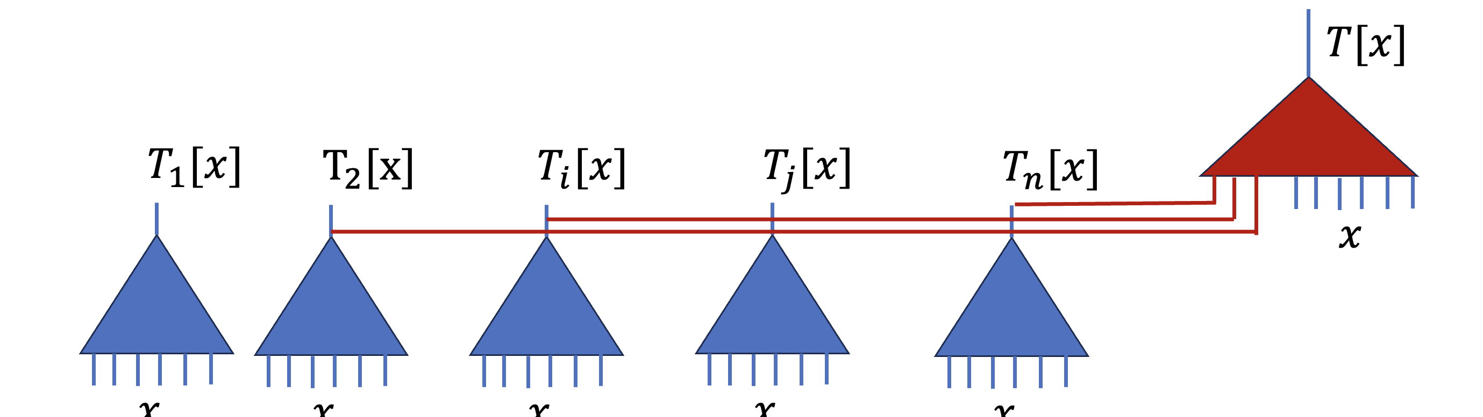
Simplifying Assumption
Assume that $iO(C_{i})$ always output a circuit $C$ that first computes $T_{1}[x],…,T_{m}[x]$, and then uses the outputs (and $x$) to compute $T[x]$
The obfuscation only needs to hide $i$

Slide 27
Intuition
Claim: If the new circuit that computes $T[x]$ is small, it must touch a large fraction of $T_{1}[x],…,T_{m}[x]$
$$T[x]$$
$$T_{1}[x]$$
$$T_{2}[x]$$
$$T_{i}[x]$$
$$T_{j}[x]$$
$$T_{m}[x]$$
$$x$$
$$x$$
$$x$$
$$x$$
$$x$$
$$x$$

Slide 28
Intuition
Any small circuit that computes $T[x]$ must touch $T_{1},…,T_{m}$
By the security of the PRF, $iO(C_{i})$ can use $T_{i}$ to compute $T$, but cannot use $T_{j}$
($T_{j}$ is indistinguishable from random given $T$, $k_{i}$)
$iO(C_{i})$ must touch $T_{i}$
$iO(C_{j})$ must touch $T_{j}$
$$T[x]$$
$$T_{1}[x]$$
$$T_{2}[x]$$
$$T_{i}[x]$$
$$T_{j}[x]$$
$$T_{m}[x]$$
$$x$$
$$x$$
$$x$$
$$x$$
$$x$$
$$x$$

Slide 29
Intuition
$iO(C_{i})$ must touch $T_{i}$
$iO(C_{j})$ must touch $T_{j}$
$⇒$ By security of iO, $iO(C_{i})$ must touch $T_{j}$
(for all $j$)
$$T[x]$$
$$T_{1}[x]$$
$$T_{2}[x]$$
$$T_{i}[x]$$
$$T_{j}[x]$$
$$T_{m}[x]$$
$$x$$
$$x$$
$$x$$
$$x$$
$$x$$
$$x$$

Slide 30
Intuition
$\left|C_{i}\right|=nm+o\left(n\right)$
$\left|iO\left(C_{i}\right)\right|≥nm+m=\left|C_{i}\right|+Ω(m)$
Taking $n=m$ we get $\left|iO\left(C_{i}\right)\right|≥\left|C_{i}\right|+Ω(\sqrt{\left|C_{i}\right|})$
$$T[x]$$
$$T_{1}[x]$$
$$T_{2}[x]$$
$$T_{i}[x]$$
$$T_{j}[x]$$
$$T_{m}[x]$$
$$x$$
$$x$$
$$x$$
$$x$$
$$x$$
$$x$$

Slide 31
The Assumption
It is important that we know which sub-circuits the final circuit touches
Lower bound on a conditional version of obfuscation
Can we get rid of the assumption?
Yes, using ideas from [Ilango-Loff-Oliveira]

Slide 32
The Circuits
$$T_{1}[x]$$
$$T_{2}[x]$$
$$T_{i}[x]$$
$$T_{j}[x]$$
$$T_{m}[x]$$
$$T[x]$$
The idea: make any internal gate an output gate
$$C_{i}=$$
$$f_{k_{i}}(x)$$
$$x$$
$$x$$
$$x$$
$$x$$
$$x$$
$$x$$
$$f_{k_{i}}(x)$$

Slide 33
The Circuits
$$T_{1}[x]$$
$$T_{2}[x]$$
$$T_{i}[x]$$
$$T_{j}[x]$$
$$T_{m}[x]$$
$$T[x]$$
The idea: make any internal gate an output gate
$$C_{i}=$$
$$f_{k_{i}}(x)$$
$$x$$
$$x$$
$$x$$
$$x$$
$$x$$
$$x$$

Slide 34
The Circuits
$$T_{1}[x]$$
$$T_{2}[x]$$
$$T_{i}[x]$$
$$T_{j}[x]$$
$$T_{m}[x]$$
$$T[x]$$
The idea: make any internal gate an output gate
$$C_{i}=$$
$$f_{k_{i}}(x)$$
$$x$$
$$x$$
$$x$$
$$x$$
$$x$$
$$x$$
$$x$$

Slide 35
MCSP and Obfuscation
Thm: Assuming iO with overhead $p$ (and other mild assumptions),
GapMCSP[$s,p(s)$] is not Levin NP-Complete.
Corollary: GapMCSP is Levin NP-Complete $⇒$ No obfuscation
Better hardness of approximation $⇒$ better lower bounds
To rule out obfuscation/prove a lower bound, enough to construct Levin reduction assuming iO (+OWF/PKE/MPC…)
[Huang-Ilango-Ren]
(With a small Gap)
(With a small overhead)

Slide 36
Conclusion
GapMCSP is not Levin NP-complete in Obfustopia
Lower bound on the overhead of obfuscation
Connection between meta-complexity and crypto lead to new results in crypto
Thanks!

