Slide 1
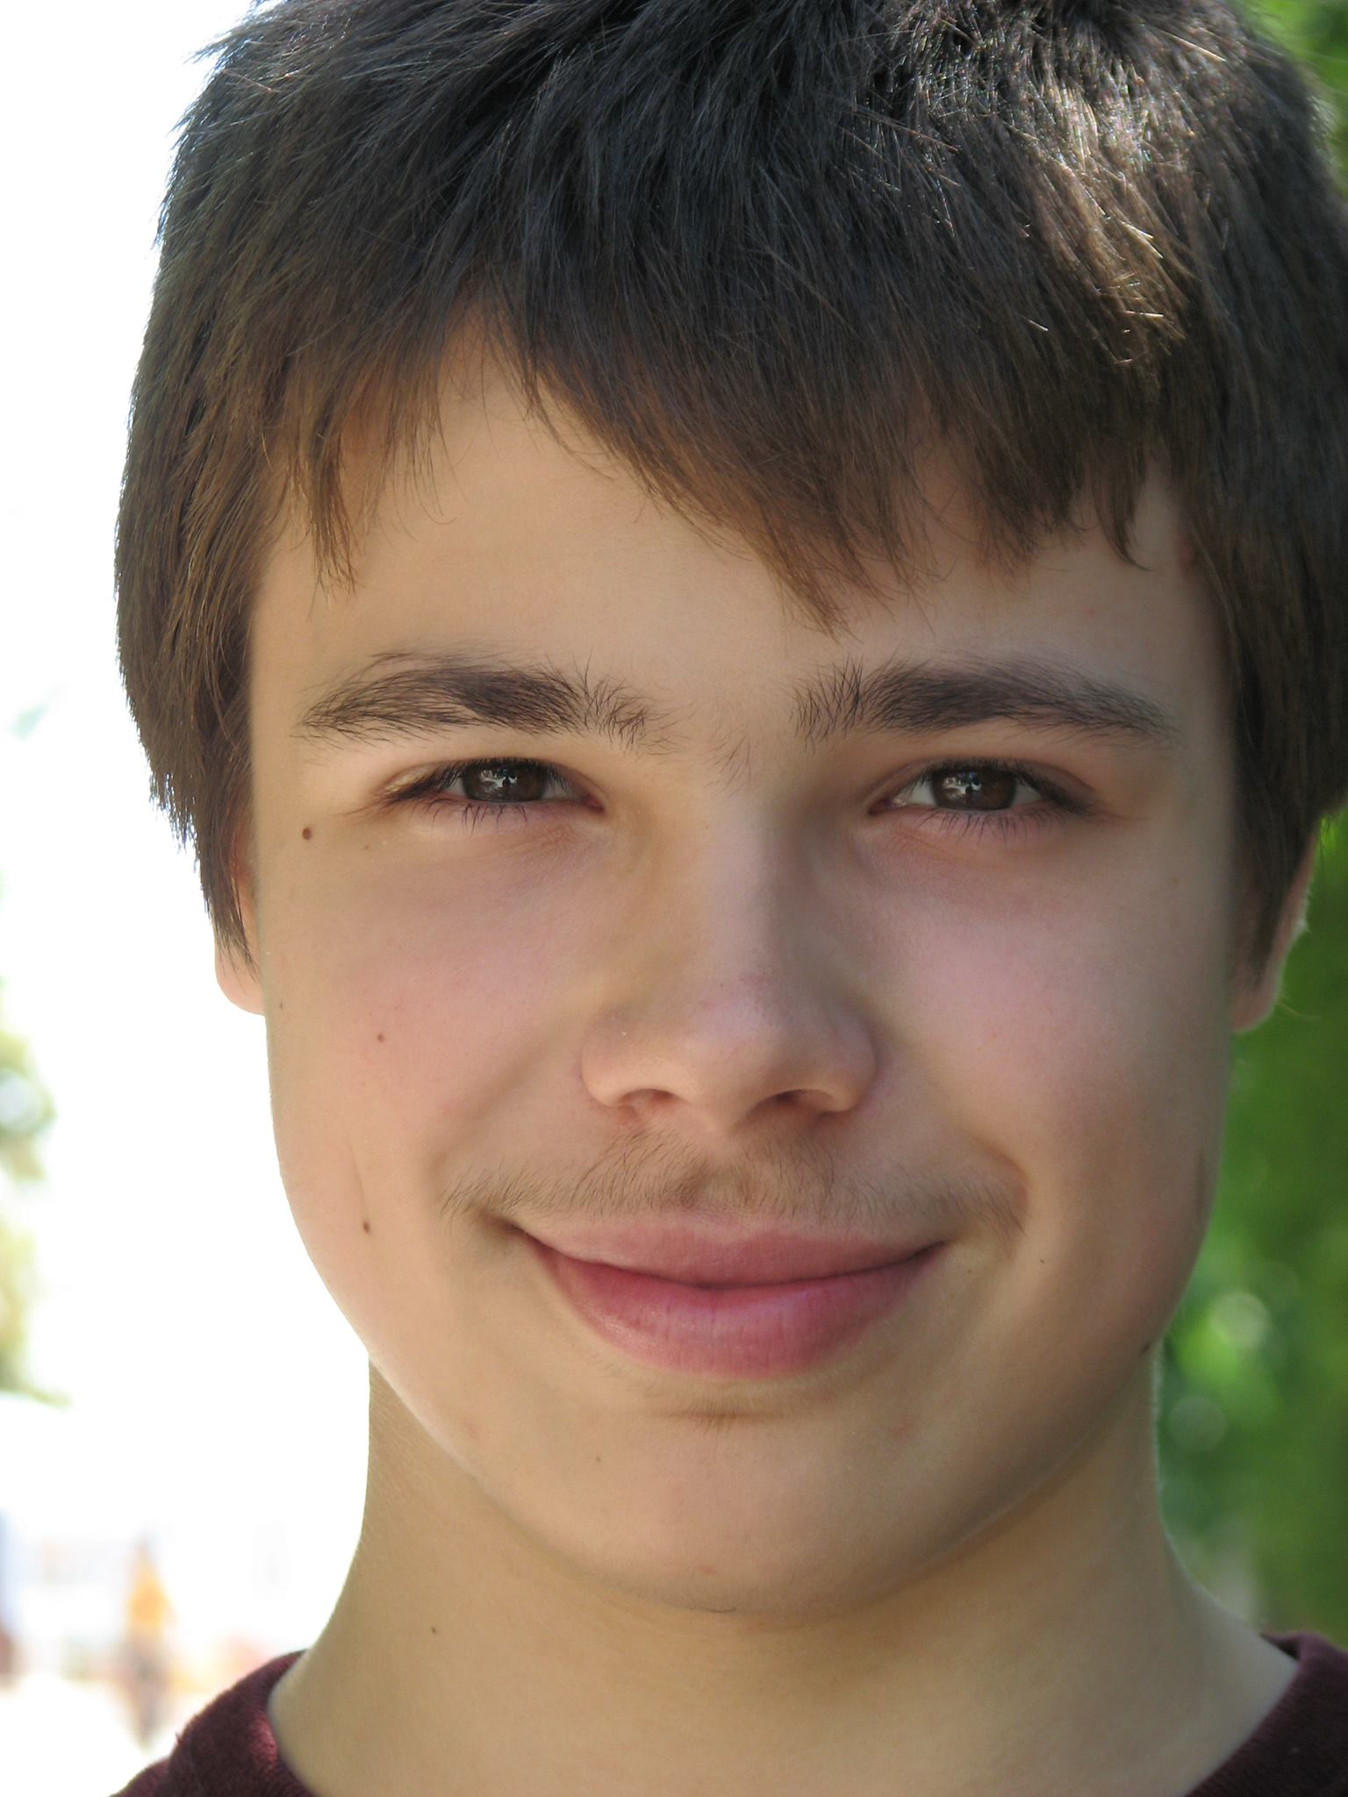
High Dimensional Calibration For Rational Decision Making
Aaron Roth
Joint work with
George Noarov, Ramya Ramalingam, Stephan Xie

Slide 2
Prediction for Action
Consider a decision maker with action space $A$ and utility function:
$$u:A×S→[0,1]$$
for some state space $S⊂ℝ^{d}$. $u\left(a,⋅\right)$ is linear, Lipschitz in $s$ for all $a$.
Models, e.g.
A decision maker with arbitrary utilities $u(a,o)$ for $d$ distinct outcomes;
$s$ is a distribution over outcomes.
Routing games (and other congestion games);
$s$ is a vector of road/edge congestions
Online Max-Weight Matching
$s$ is a vector of edge weights.
Extensive form games
$s$ is a vector of probabilities that each terminal node is made reachable by opponents
…

Slide 3
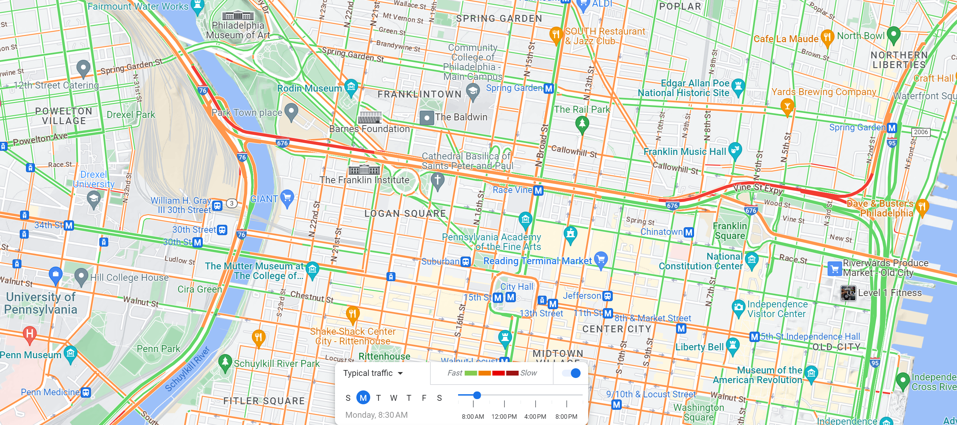
Prediction for Action
If $s$ were known, action would be easy. Could just best respond.
$$BR\left(u,s\right)=\arg{\max_{a∈A}{u(a,s)}}$$
Difficulty: Must act before $s$ is known.
Suppose we have a prediction $\hat{s}$.
Is it a good idea to play $BR\left(u,\hat{s}\right)?$

Slide 4
Calibration
Forecasts $\hat{s}$ are calibrated if they are unbiased conditional on their own predictions:
$$𝔼\left[s \right|\hat{s}]=\hat{s}$$
It is a good idea to follow calibrated forecasts.
Theorem: If forecasts $\hat{s}$ are calibrated, then for every $u$, the best response policy $f^{∗}\left(\hat{s}\right)=BR(u,\hat{s})$ is a dominant strategy amongst all policies $f:S→A$ mapping forecasts to actions.

Slide 5
Calibration
Good news:
Calibrated predictions incentivize agents to treat them as correct.
It is possible to produce calibrated predictions even for an adversarially chosen sequence of states [Foster Vohra]
Unfortunately…
One way to achieve calibration is to be uninformative:
The constant prediction $\hat{s}=𝔼[s]$ is calibrated --- but not useful.
The number of possible predictions $\hat{s}$ grows exponentially in $d$
The computational and statistical complexity of achieving calibration against adversarial sequences also grows exponentially with $d$…

Slide 6
This Talk
In high dimensional settings, what can we ask for short of calibration that still makes it a good idea for agents to treat forecasts as correct?
Can we obtain it efficiently (computationally and statistically) in adversarial settings, and
Does this lead us to new learning algorithms for large action spaces?

Slide 7
The Online Prediction Setting
A context space $X$
Features relevant to the prediction task
A convex prediction/outcome space $C⊂ℝ^{d}$
E.g. the probability simplex, the set of all feasible road congestions, …
In rounds $t=1,…,T$:
The learner observes some context $x_{t}∈X$.
The learner produces a prediction ${\hat{s}}_{t}∈C$
The learner observes outcome $s_{t}∈C$

Slide 8
Making Unbiased Predictions
An event $E(x_{t},{\hat{s}}_{t})$ is a function $E:X×C→\{0,1\}$. It selects a subsequence of rounds as a function of the context and prediction.
Can also depend on history, map to the reals, but unimportant for this talk.
Goal: Given a collection of events $ℰ$, make $ℰ$-unbiased predictions: for each $E∈ℰ$:
$${\left\|\sum_{t=1}^{T}{E\left(x_{t},{\hat{s}}_{t}\right)}⋅\left({\hat{s}}_{t}−s_{t}\right)\right\|}_{∞}≤α$$
Calibration is the special case of ${\left\{E\left({\hat{s}}_{t}\right)=1\left[{\hat{s}}_{t}=s\right]\right\}}_{s∈C}$
Exponentially in $d$ many events

Slide 9
Questions
Calibration is useful but hard to obtain.. So:
Are predictions that are unbiased subject to only a modest (polynomial) number of conditioning events useful for decision making, and
Can we efficiently make $ℰ$-unbiased predictions for modestly sized collections $ℰ?$

Slide 10
Warmup: (Internal) Regret
Consider a repeated interaction with action/state sequence:
$$π^{T}=\{\left(a_{1},s_{1}\right),\left(a_{2},s_{2}\right),…,\left(a_{T},s_{T}\right)\}$$
The agent has (external) Regret $α$ if:
$$\sum_{t=1}^{T}{u\left(a_{t},s_{t}\right)≥\min_{a∈A}{\sum_{t=1}^{T}{u(a,s_{t})}−α}}$$
The agent has internal regret $α$ if for every $a∈A$:
$$\sum_{t=1}^{T}{1\left[a_{t}=a\right]⋅u\left(a_{t},s_{t}\right)≥\min_{a^{′}∈A}{\sum_{t=1}^{T}{1\left[a_{t}=a\right]⋅u(a^{′},s_{t})}−α}}$$
“On the subsequence on which the agent played $a$, $a$ was a best response”
If all agents in an interaction have $α$ internal regret, play is a $kα$-approximate correlated equilibrium.

Slide 11
Warmup: Internal Regret
Best responding to calibrated forecasts yields no internal regret, but not necessary.
Let $E_{u,a}\left(\hat{s}\right)=1\left[a=BR(u,\hat{s})\right]$, $ℰ_{u}={\left\{E_{u,a}\right\}}_{a∈A}$
The events that each action $a$ is a best response to $\hat{s}$ for $u$.
Claim: If predictions ${\hat{s}}_{1},…,{\hat{s}}_{T}$ have $ℰ_{u}$-bias $α$, then if an agent uses best response policy $f_{u}^{∗}\left(\hat{s}\right)=BR(u,\hat{s})$, they have internal regret $2α$.
Only $k=|A|$ conditioning events, rather than $2^{d}$
If there are many agents with utility functions $u∈U$, can give unbiased predictions wrt $E_{U}=\bigcup_{u∈U}{ℰ_{u}}$ and obtain guarantees for all agents.

Slide 12
Online Combinatorial Optimization
A set $B$ of $d$ base actions.
E.g. roads in a network
A feasible set of actions $A⊆2^{B}$
E.g. $s→t$ paths in a network
State $s$ encodes gain $g_{u,e}(s)$ for each $s∈B$
Utility for an action $a∈A$: $u\left(a,s\right)= \sum_{e∈a}{g_{u,e}(s)}$
Up to $2^{d}$ actions, but $d$-dimensional linear structure.
Expert learning the special case of $A=B$.

Slide 13
Examples

Slide 14
Subsequence Regret
Given a collection $ℰ$ of subsequence indicator functions $E(x_{t},a_{t}$), an agent has $α$-subsequence regret if for every $E∈ℰ:$
$$\sum_{t=1}^{T}{E(x_{t},a_{t})u\left(a_{t},s_{t}\right)≥\min_{a^{′}∈A}{\sum_{t=1}^{T}{E(x_{t},a_{t})⋅u(a^{′},s_{t})}−α}}$$
Internal regret is the special case of events $E_{a}(a_{t})=1[a_{t}=a]$
Let $E_{u,b}\left({\hat{s}}_{t}\right)=1\left[b∈BR(u,{\hat{s}}_{t})\right],$ $ℰ_{u}={\left\{E_{u,b}\right\}}_{b∈B}$
Let $ℰ×ℰ_{u}=\left\{E\left(x_{t},BR\left(u,{\hat{s}}_{t}\right)\right)⋅E_{u,b}\left({\hat{s}}_{t}\right):E∈ℰ,E_{u,b}∈ℰ_{u}\right\}$

Slide 15
Online Combinatorial Optimization
Theorem: For any collection of events $ℰ$, if forecasts ${\hat{s}}_{1},…,{\hat{s}}_{T}$ have $(ℰ×ℰ_{u})$-bias at most $α$, then the best response policy has subsequence regret over $ℰ$ at most $2αd$.
Requires unbiasedness on only $d⋅|ℰ|$ events.
Can ask for this simultaniously for $m$ agents with different $u$’s and action sets, with $m⋅d⋅|ℰ|$ events…

Slide 16
Online Combinatorial Optimization
e.g. can publish traffic reports that are a good idea to follow (no regret) simultaniously for every agent who might have different source/destination pairs. Not just overall but also:
On Rainy Days
On Mondays
On National Holidays
On days when the best route involves I-76
On days when the best route takes surface roads right after a Phillies game
…

Slide 17
In any game with polynomially many actions
Can publish forecasts that promise that any downstream decision maker with utility function from a polynomially large set has no swap regret, not just overall, but on any subsequence of days in a polynomially large collection.
E.g. Publish bid forecasts in a repeated 1st price auction so that no best-responding agent (independently of their valuation) has any swap regret, overall or…
Conditional on properties of the item (user demographics of an ad impression, …)
Conditional on history of bids (on days after we have been outbid, …)
…

Slide 18
Extensive Form Games
2
4
1
3
2
5
6
3

Slide 19
Extensive Form Games
2
4
1
3
2
5
6
3
Action space exponentially large in the game tree.

Slide 20
Extensive Form Games
2
4
1
3
2
5
6
3
A strategy makes a subset of the leaves reachable. Payoff corresponds to
the leaf also made reachable by opponents.

Slide 21
Extensive Form Games
Let $ℒ$ be the set of leaves in an extensive form game.
Fix a player $i$. For $ℓ∈ℒ$, let $r_{i}(ℓ)$ be the reward for $i$ at $ℓ$.
Given a strategy $a_{i}$ for player $i$, let $R\left(a_{i}\right)∈{\left\{0,1\right\}}^{|ℒ|}$ be the indicator vector for the set of leaves $a_{i}$ makes reachable.
The reward for agent $i$ for playing $a_{i}$ can be written as:
$$u\left(a_{i},a_{−i}\right)=⟨R\left(a_{i}\right),g\left(a_{−i}\right)⟩$$
Where $g\left(a_{−i}\right)∈ℝ^{|ℒ|}$ is $g_{ℓ}\left(a_{−i}\right)=r_{i}\left(ℓ\right)⋅\operatorname{Pr}{[\text{opponents} \text{make} ℓ \text{reachable}]}$
An instance of online combinatorial optimization…

Slide 22
Extensive Form Games
So can efficiently obtain subsequence regret in extensive form games for any polynomial number of subsequences.
By choosing the right collection of subsequences, we recover and generalize existing notions of extensive form regret:
Counterfactual regret
Regret to Causal deviations
…
Converge to notions of extensive-form correlated equilibrium.

Slide 23
Efficiently Making $ℰ$-Unbiased Predictions (Applying a Multiobjective Optimization Strategy from [LNPR22])
A multiobjective optimization problem:
For each $E∈ℰ$, $i∈[d]$, $σ∈\{−1,1\}$ we want:
$$σ⋅\sum_{t=1}^{T}{E\left(x_{t},{\hat{s}}_{t}\right)}⋅{\left({\hat{s}}_{t}−s_{t}\right)}_{i}≤α$$
Run a no regret algorithm (like Exponential Weights) over $2|ℰ|d$ experts $(E,i,σ)$ with per-round gains defined as:
$$g_{E,i,σ}^{t}=σE\left(x_{t},{\hat{s}}_{t}\right){\left({\hat{s}}_{t}−s_{t}\right)}_{i}$$
No-regret guarantee is:
$$\sum_{t=1}^{T}{\sum_{E,i,σ}{w_{E,i,σ}^{t}σE\left(x_{t},{\hat{s}}_{t}\right){\left({\hat{s}}_{t}−s_{t}\right)}_{i}}}≥\max_{E,i,σ}{σ⋅\sum_{t=1}^{T}{E\left(x_{t},{\hat{s}}_{t}\right)}⋅{\left({\hat{s}}_{t}−s_{t}\right)}_{i}}−O\left(\sqrt{T⋅\log{(|ℰ|d)}}\right)$$
So if we can make predictions ${\hat{s}}_{t}$ such that $𝔼_{{\hat{s}}_{t}}\left[\sum_{E,i,σ}{w_{E,i,σ}^{t}σE\left(x_{t},{\hat{s}}_{t}\right){\left({\hat{s}}_{t}−s_{t}\right)}_{i}}\right]≤0$ for all $s_{t}$…
We’ll guarantee $\max_{E,i}\left|\sum_{t=1}^{T}{E\left(x_{t},{\hat{s}}_{t}\right)}⋅{\left({\hat{s}}_{t}−s_{t}\right)}_{i}\right|≤O\left(\sqrt{T⋅\log{(|ℰ|d)}}\right)$

Slide 24
Efficiently Making $ℰ$-Unbiased Predictions (Applying a Multiobjective Optimization Strategy from [LNPR22])
Goal: Find a distribution over predictions s.t. for all $s_{t}$:
$$𝔼_{{\hat{s}}_{t}}\left[\sum_{E,i,σ}{w_{E,i,σ}^{t}σE\left(x_{t},{\hat{s}}_{t}\right){\left({\hat{s}}_{t}−s_{t}\right)}_{i}}\right]≤0$$
If the adversary first committed to a distribution over $s_{t}$, we could just play ${\hat{s}}_{t}=𝔼[s_{t}]$.
By the minimax theorem, a solution exists --- we just need to find it!
A minimax equilibrium computation…
Difficulty: Exponentially large action spaces.
Can be overcome with simulated play using learning dynamics…

Slide 25
Efficiently Making $ℰ$-Unbiased Predictions
We can compute a minimax strategy using learning dynamics. Repeated play in which:
The adversary uses a no-regret learning algorithm, and…
The learner best responds.
The objective $𝔼_{{\hat{s}}_{t}}\left[\sum_{E,i,σ}{w_{E,i,σ}^{t}σE\left(x_{t},{\hat{s}}_{t}\right){\left({\hat{s}}_{t}−s_{t}\right)}_{i}}\right]$ is linear in the adversary’s action $s_{t}$
So the adversary can efficiently play “Follow the Perturbed Leader”
The objective is a complicated function of the learner’s action ${\hat{s}}_{t}$… But to play so as to obtain value $≤0$, it suffices to play ${\hat{s}}_{t}=𝔼[s_{t}]$.
i.e. can just “copy” the adversary’s strategy.

Slide 26
Efficiently Making $ℰ$-Unbiased Predictions
Theorem: For any set of events $ℰ$ and any $α>0$, there is an online prediction algorithm that can make $d$-dimensional adversarial predictions over $T$ rounds such that their worst-case $ℰ$-bias is at most $α$ for:
$$α≤\sqrt{\log\left(d\left|ℰ\right|T\right)+T}$$
The per-round running time is polynomial in $d$ and $T$.
For disjoint events, running time decreases to polylog$(T)$.
More refined bounds (less bias for shorter subsequences)

Slide 27
Upshot
Calibration incentivizes downstream agents to treat predictions as correct, but has exponentially growing complexity…
The complexity does not stem from the exponentially large action space, but the exponentially large number of conditioning events.
Can efficiently make predictions that are unbiased subject to polynomially many events.

Slide 28
Upshot
For particular utility functions, polynomially many events are enough.
A useful algorithm design paradigm --- you only have one utility function!
Can design “coordination mechanisms” for whole classes of utility functions
E.g. for all source-destination pairs in a routing game.
Predictions agents are incentivized to follow, and lead to no internal regret/correlated equilibrium.
Requires much less agent sophistication than running their own no-internal-regret algorithm.
Concrete Mechanism Design Application
Sequential principal agent problems without a prior, a la Camara, Hartline, and Johnson with an exponentially improved dependence on the state space. (joint work with Natalie Collina and Han Shao)

Slide 29
Upshot
Other applications…
Uncertainty Quantification:
In multiclass classification problems can produce class scores that can be treated as probabilities for producing prediction sets of different coverage probabilities.
In regression problems can produce functions that can be treated as label CDFs to produce prediction intervals of different coverage probabilities.
Thanks!
High Dimensional Prediction for Sequential Decision Making.
Georgy Noarov, Ramya Ramalingam, Aaron Roth, Stephan Xie
Available on ArXiV

